Slide 1


Morris Training
Section 1
Powering X35 On and Off
Icon Identification
General Set Up
Global Home Screens

Slide 2
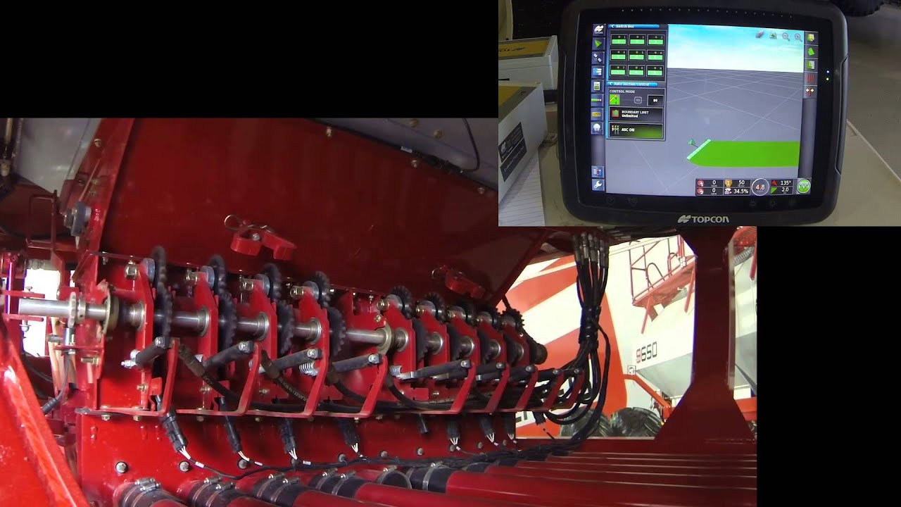
Monitor Set Up
1)Powering X35 On and Off

Slide 3
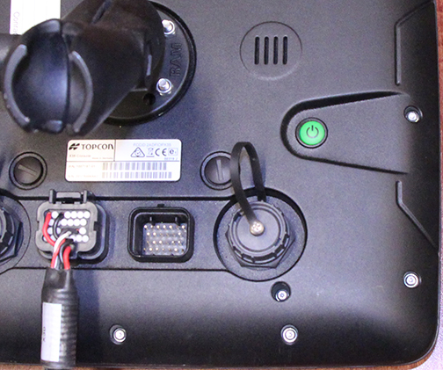
To Power ON Press and hold the Green Power button, located on the back of your console. You may have to hold the button for up to 5 seconds or until the Hour Glass Appears on the screen.

Slide 4
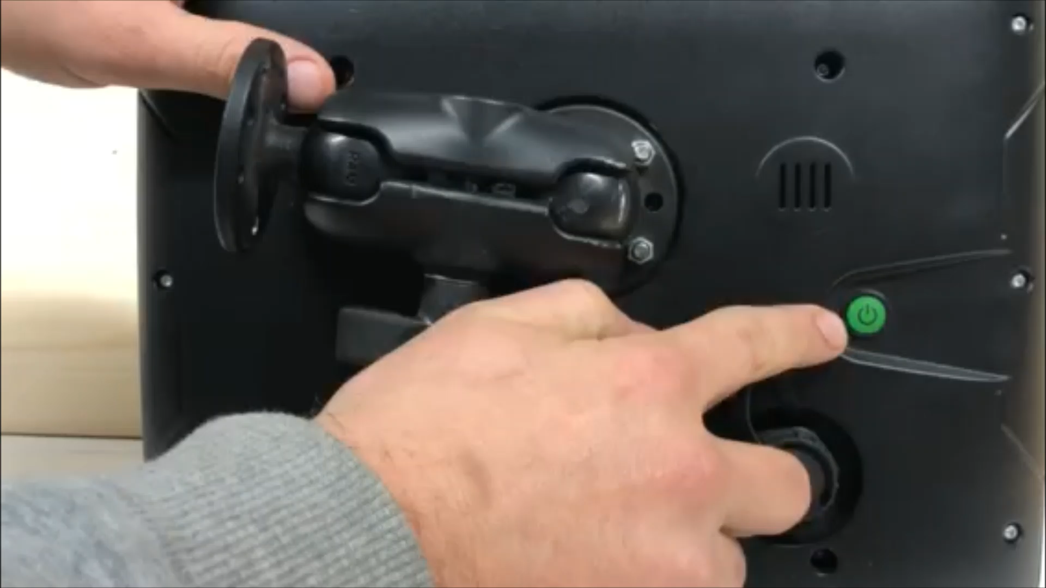

Slide 5

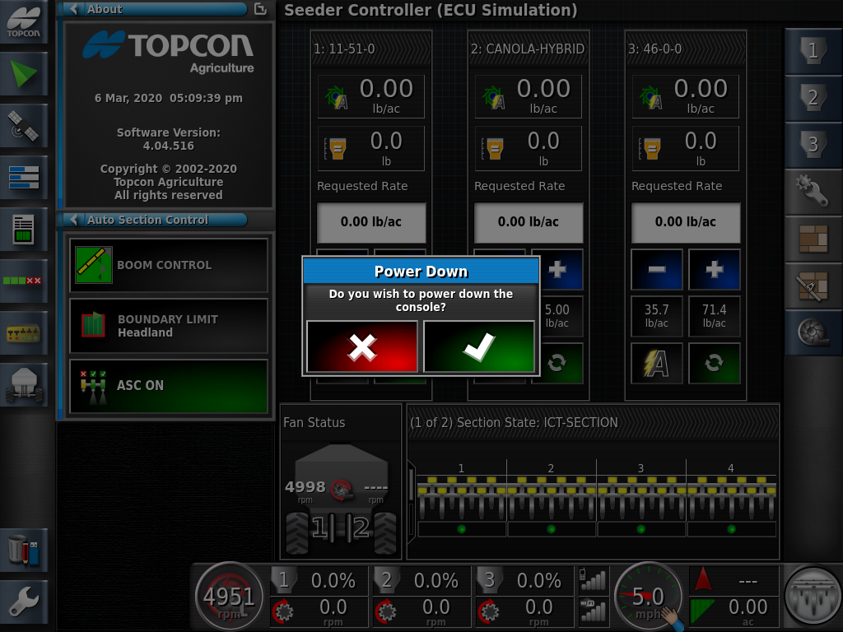
To Power Off the X35 system, swipe upwards from the bottom of the screen to reveal the user control ribbon, press the Off Icon.
A Power Down Prompt will appear, simply just press the Green Check mark.

Slide 6
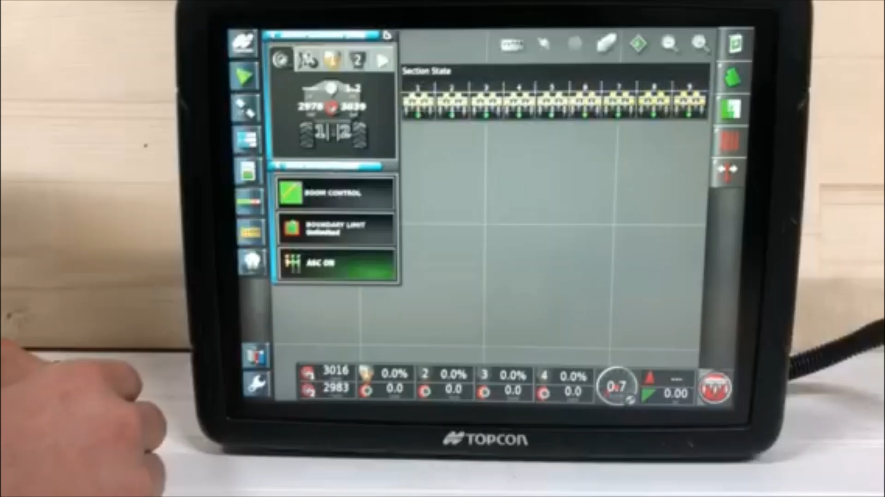

Slide 7
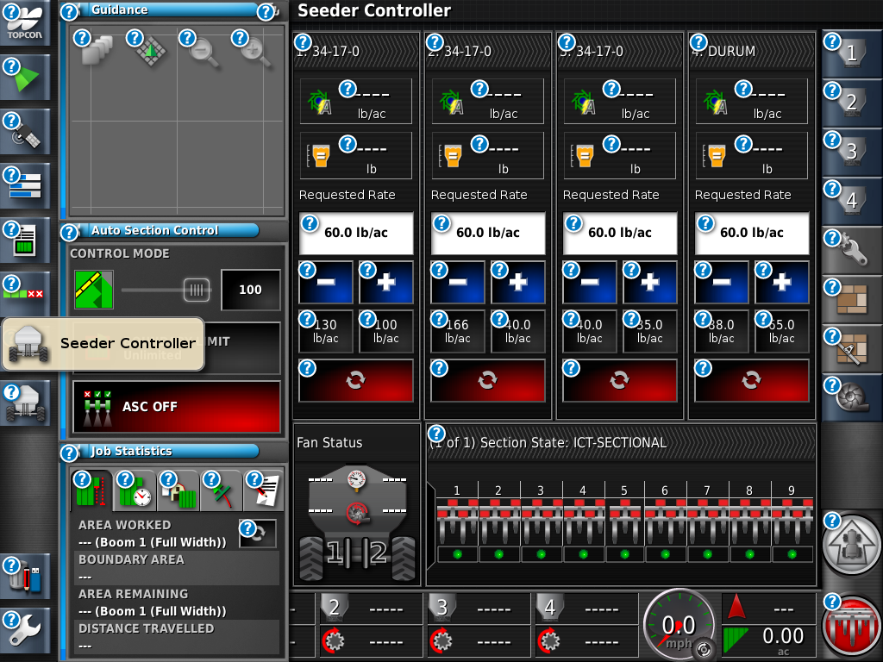
Monitor Set Up
2) Icon Identification

Slide 8
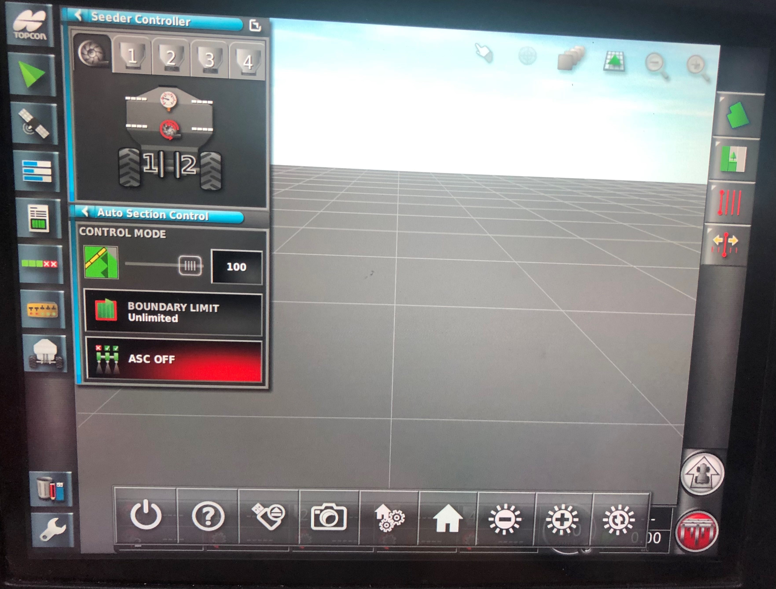
Icon Identification
Swipe up from bottom of screen and the User Control Ribbon will appear. From here you can select Power Off, Icon Information, USB Eject, Screen Shot, Manage Global Home Screen, Load Global Home Screen and Screen Brightness.

Slide 9
Select The Question Mark

Slide 10
After selecting the Question Mark, the screen will now look like this. With Question marks on all active icons.
Press the question mark on any icon for the name and function.
E.g. Seeder Controller

Slide 11
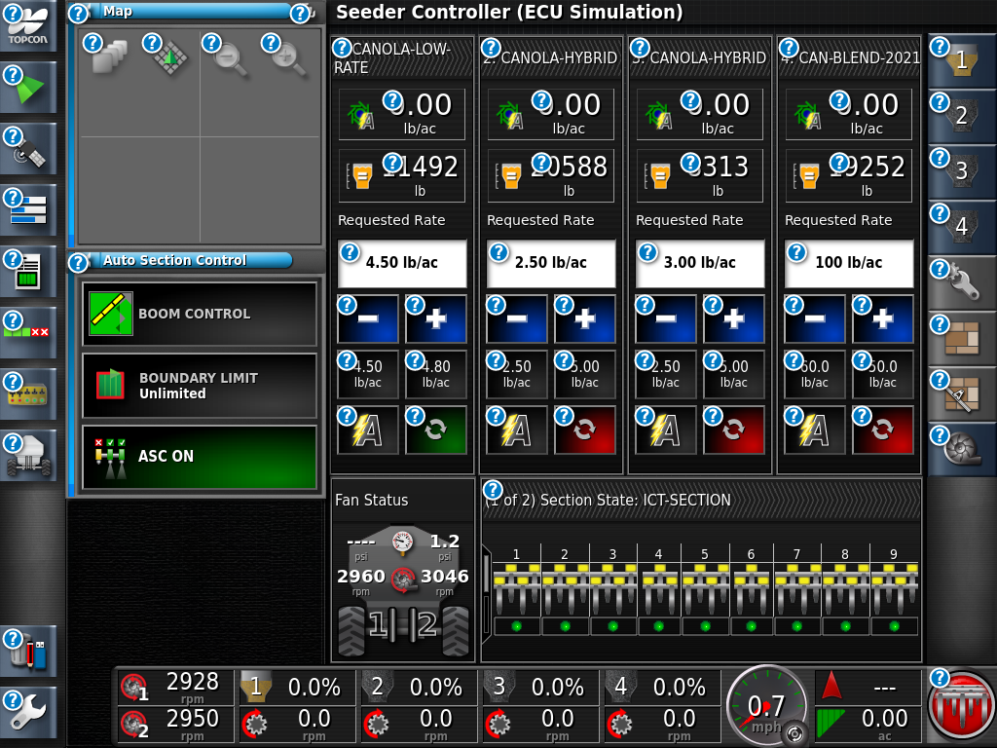
Left Side Icon Seeder Home
System Information
Guidance
GPS Information
System Diagnostics
Job Information
Auto Section Control Config.
Virtual Switchbox
Seeder Controller
Inventory Manager
Set Up

Slide 12
Tank 1
Tank 2
Tank 3
Tank 4
Configuration
Job Area Counters
Implement Area Counters
Fan Status
Master Switch

Slide 13
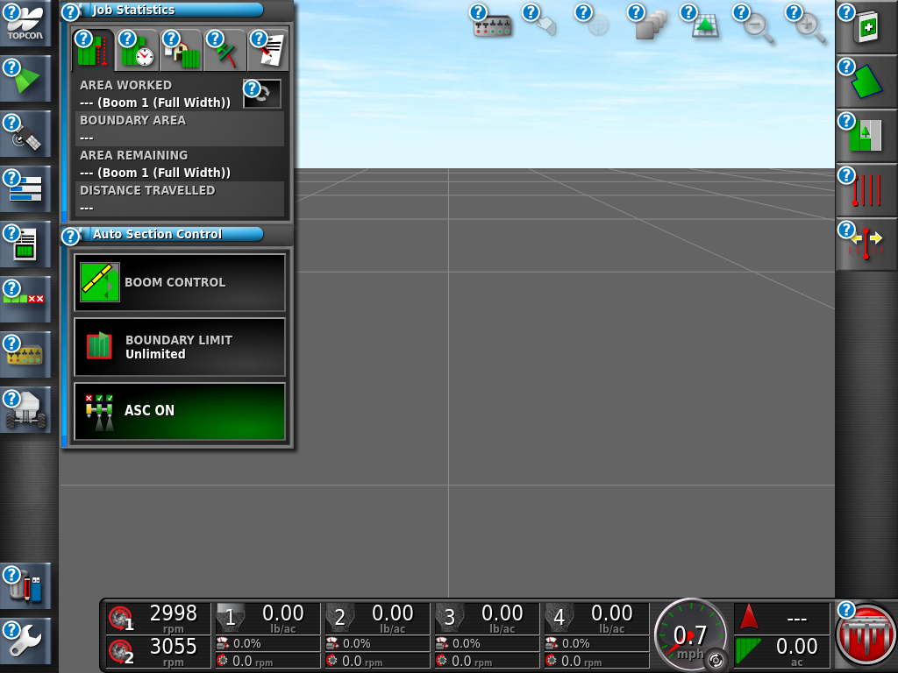
Job Assist
Field Menu
Job Menu
Guidance Menu
Nudge Menu
Note- Job Assist gives you definitions of job menu and use of guidelines.

Slide 14
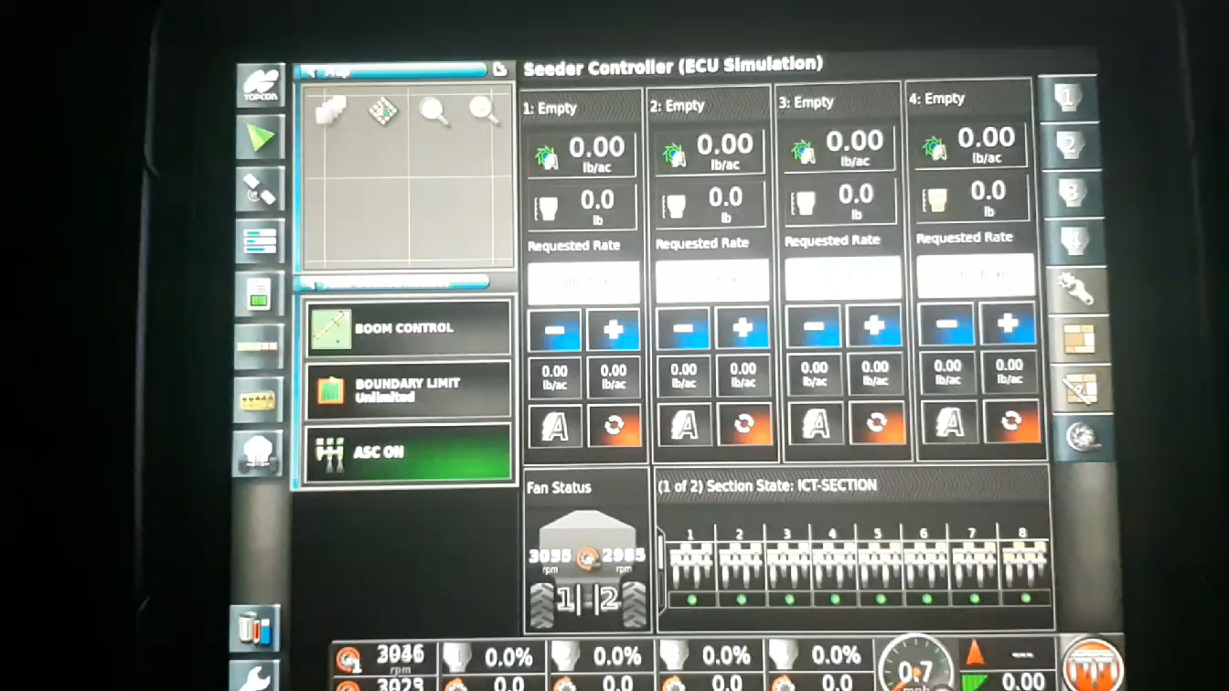

Slide 15
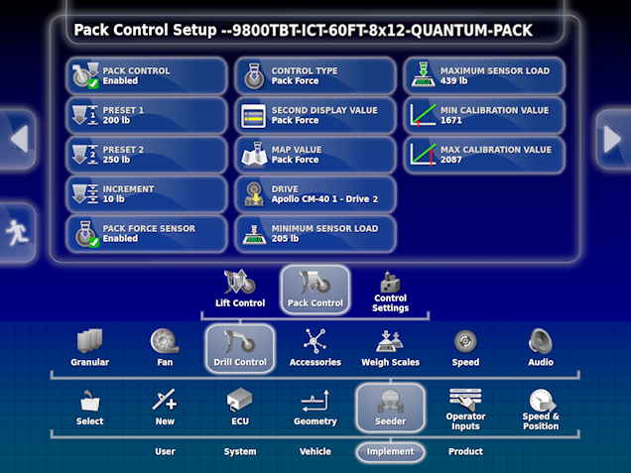
Monitor Set Up
3)General Set Up

Slide 16
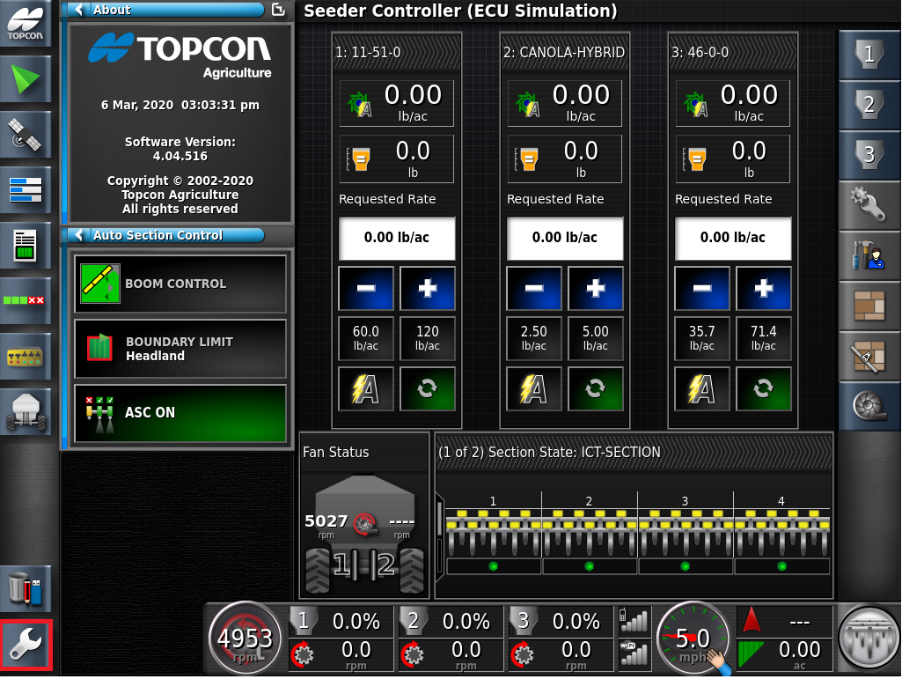
General Set Up
Press the Wrench on the Bottom Left Corner to enter the Setup Menu

Slide 17
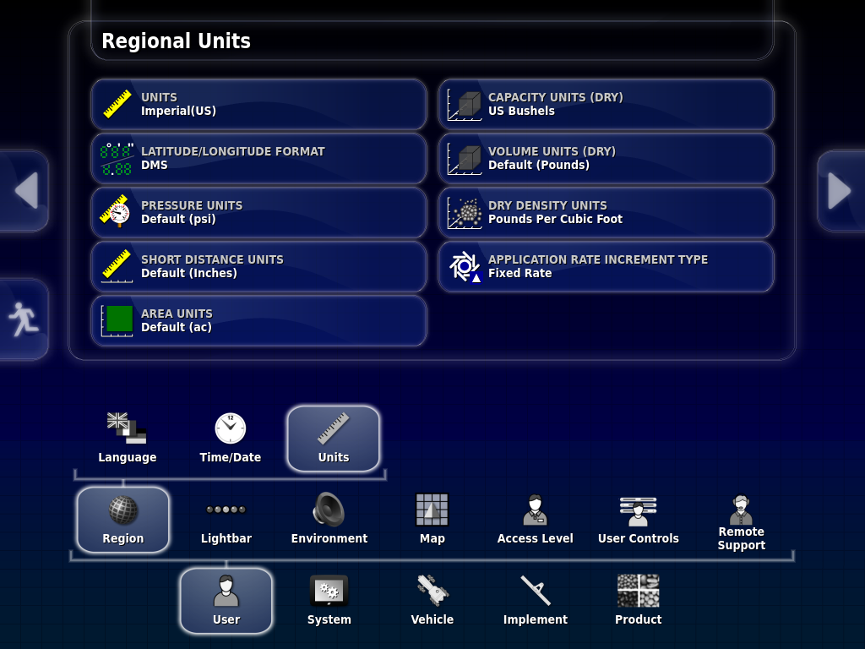
Navigate to User-Region- Units. Always start from the bottom of the screen upwards.
-Units - Imperial (US)
-Pressure units – psi
-Short Distance – Inches
-Area Units – AC
Capacity Units - US bushels
Volume Units Dry – Pounds
Dry density units - Pounds per Cubic Foot

Slide 18
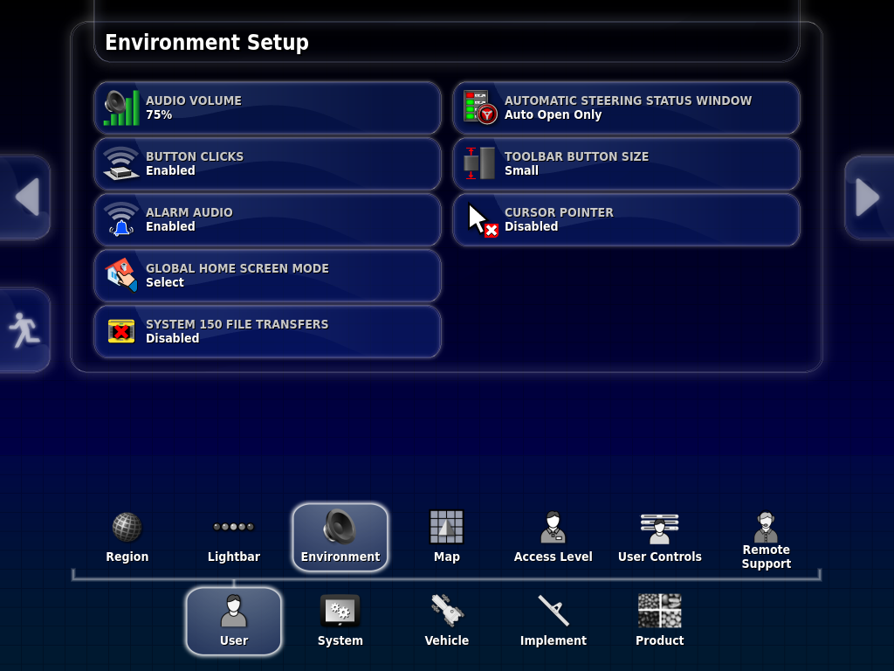
Environment Set Up
Navigate to User- Environment
-Audio Volume – 75% icon, Adjust the volume to a comfortable level
-Button Clicks and Alarm Audio ENABLE
Global Home Screen Mode – Select

Slide 19
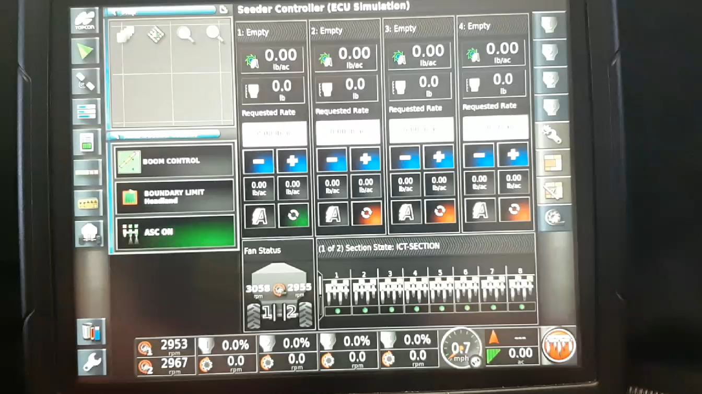

Slide 20
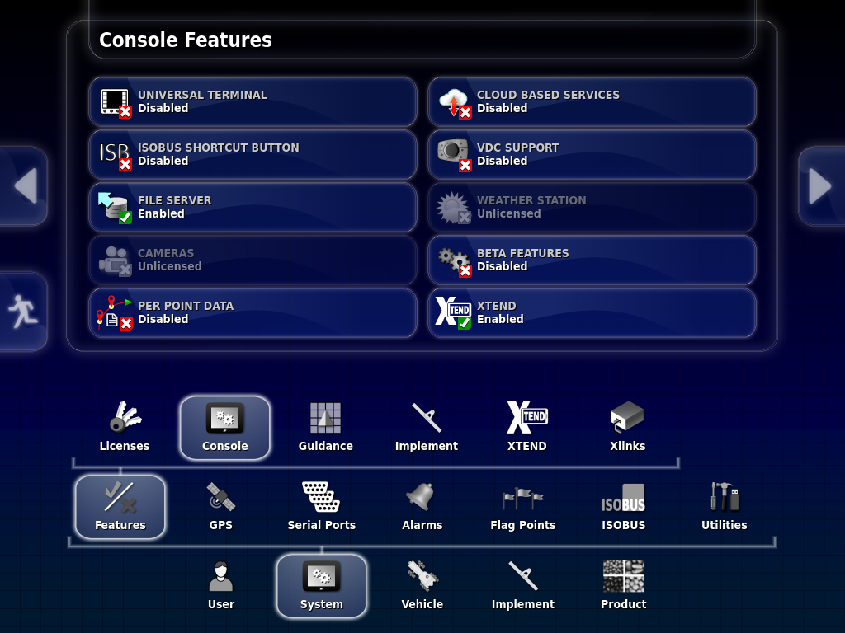
Console Features
Navigate from System, Features, and then Console
VDC SUPPORT-Enable If You Have a VDC Switch (Vehicle Display Controller)
UNIVERSAL TERMINAL – Disabled
XTEND – Enabled

Slide 21
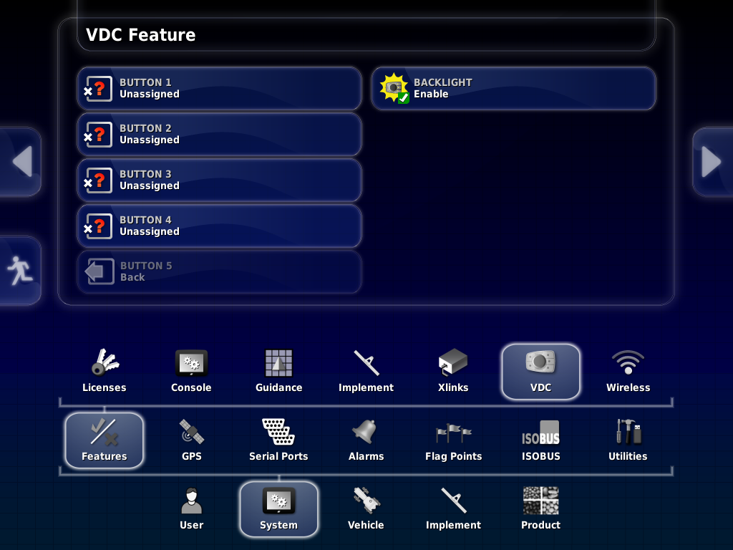
VDC Feature
If you have chosen to Enable VDC a VDC Feature Icon will Appear. Once you press this icon your VDC Feature page will come up.

Slide 22
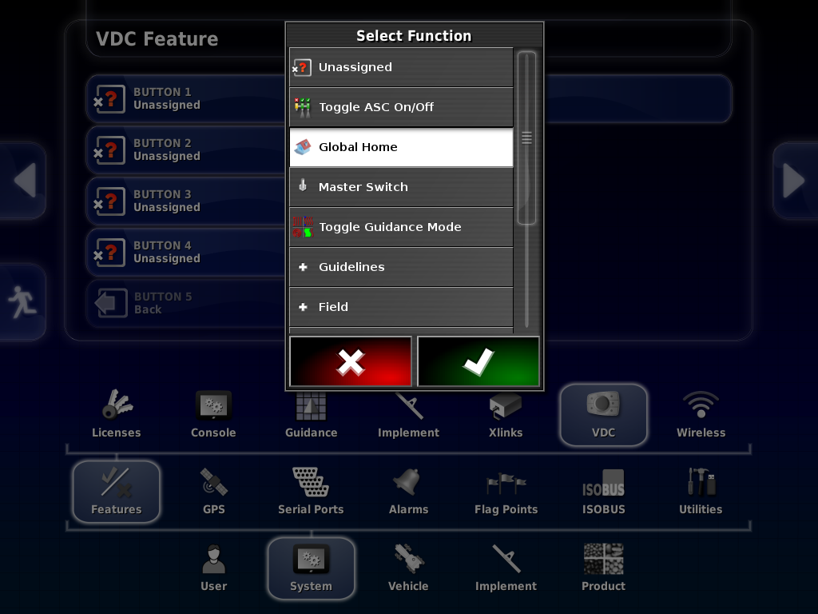
You will now have an option to Assign 4 Buttons by touching the Unassigned Button.
Select a function (ex Global Home) and hit Green Check mark.
Now pressing Button 1 on the VDC switch will take you to you Global Home Screen

Slide 23
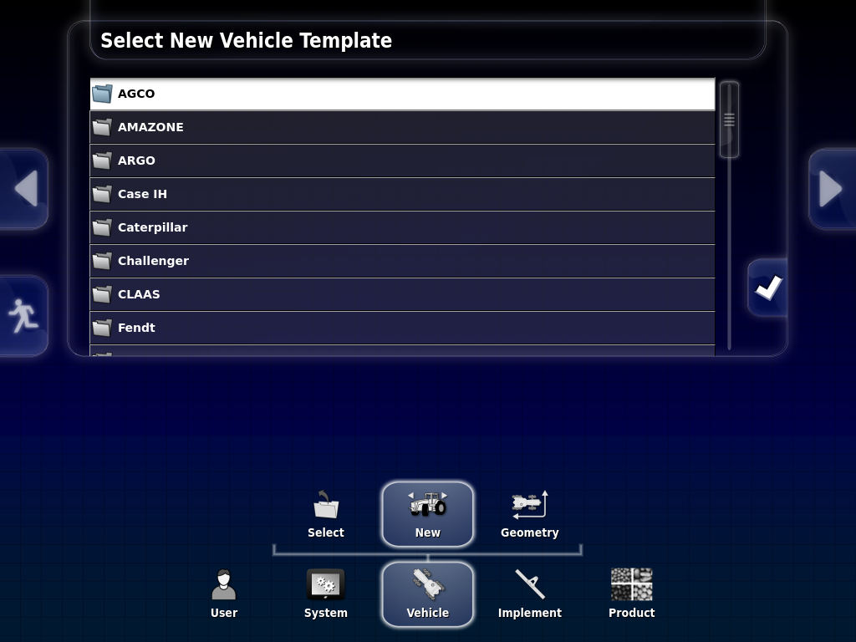
Select New Vehicle Template
Select –Vehicle then New
Select your tractor manufacture from the list. Hit the white check mark.

Slide 24
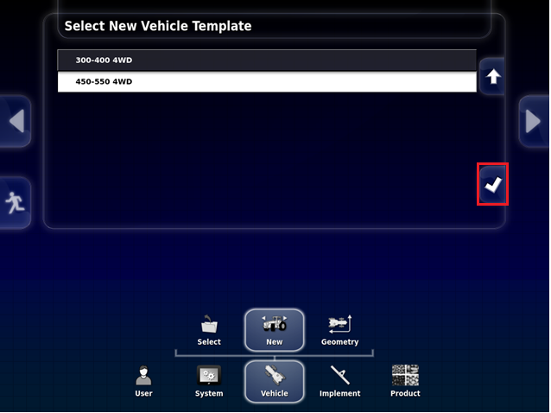
Select the Model of tractor from the list. Press the White Check mark to Continue

Slide 25
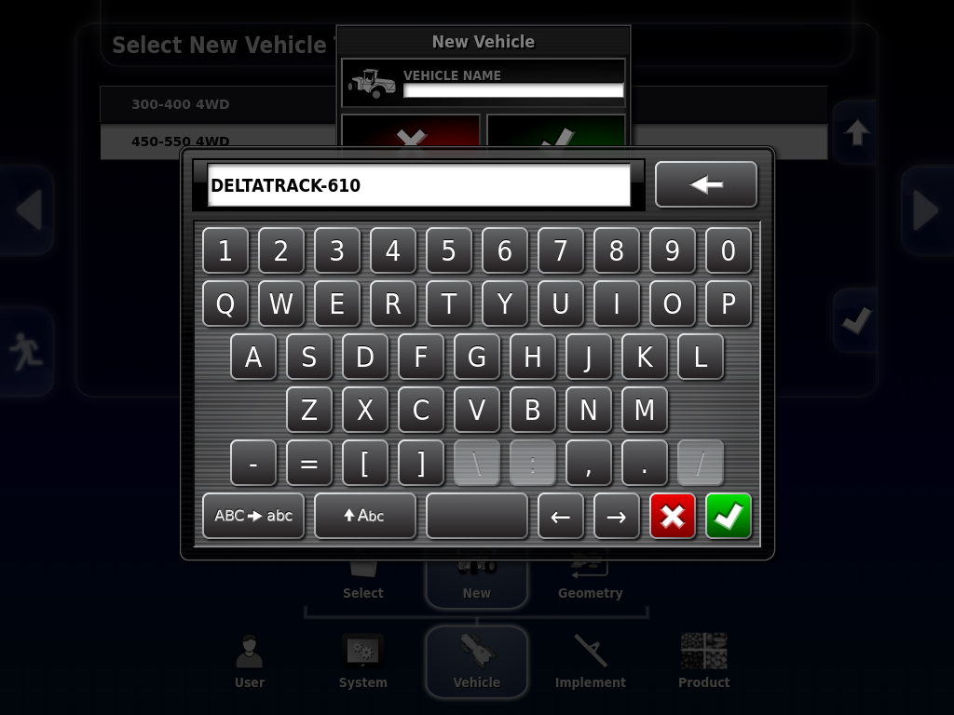
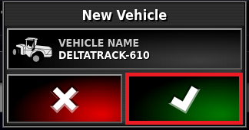
Now enter the Model of your tractor.
Ex. Deltatrack-610
Confirm the model is correct. Apply with the green check mark

Slide 26
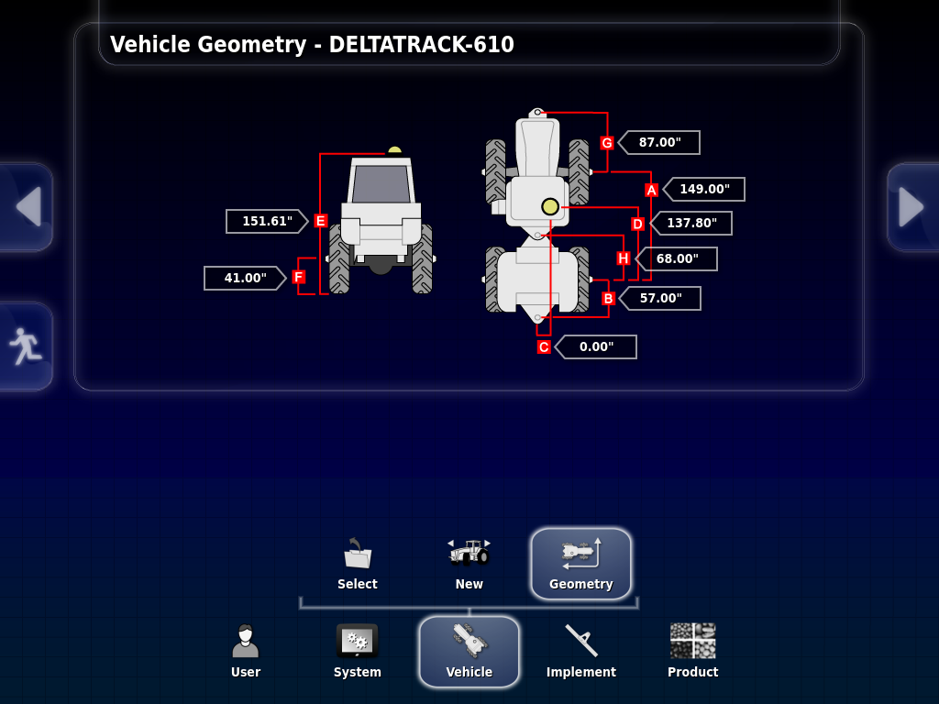
Vehicle (Tractor) Geometry
Select Vehicle then Geometry
Adjust the dimensions as needed. Use a tape measure, and record your dimensions on a note pad. It is very important to have the dimensions as accurate as possible. Especially when equipped with an ICT unit.
Letter C is the GPS antenna Offset from the center of the hitch, normally the antenna is centered, and the value is left at 0. NOTE If your “c” measurement is to the left is a negative number (e.g. -4) and to the right a positive number(e.g. 4)

Slide 27
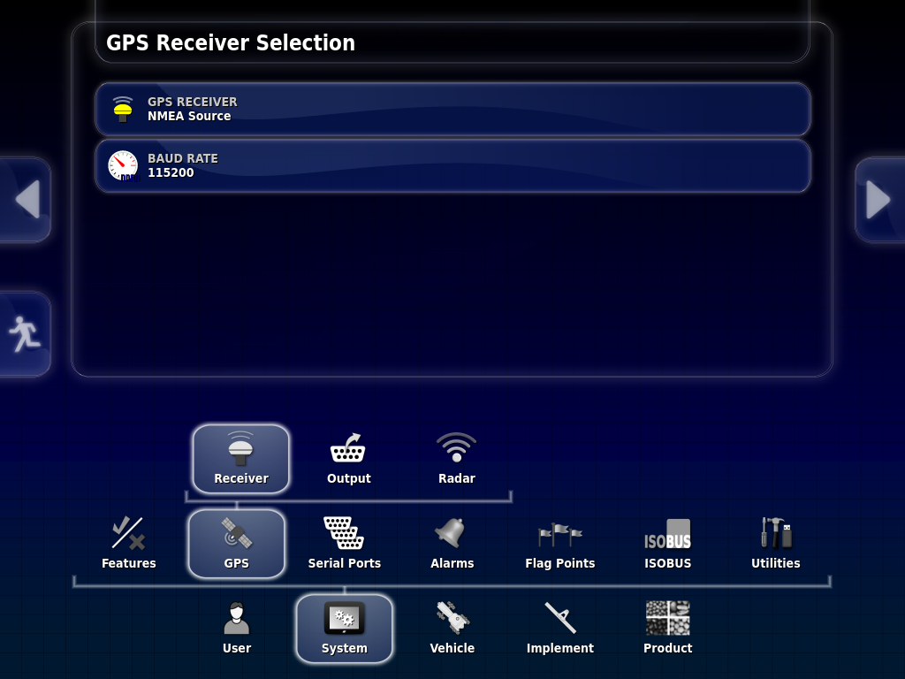
GPS CONNECTIONS
Navigate from System-GPS-Receiver.
GPS Reciever-Nmea Source
Baud Rate – Match the Baud rate of the OEM monitor.

Slide 28
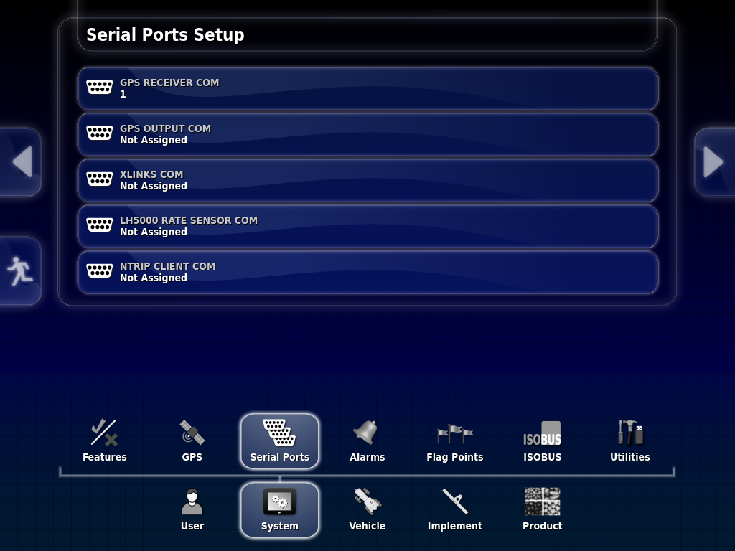

GPS CONNECTIONS
System- Serial Ports
Serial Port Set Up-GPS Receiver Com – 1
Once These Steps are complete. You must select appropriate output NMEA Streams on your factory OEM monitor.
GGA RMC X
GSA VTG
GST X ZDA

Slide 29
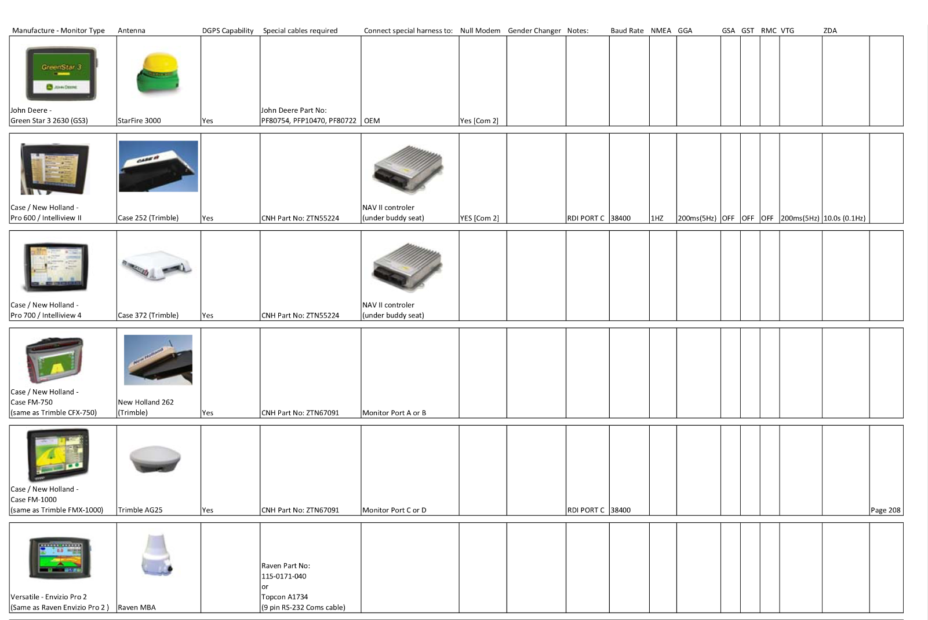
Here is some harnessing with part numbers required for Factory GPS to hook to X35.

Slide 30
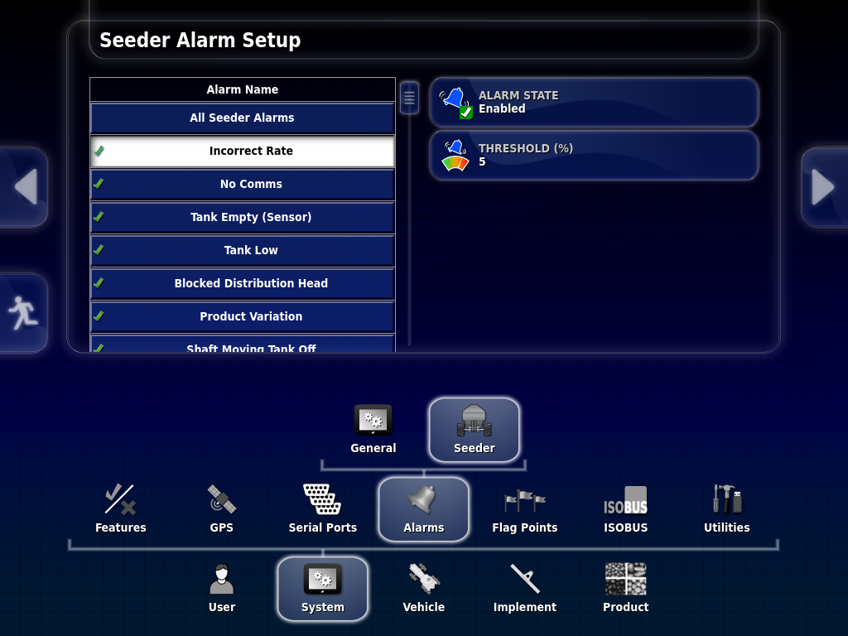
ALARMS
Go System then Alarms then Seeder
Ensure All Seeder enabled, only the adjustable parameters are shown below.
Incorrect Rate - 5% (Threshold)

Slide 31
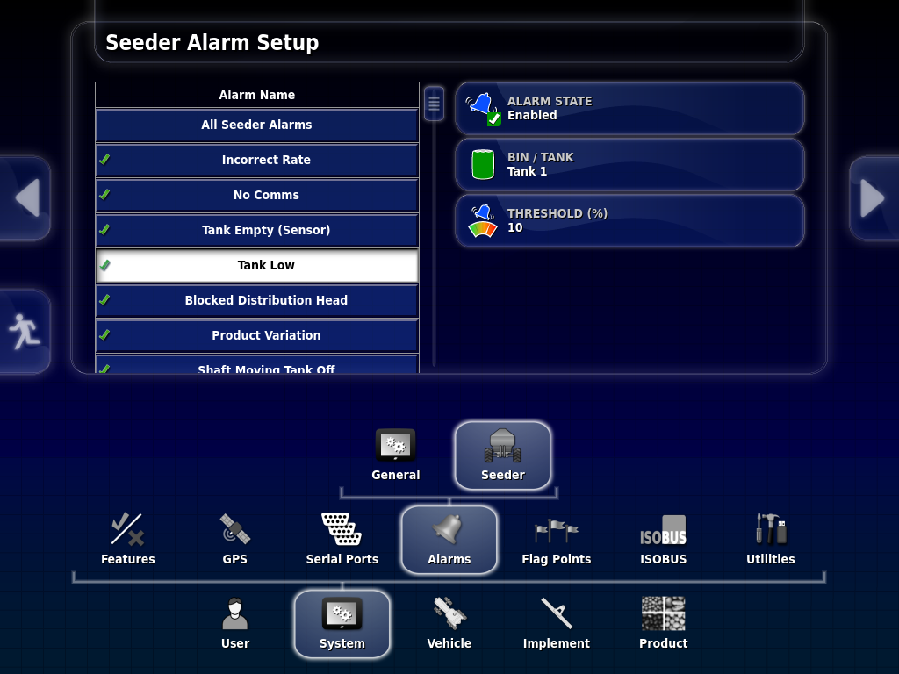
Tank Low – Threshold 10%

Slide 32
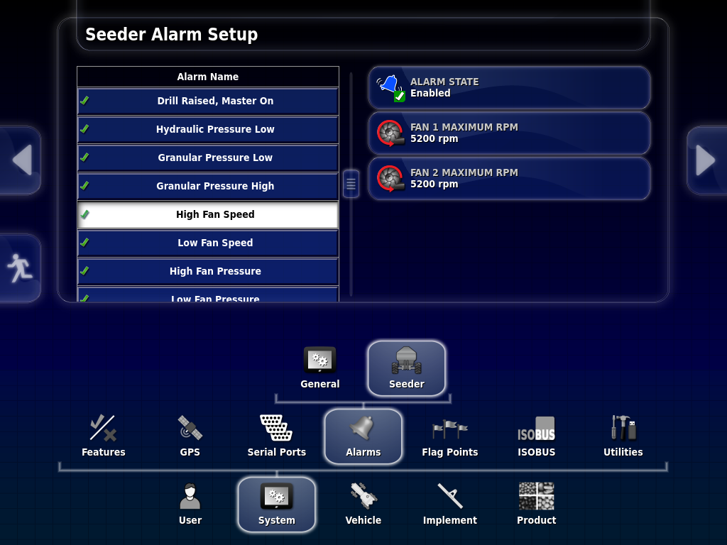
High Fan Speed –
Fan 1 Maximum RPM 5200 (user adjustable)
Fan 2 Maximum RPM 5200 (user adjustable)

Slide 33
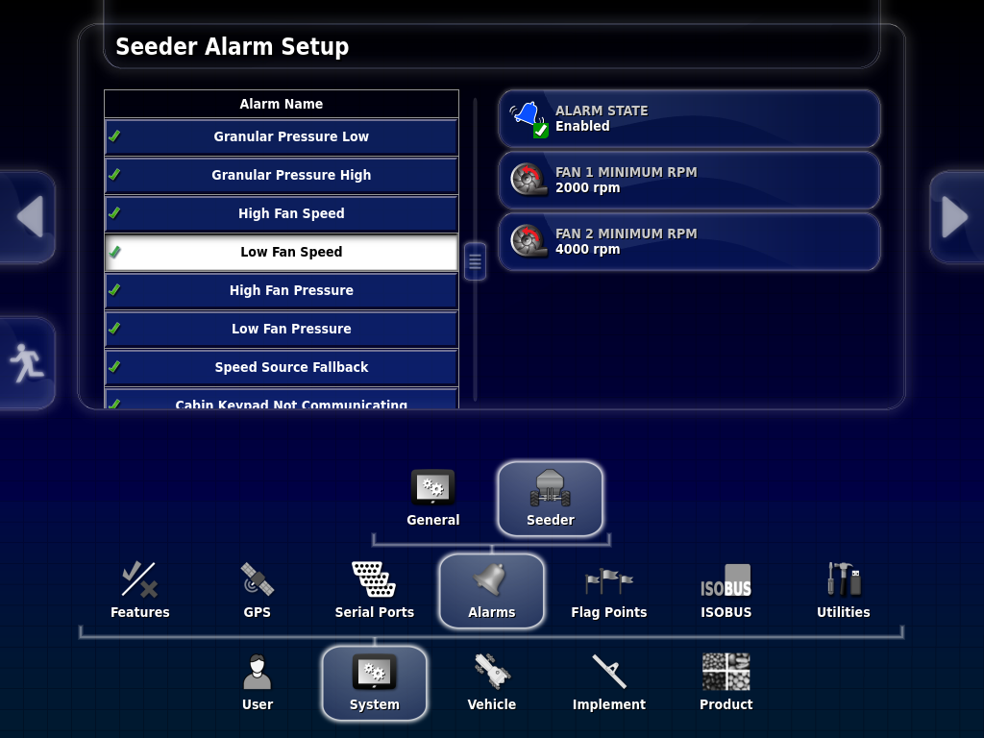
Low Fan Speed –
Fan 1 Minimum RPM 2000 (user adjustable)
Fan 2 Minimum RPM 4000 (user adjustable)

Slide 34
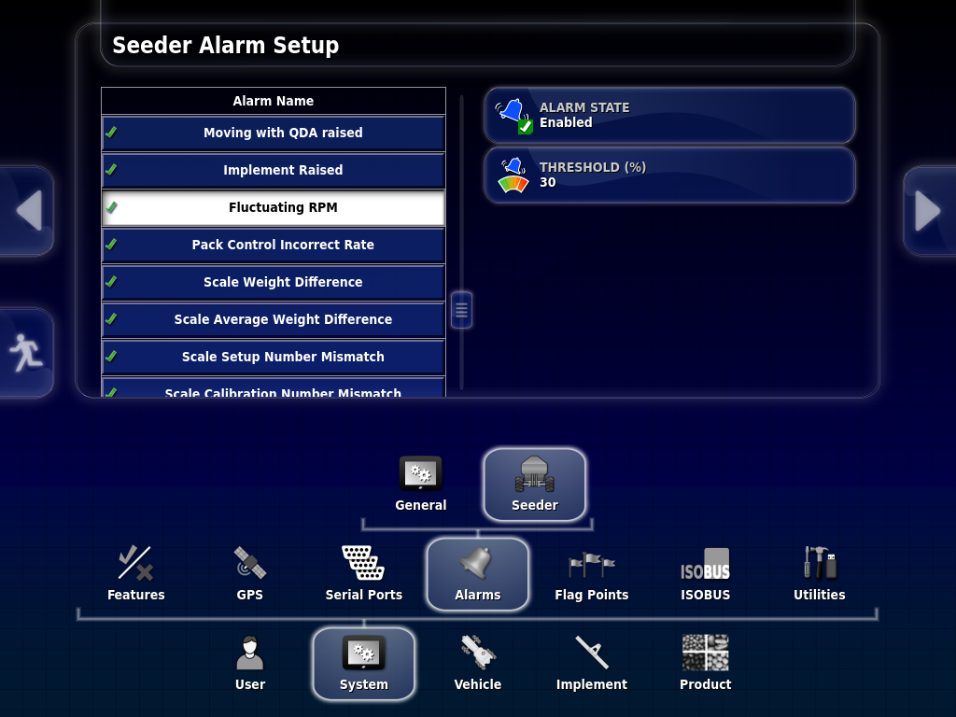
Fluctuating RPM – Threshold 30%

Slide 35
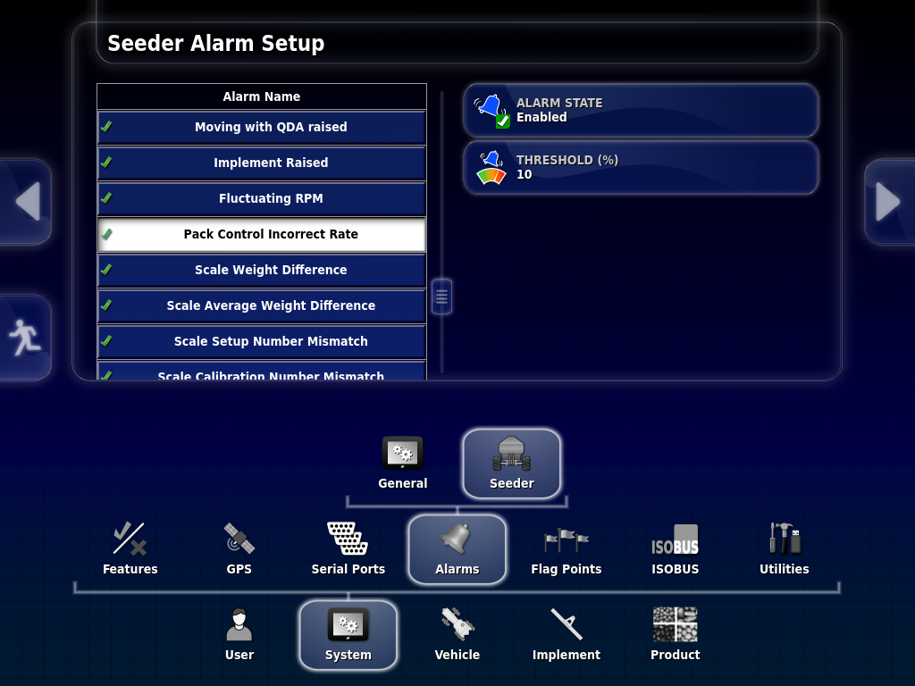
Pack Control Incorrect Rate – Threshold 10%

Slide 36
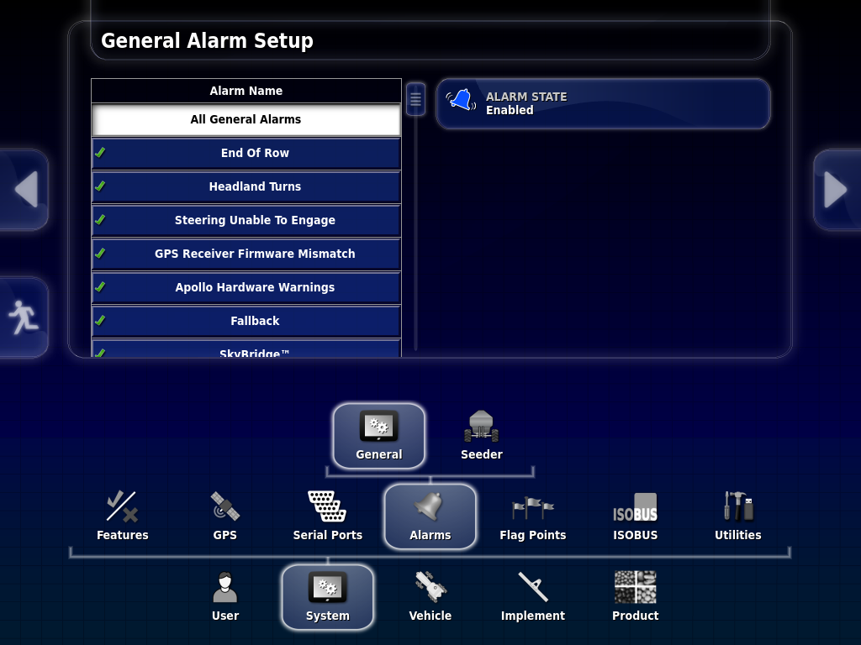
Ensure All General Alarms are enabled

Slide 37

Press the Running Man to get Back to the Run Screen!

Slide 38
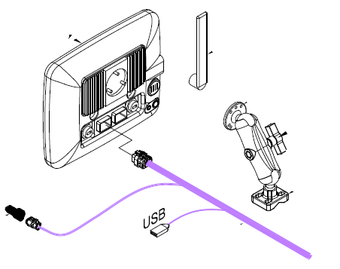
Create a backup profile on USB stick
Insert a blank USB stick into the either the USB port on the X35 monitor or main harness.

Slide 39
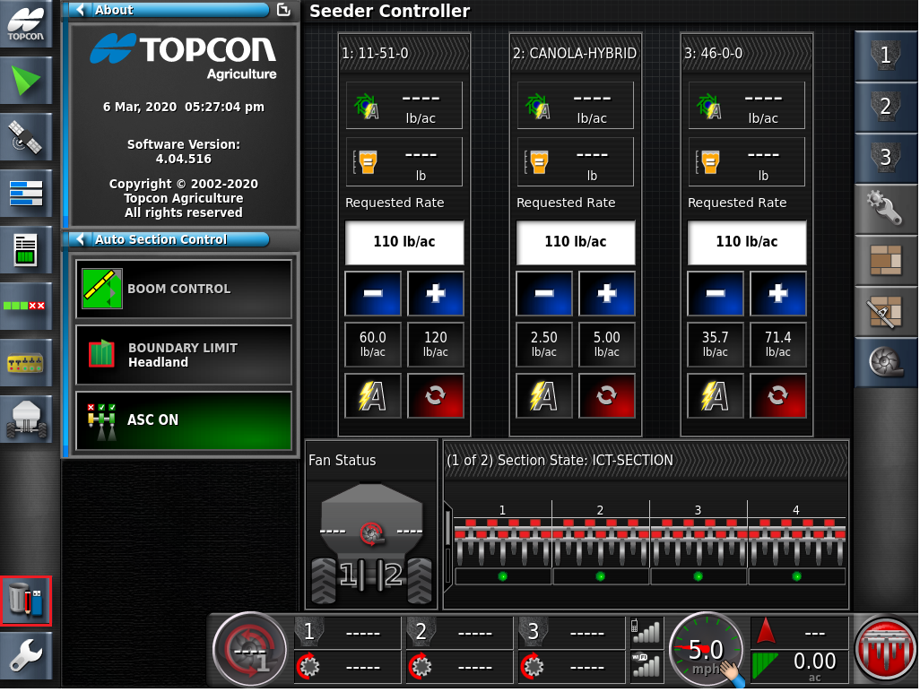

Press the INVENTORY MANAGER icon.

Slide 40
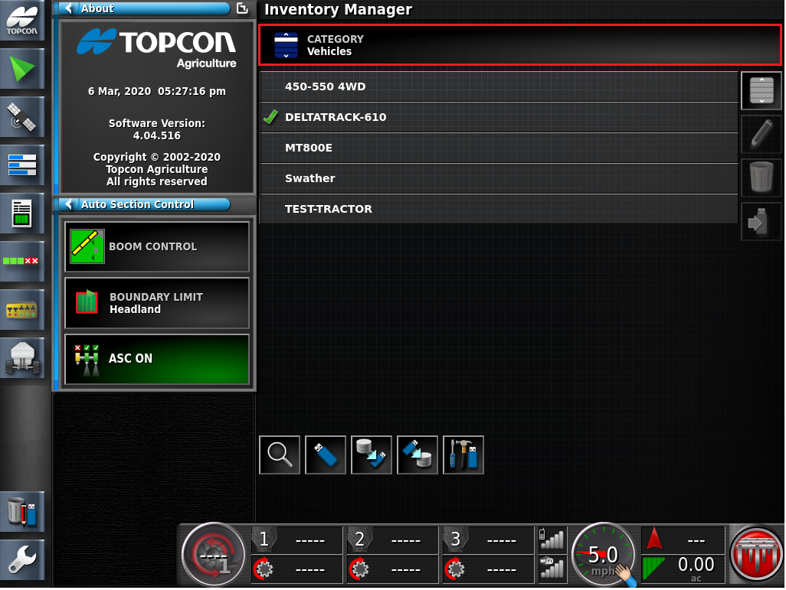
Press the CATEGORY tab

Slide 41
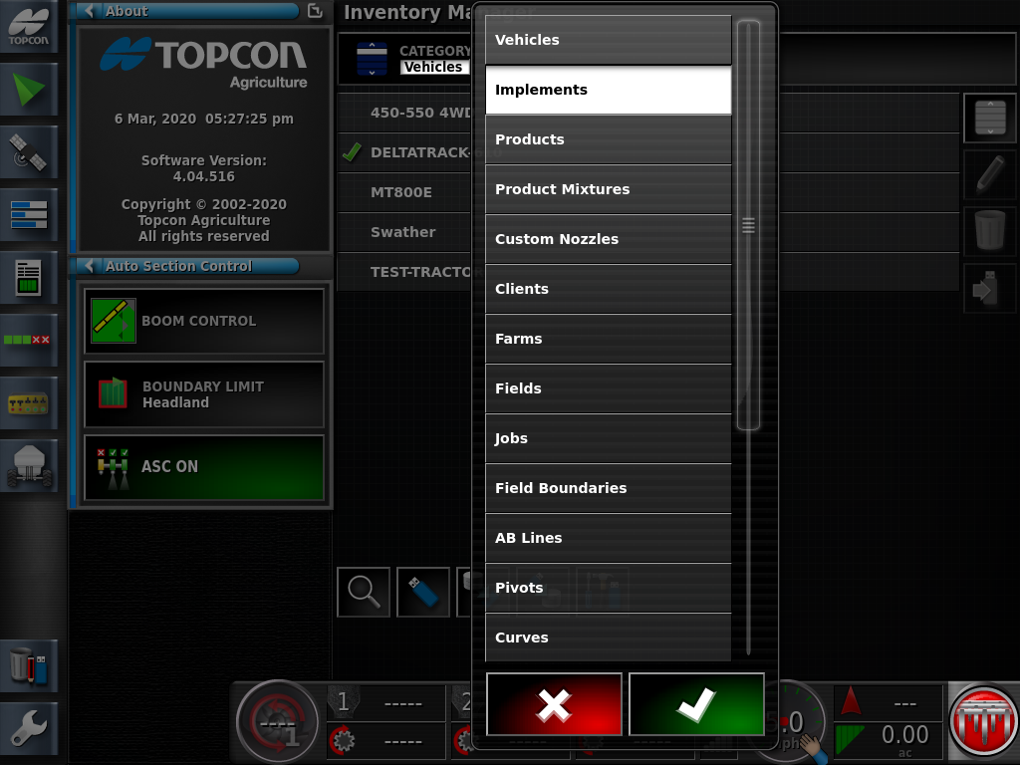
A drop down list will appear, select Implements from the list. Press the Green check mark

Slide 42
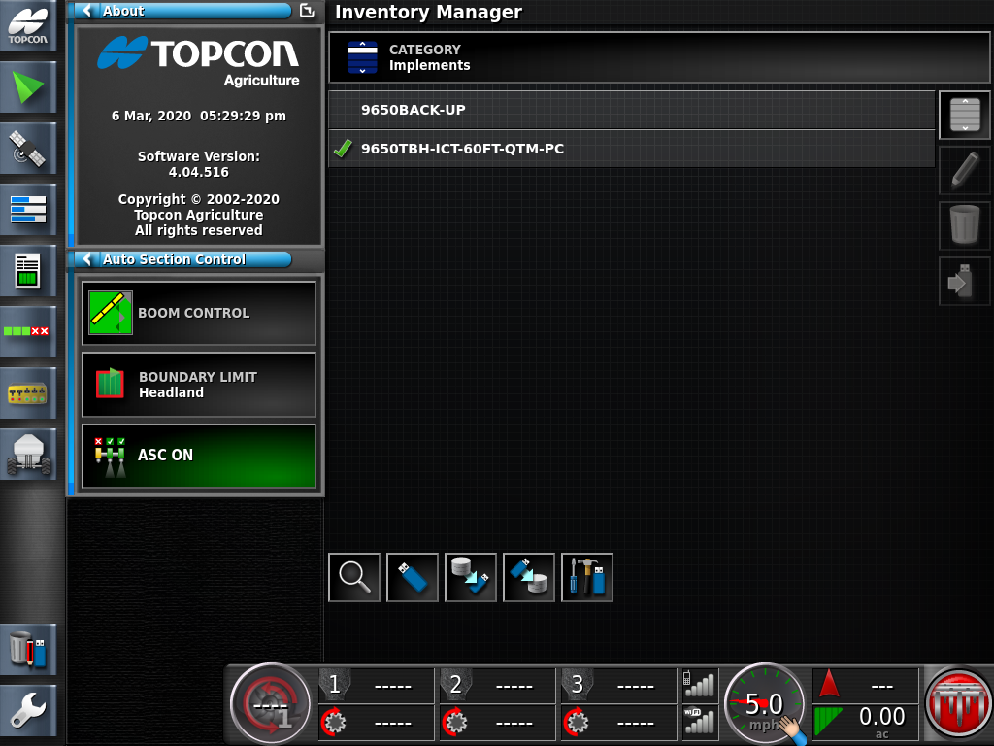
Highlight the Implements you wish to back up

Slide 43
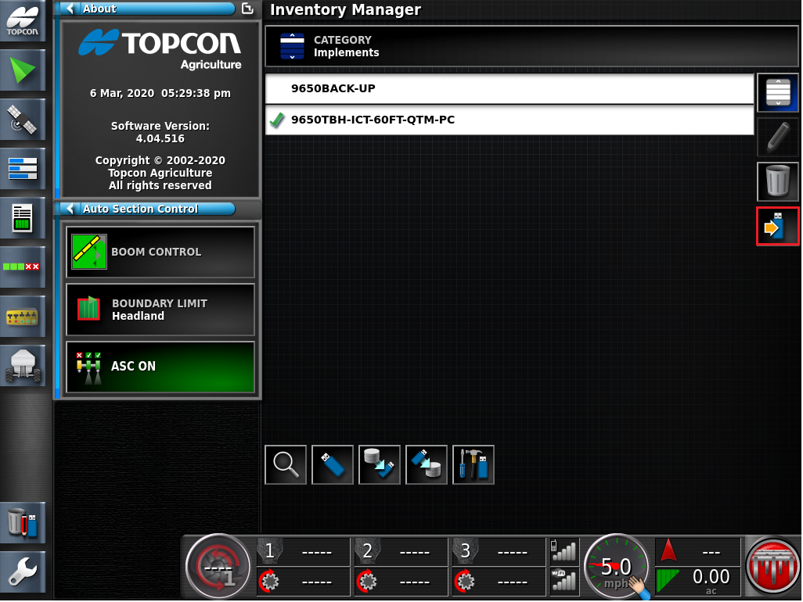

Press the Export to USB icon which is on the (Right hand side) of the screen

Slide 44
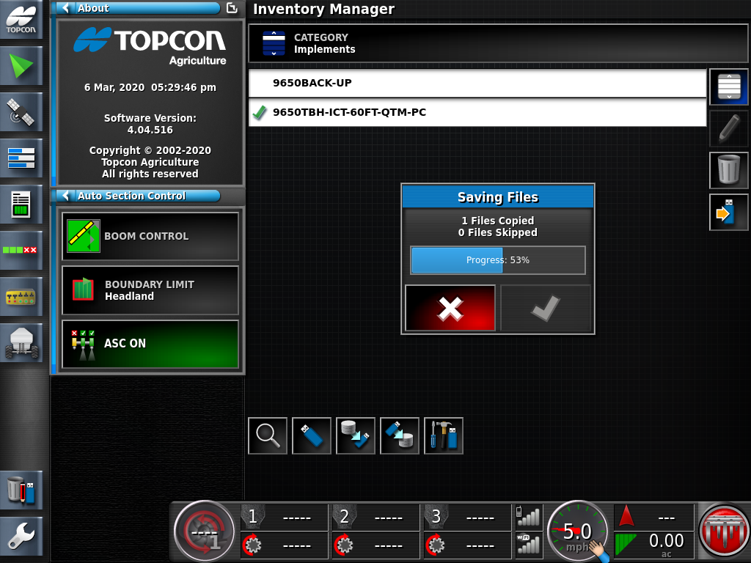
The backup profiles will be transferred to the USB stick. When Complete press the Green check mark and eject the USB stick by using the eject feature. Label the memory stick Morris Back up profile. Keep this USB stick in a safe location.

Slide 45
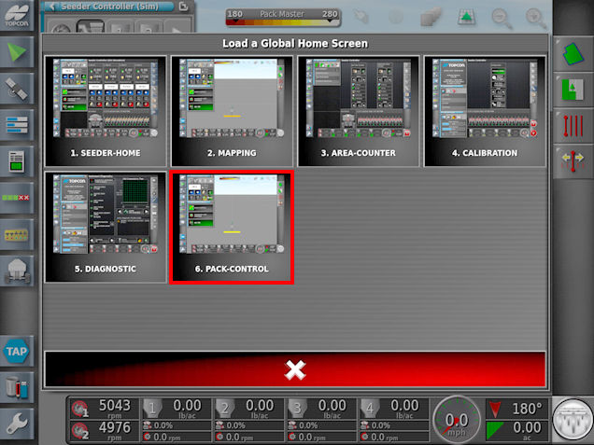
LOAD A GLOBAL SCREEN

Slide 46

SWIPE UP FROM BOTTOM OF YOUR SCREEN- SELECT THE HOUSE

Slide 47
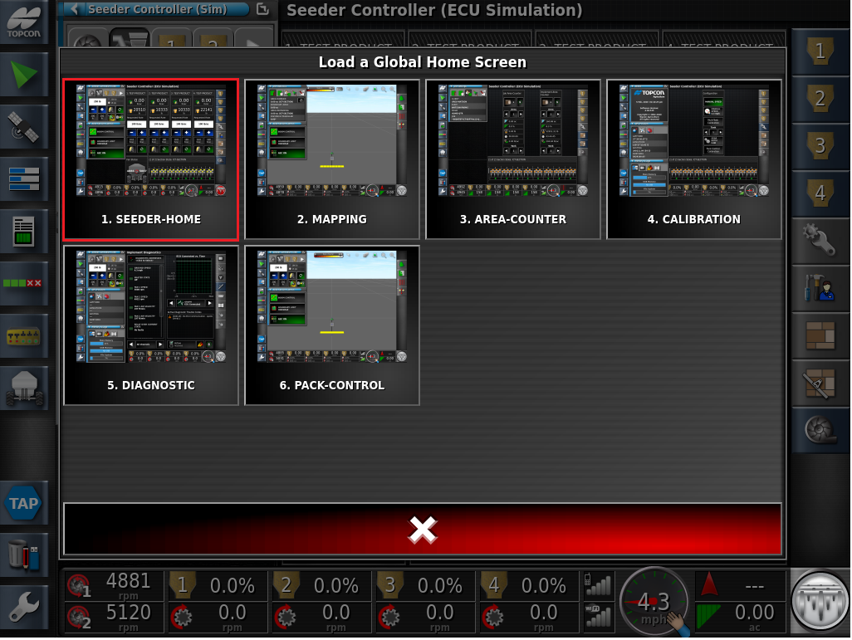
Each Global Home screen will take you to individual pages for different functions
Ex. #1 is Seeder Home

Slide 48
Thank You

