Slide 1
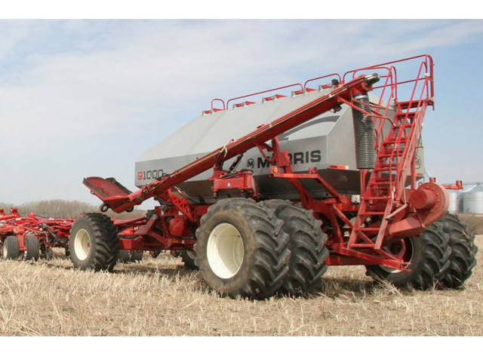

Tank Calibration
Section 4
1) Calibration Using Keypad and X35 Monitor

Slide 2
CHECK LIST BEFORE YOU FILL TANKS OR START CALIBRATING
1) Check seed plate setting before product is in the metering system you would have empty the metering system to change seed plate setting
2) Check the Collector body diverters, these need to be in CLEAN OUT position for calibrating or you may damage the diverters
3) Make sure you have the hair pins in the correct position for the drive you require on each tank (DIRECT DRIVE OR SLOW SPEED)
4) Make sure you set your GEAR RATIO in your CALIBRATION SCREEN TO 2 for DIRECT DRIVE and SLOW SPEED TO 16

Slide 3
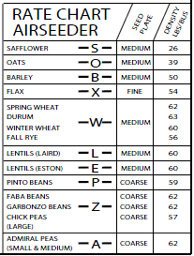
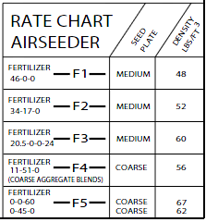
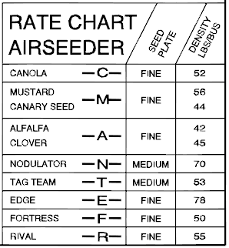
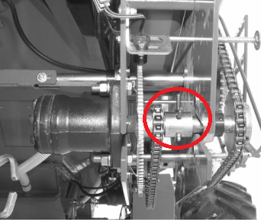
Before you can Calibrate you need to check a few settings
Seed plate setting what seed plate setting is needed FINE, MEDIUM, COURSE
Direct Drive
Slow Speed Drive
CANOLA IS A SLOW SPEED SETTING
CANOLA C
FINE
EXAMPLE:
FINE SEED PLATE SETTING
CANOLA
Which Transmission setting do you need DRIECT DRIVE gear ratio 2 or SLOW SPEED gear ratio 16
SHOWS DIRECT DRIVE HAIR PIN IS OFF THE HYDRUALIC MOTOR

Slide 4
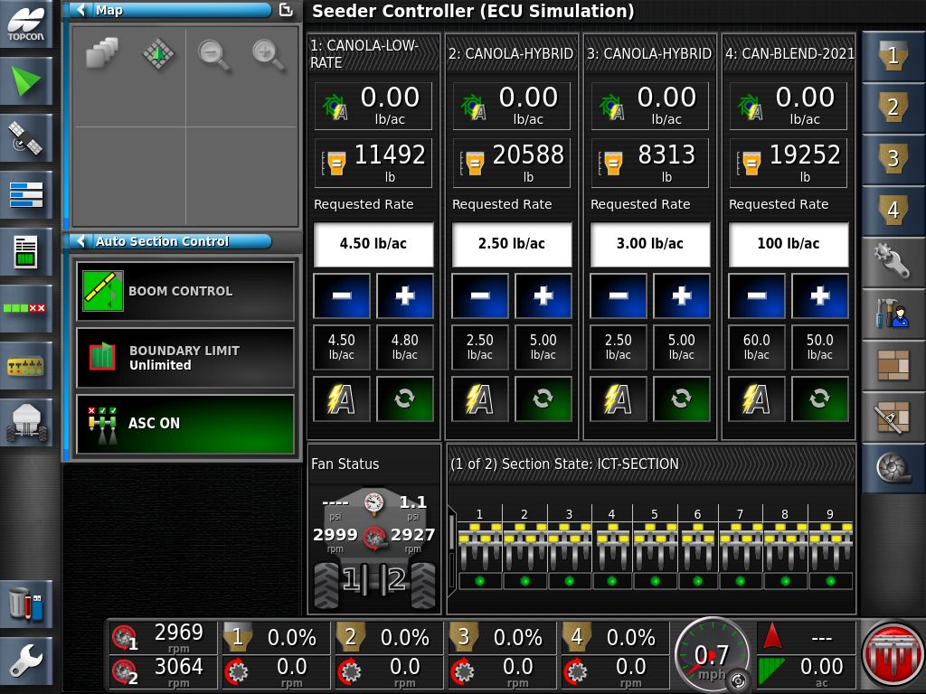

From Seeder Controller swipe up from the bottom of your screen and the Control Ribbon will appear
Press Load Global Home Screen Icon

Slide 5
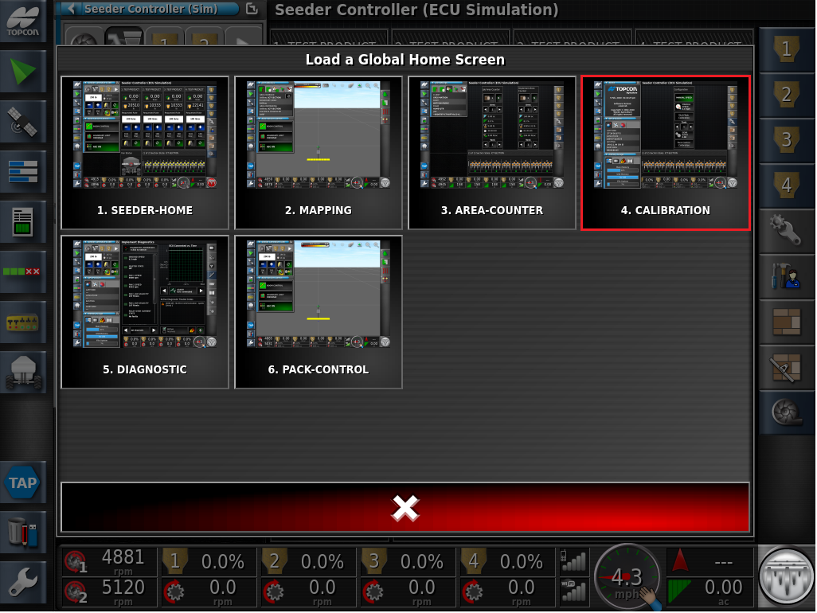
Press on the CALIBRATION SCREEN

Slide 6
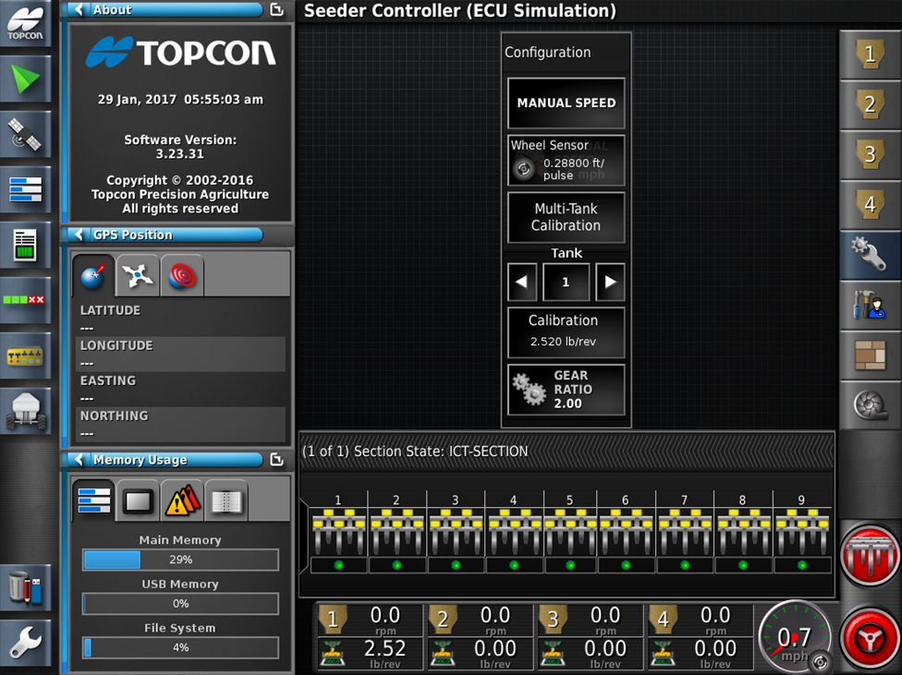
ICONS THAT YOU WILL USE ON CALIBRATION SCREEN
MANUAL SPEED ON/OFF
SET THE MANUAL SPEED/SHOW SPEED WHEN ON
ENTER CALIBRATION WIZZARD
PRESS TO TOGGLE THROUGH TANKS 1, 2, 3, 4.
SHOWS CAL FACTOR / UNCALIBRATED/ENTER CAL FACTOR
PRESS TO SET GEAR RATIO (2 OR 16)
DIRECT DRIVE =GEAR RATIO 2
SLOW SPEED= GEAR RATIO 16

Slide 7
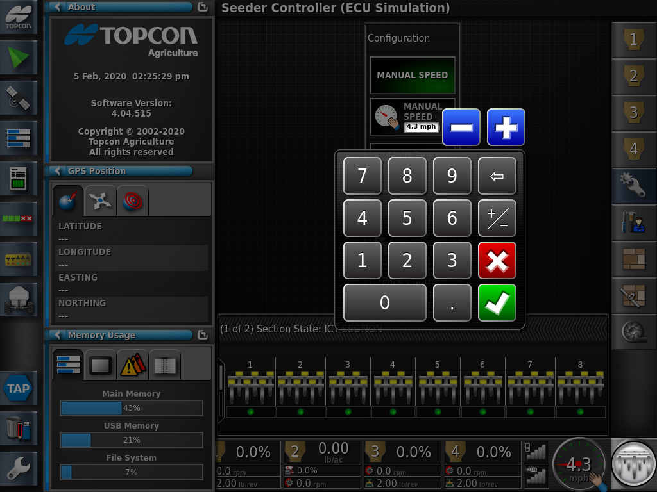
PRESS ON MANUAL SPEED WILL TURN GREEN
PRESS ON MANUAL SPEED WHERE THE HAND SPEEDOMETER
KEY PAY WILL APPEAR ENTER YOUR SEEDING SPEED
THEN PRESS GREEN CHECK MARK

Slide 8
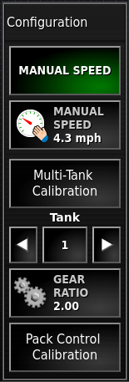
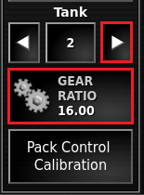
Gear Ratios:
Direct Drive: 2.00 (Cereals / Fertilizers)
Slow Speed: 16.00 (Canola / Inoculants)
PRESS ARROW TO GO TO TANK 2
SLOW SPEED DRIVE: 16.00
(Canola, Inoculant)
Direct Drive: 2.00 (Cereals / Fertilizers)

Slide 9
Now on with calibration
1.Ensure Manual Speed is ON and there is a speed showing
2. ENSURE CORRECT GEAR RATIO IS ENTERED 2. Press this ICON and you can enter gear ratio of 2 or 16
DIRECT DRIVE =GEAR RATIO 2
SLOW SPEED= GEAR RATIO 16

Slide 10
Press Multi-Tank Calibration

Slide 11
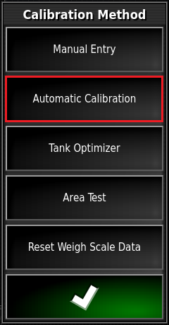
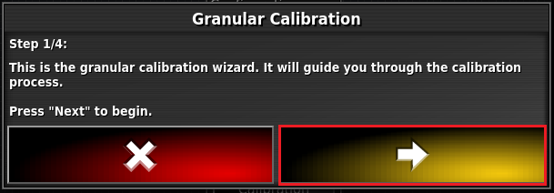
PRESS Automatic Calibration
YOU WILL AUTOMATICALY ADVANCE TO GRANULAR CALIBRATION
PRESS THE YELLOW AROW

Slide 12
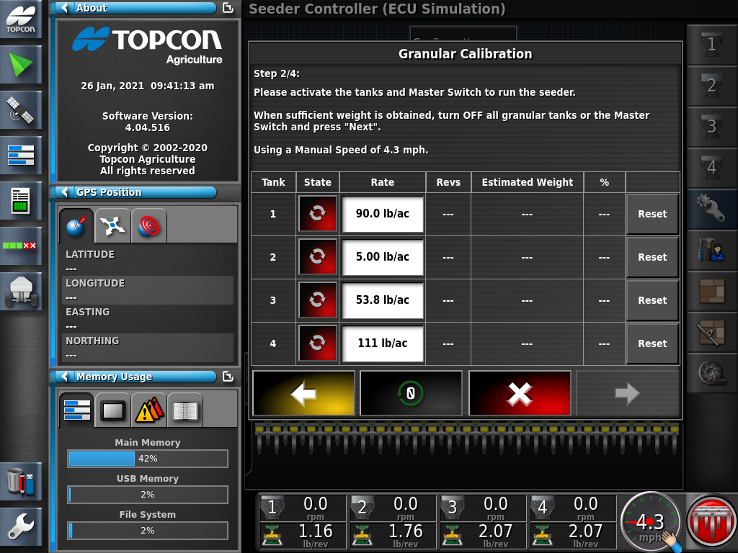
PRESS TANK 1 STATE

Slide 13
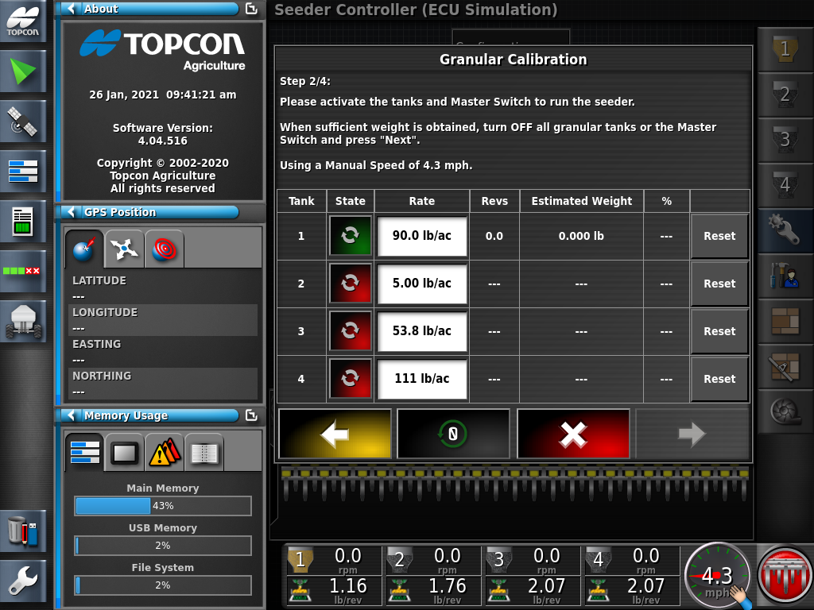
AFTER YOU PRESS THE TANK 1 STATE IT WILL TURN GREEN

Slide 14
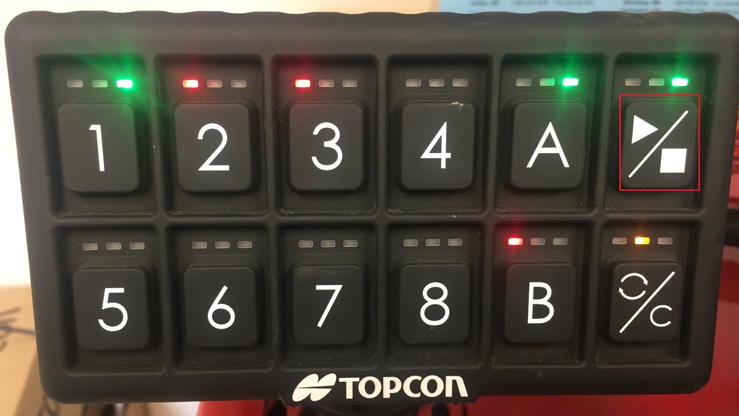
USING KEYPAD TO CALIBRATE
FIRST STEP
PRESS A TO ACTIVATE CALIBRATION WIZZARD
SECOND STEP
THIRD STEP
PRESS #1 TO ACTIVATE TANK 1
ON/OFF
RESET

Slide 15
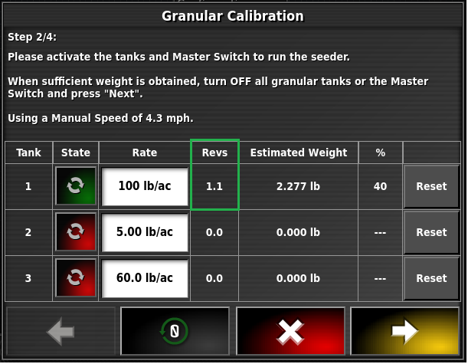
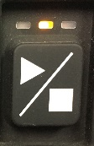
Priming the Meter Body
7.6
Allow the metering to run for several rotations, stop the metering by pressing the Stop Key
Remove the sample collector and empty the product back into the tank. This is not a calibration but only to ensure the metering wheels are primed, do not weigh this sample

Slide 16
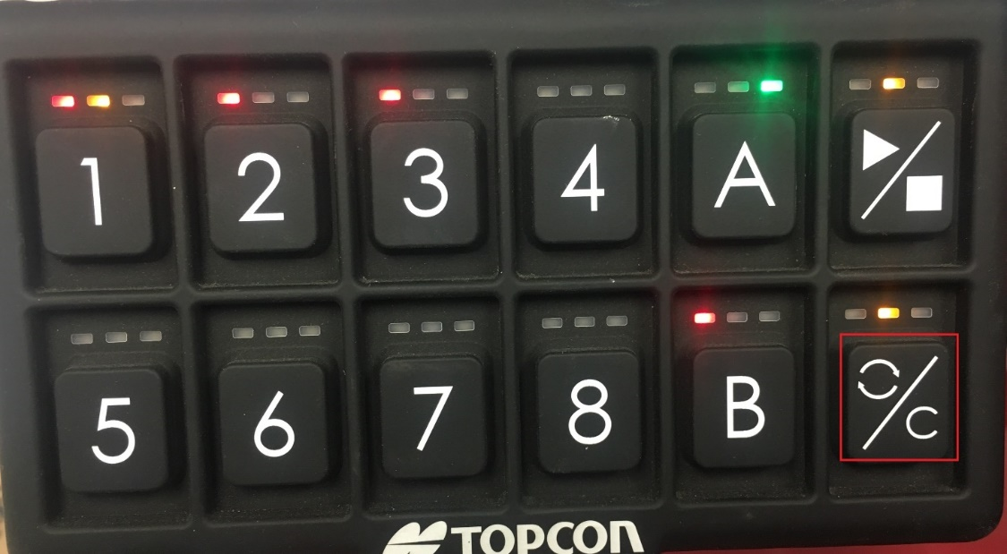

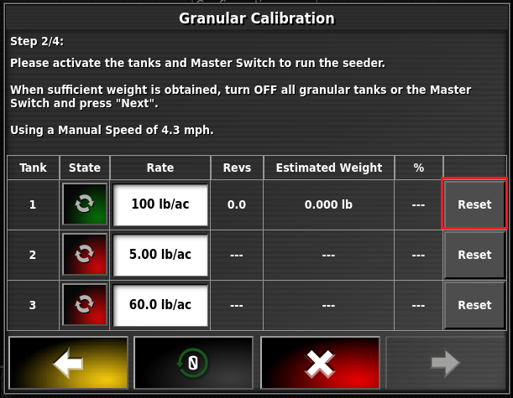
Clear the priming data by pressing the RESET ICON on the keypad.
YOU CAN PRESS RESET ON THE CALIBRATION SCREEN ALSO
After priming the metering wheels you have to empty the calibration box and replace the calibration box back under the tank you are calibrating in this case TANK 1.

Slide 17
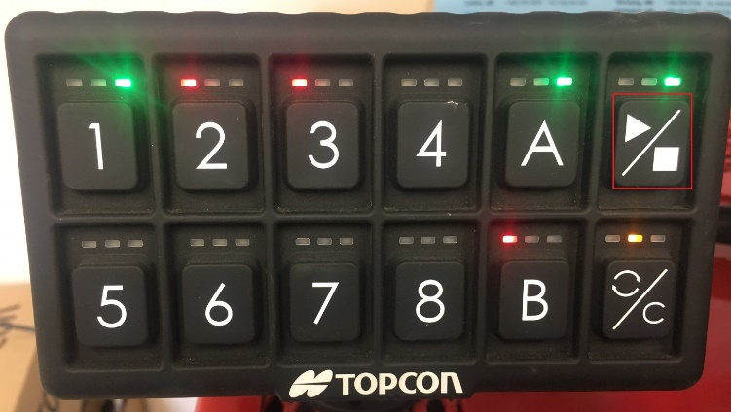

CALIBRATING TANK 1
TANK #1 ON GREEN LIGHT
IN CALIBRATION ON GREEN LIGHT
BEFORE YOUR START YOUR CALIBRATION COMFIRM THAT TANK 1 IS ON AND YOUR IN CALIBRATION
Turn the metering system ON by pressing the start Key
Caution: The metering will engage and distribute the product into the sample collector
Note: The indicator lights are now Green which confirms that Metering is On and Actively flowing

Slide 18
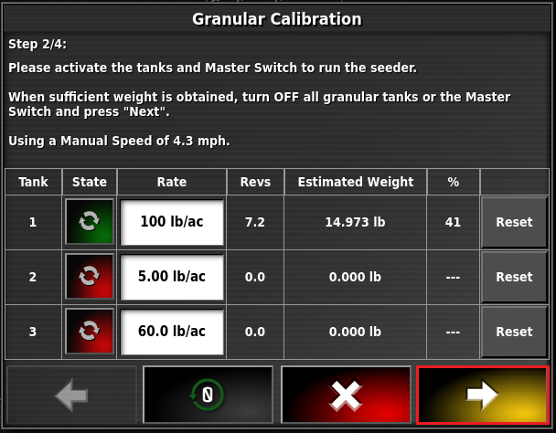
The Estimated Weight will count continuously as product is collected into the Sample Collector.
PRESS THE STATE ICON TO STOP METERING
Stop the Metering when the Estimated weight is around 15.00lbs. Proceed with the Yellow Forward Arrow.

Slide 19
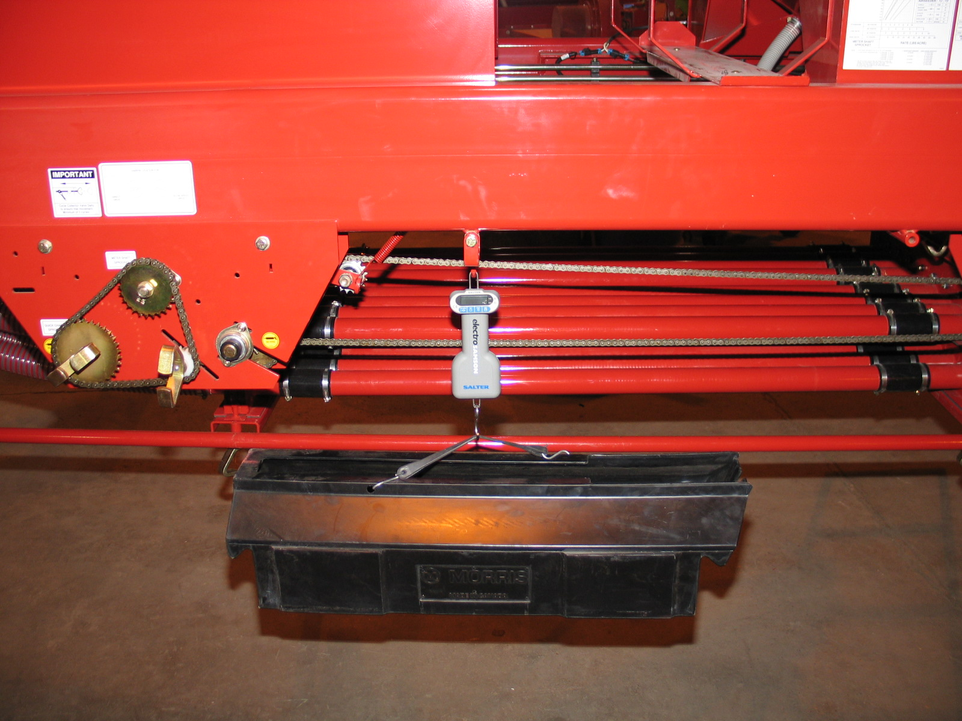
NOW WEIGH THE PRODUCT IN THE CALIBRTION BOX
15.25 lbs.
NOW YOU HAVE WEIGHT YOUR PRODUCT YOU WILL GO BACK TO THE TRACTOR CAB PRESS ON THE YELLOW ARROW

Slide 20
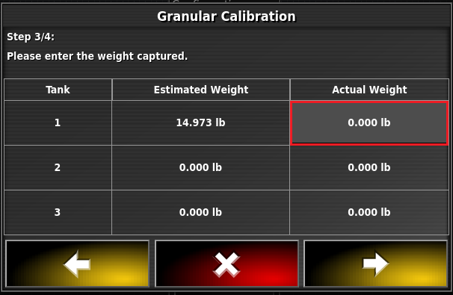
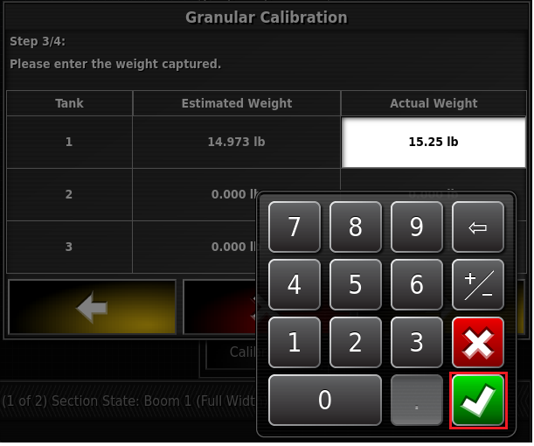
PRESS ON THE ICON 0.000 lb
KEYPAD WILL APPEAR ENTER ACTUAL WEIGHT
AFTER ENTERING ACTUAL WEIGHT PRESS GREEN CHECK MARK

Slide 21
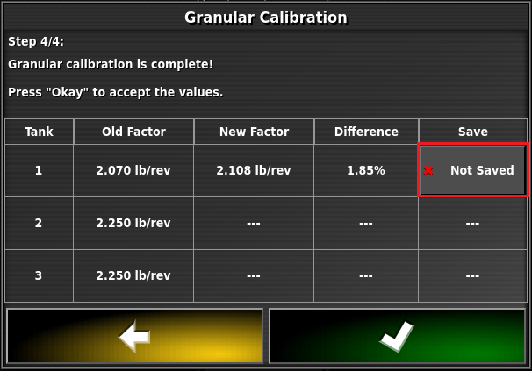
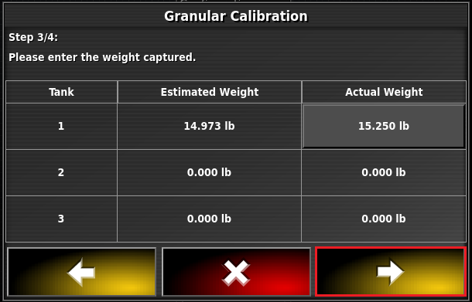
NOW YOU WILL GO TO THE NEXT SCREEN, PRESS THE Not Saved
ACTUAL WEIGHT ENTED PRESS THE YELLOW ARROW

Slide 22
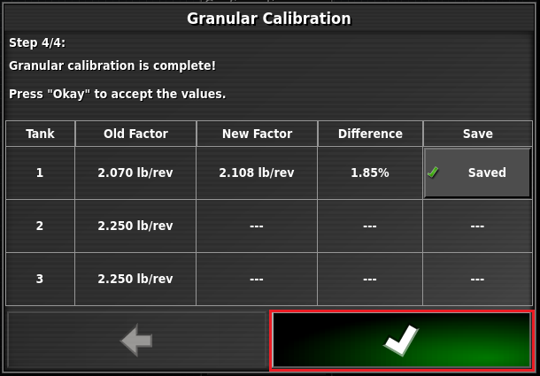
Old cal factor before calibration
NEW CAL FACTOR after calibration
The change was 1.85% difference between old cal factor and the new cal factor
Now Saved
NOW PRESS GREEN CHECK MARK

Slide 23
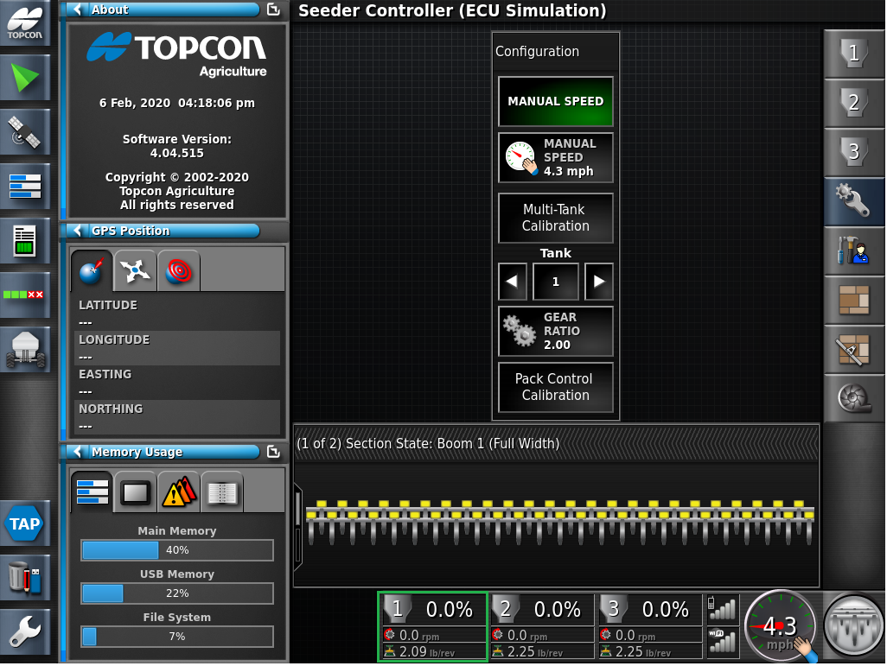
Once you press the GREEN CHECK MARK YOU WILL START BACK AT THE CALIBRATION SCREEN. YOU WILL NEED TO PREFORM 2 OR 3 CALIBRATIONS PER TANK WITH THE GOAL BEING TO GET TO LESS THAN 1% FROM YOUR SET RATE

