Slide 1


CALIBRATION USING XTEND APP
SECTION: 5
SEGMENT: 1 SETTING UP THE X35 TO PAIR YOUR WITH THE SMART PHONE
SEGMENT: 2 SETTING UP YOUR SMART PHONE TO PAIR WITH THE X35 MONITOR
SEGMENT: 3 USING THE XTEND APP ON THE SMART PHONE TO RUN CALIBRATION

Slide 2
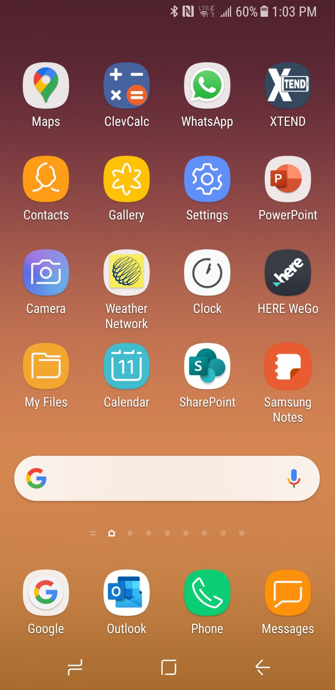
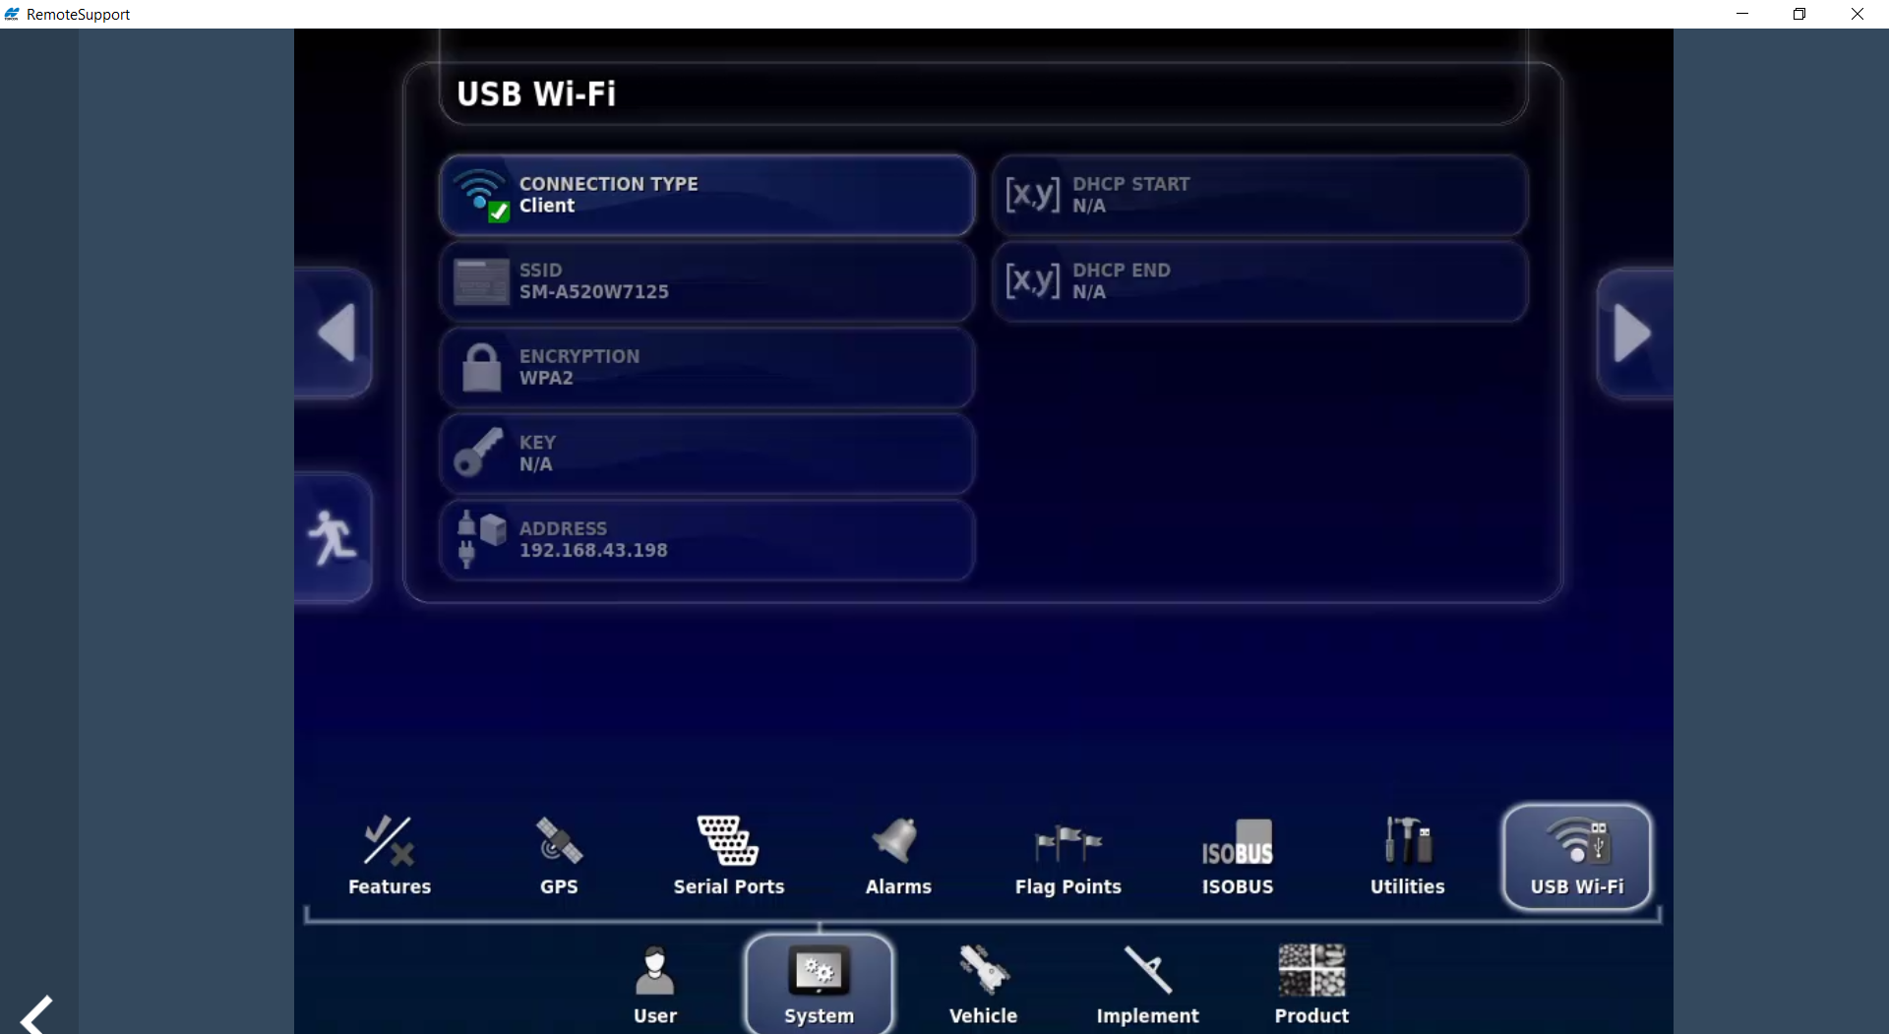
CONNECTION TYPE
Hotspot
X35-MONITOR
XTEND Top-Con Agriculture
1. Setting up X35 Monitor for XTEND Top-Con Agriculture
GALAXY A8 SAMSUNG

Slide 3
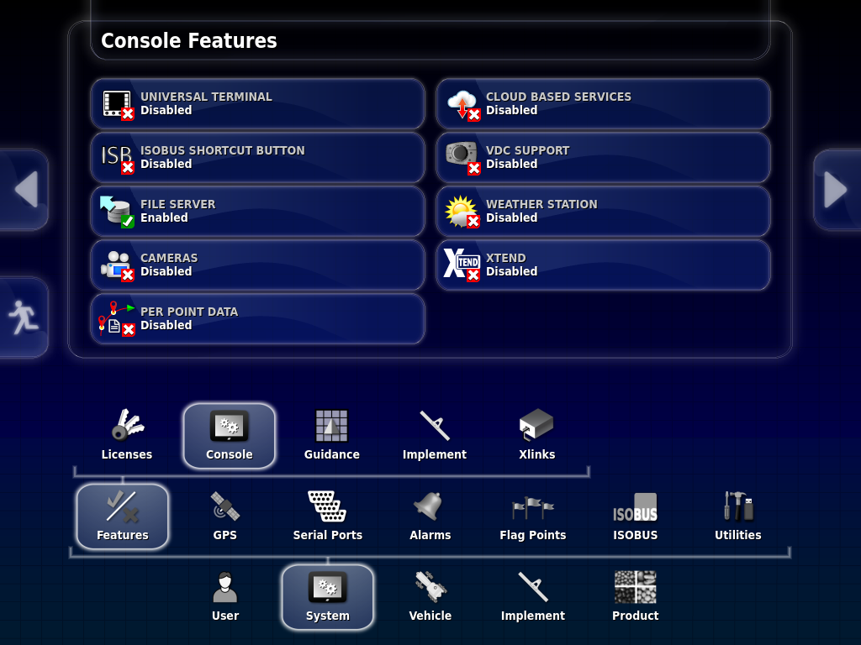
X35 SCREEN
MAKE SURE USB ANTENNA IS PLUGGED IN
CONSOLE
PRESS FEATURES ICON
SYSTEM

Slide 4
X35 SCREEN
In the Setup tree
THE XTEND ICON APPEARS, PRESS ON XTEND ICON

Slide 5
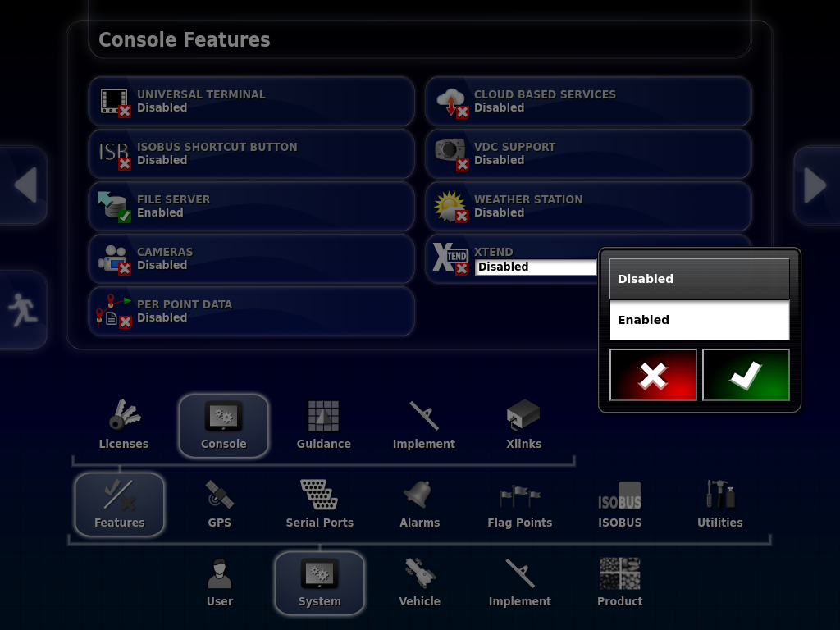
X35 MONITOR SCREEN
XTEND ICON OPEN
A Window will open

Slide 6
X35 Screen
Press Enable
Then press Green Check Mark

Slide 7
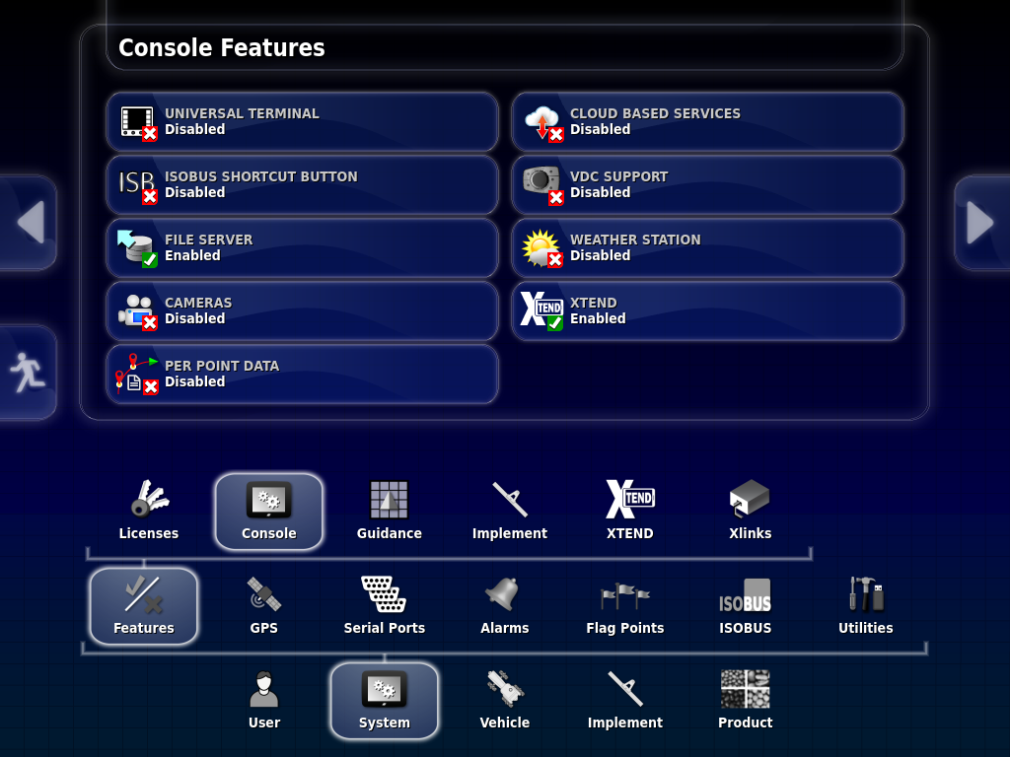
X35 Screen
THIS SCREEN IS COMPLETE
GO TO NEXT SLIDE

Slide 8
X35 SCREEN
PRESS ON USB Wi-Fi
PRESS ON SYSTEM

Slide 9
X35 SCREEN
PRESS CONNECTION TYPE

Slide 10
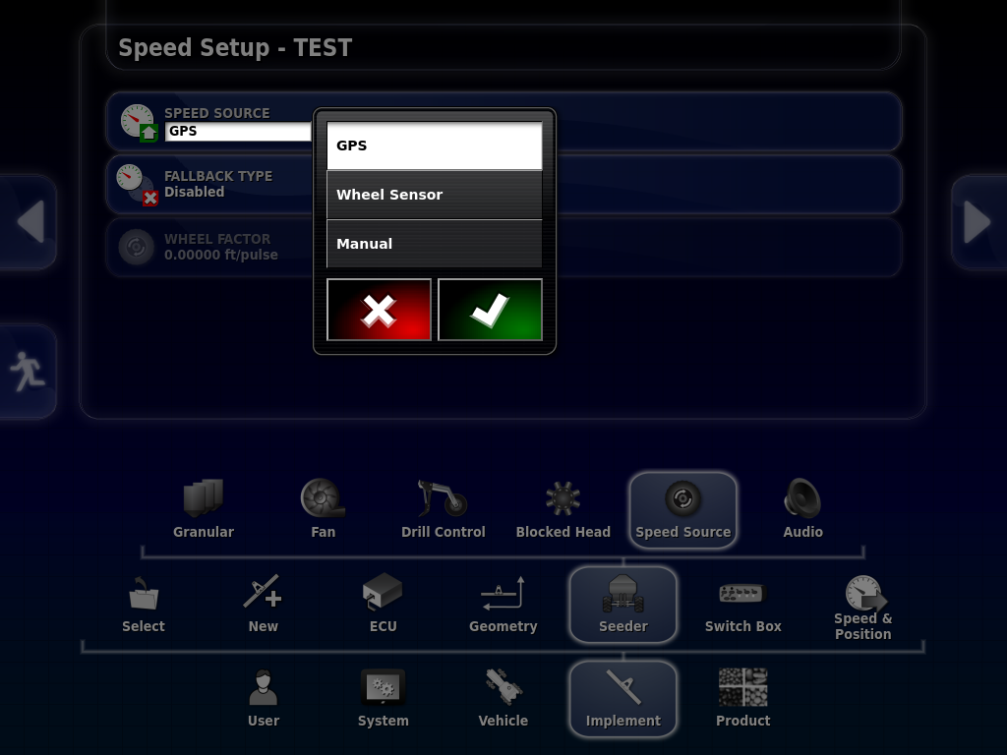
X35 SCREEN
Disable
Press Hotspot
Client
Hotspot

Slide 11
X35 SCREEN
Disabled
Client
HOTSPOT
Press GREEN CHECK MARK

Slide 12
CONNECTION TYPE
Hotspot
YOU ARE READY TO SETUP UP YOUR SMART PHONE FOR PAIRING
W35-MONITOR

Slide 13
CONNECTION TYPE
Hotspot
W35-MONITOR
END OF SEGMENT: 1

Slide 14
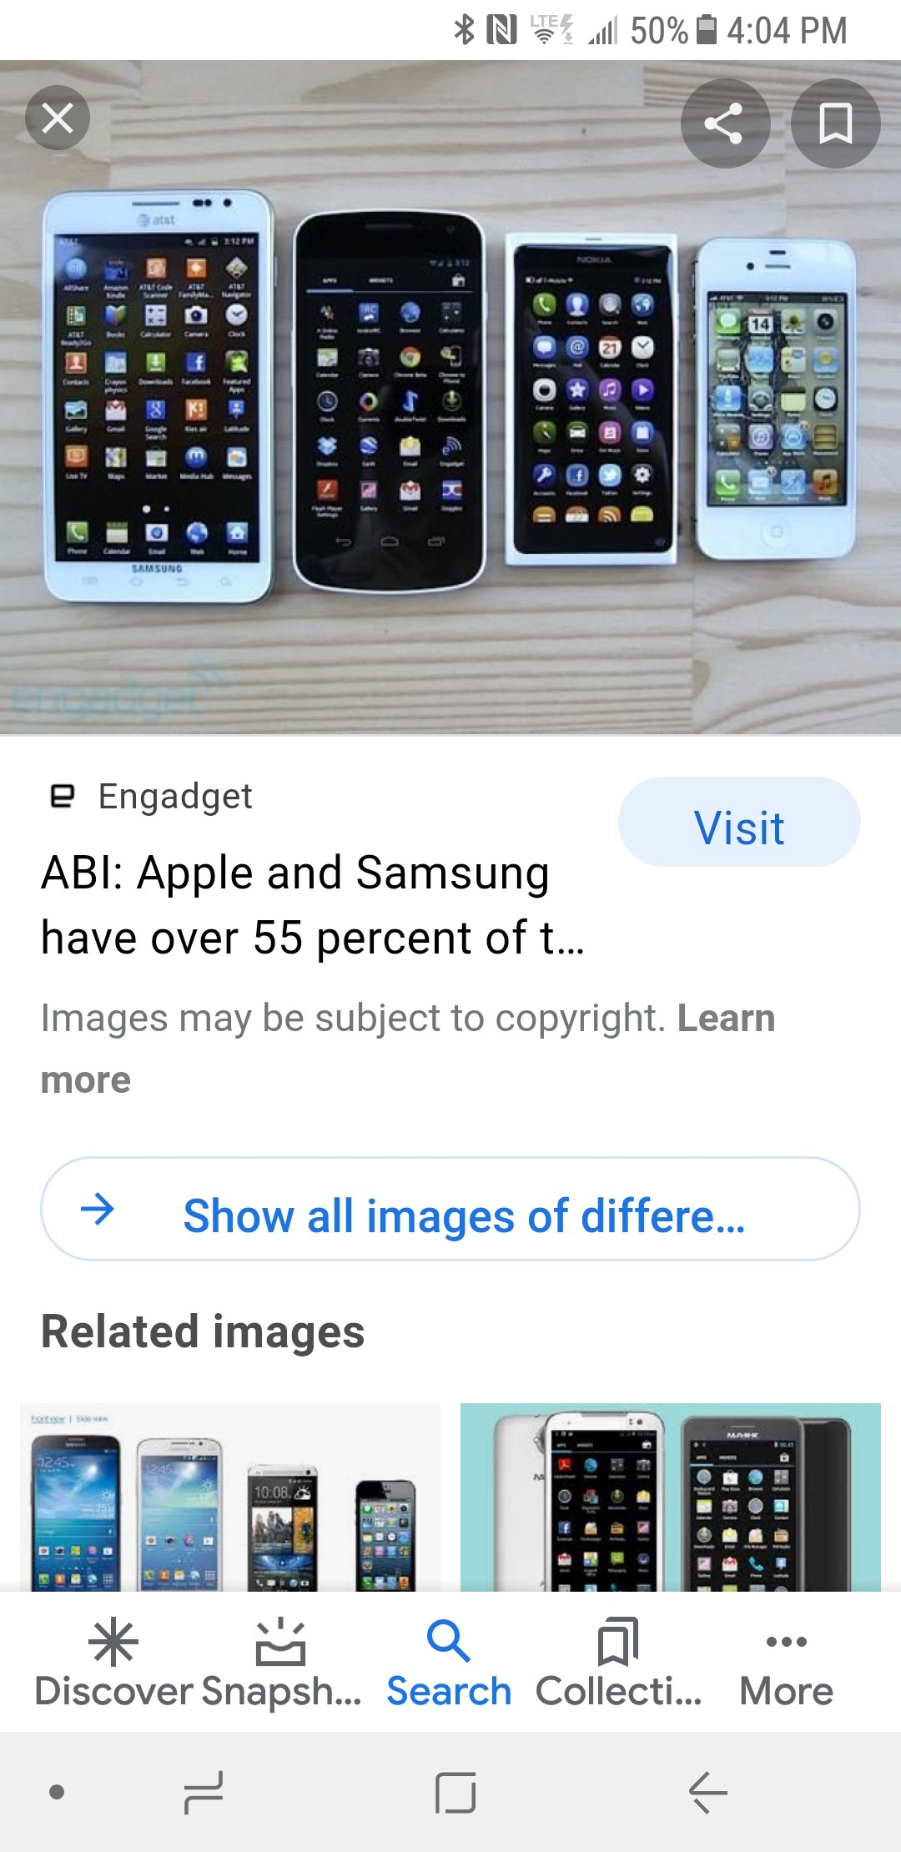
SEGMENT: 2 SETTING UP YOUR SMART PHONE TO PAIR WITH THE X35 MONITOR

Slide 15
PHONE SCREEN
DOWN LOAD XTEND APP TO YOUR SMART PHONE OR TABLET
NOW GO TO YOUR SMART PHONE OR I-PAD HOME SCREEN
(THIS IS ON A SAMSUNG GALAXY A8)

Slide 16
HOME SCREEN ON YOUR SMART PHONE
PRESS ON SETTING

Slide 17
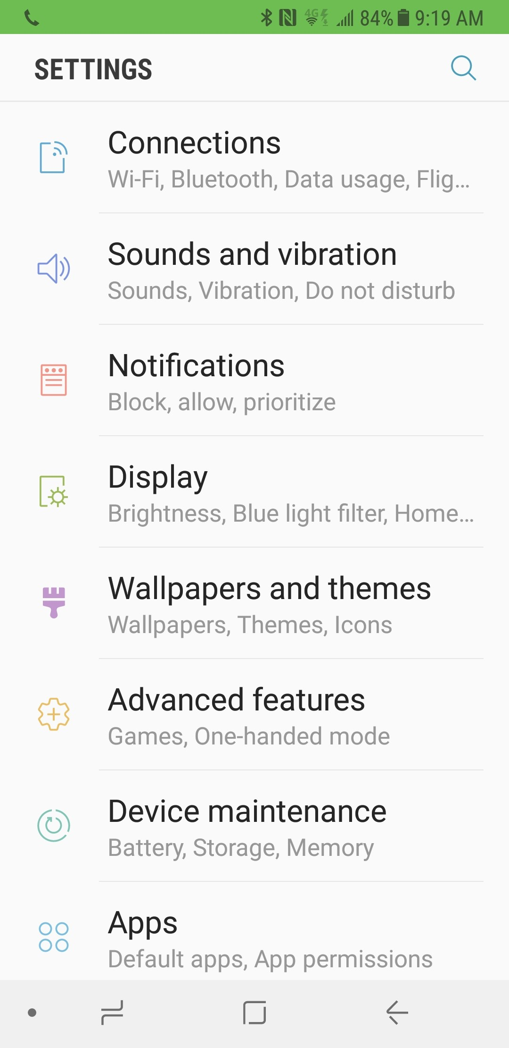
PHONE SCREEN
PRESS ON CONNECTION WINDOW
NOW OPEN YOUR CONNECTIONS WINDOW ON YOUR PHONE

Slide 18
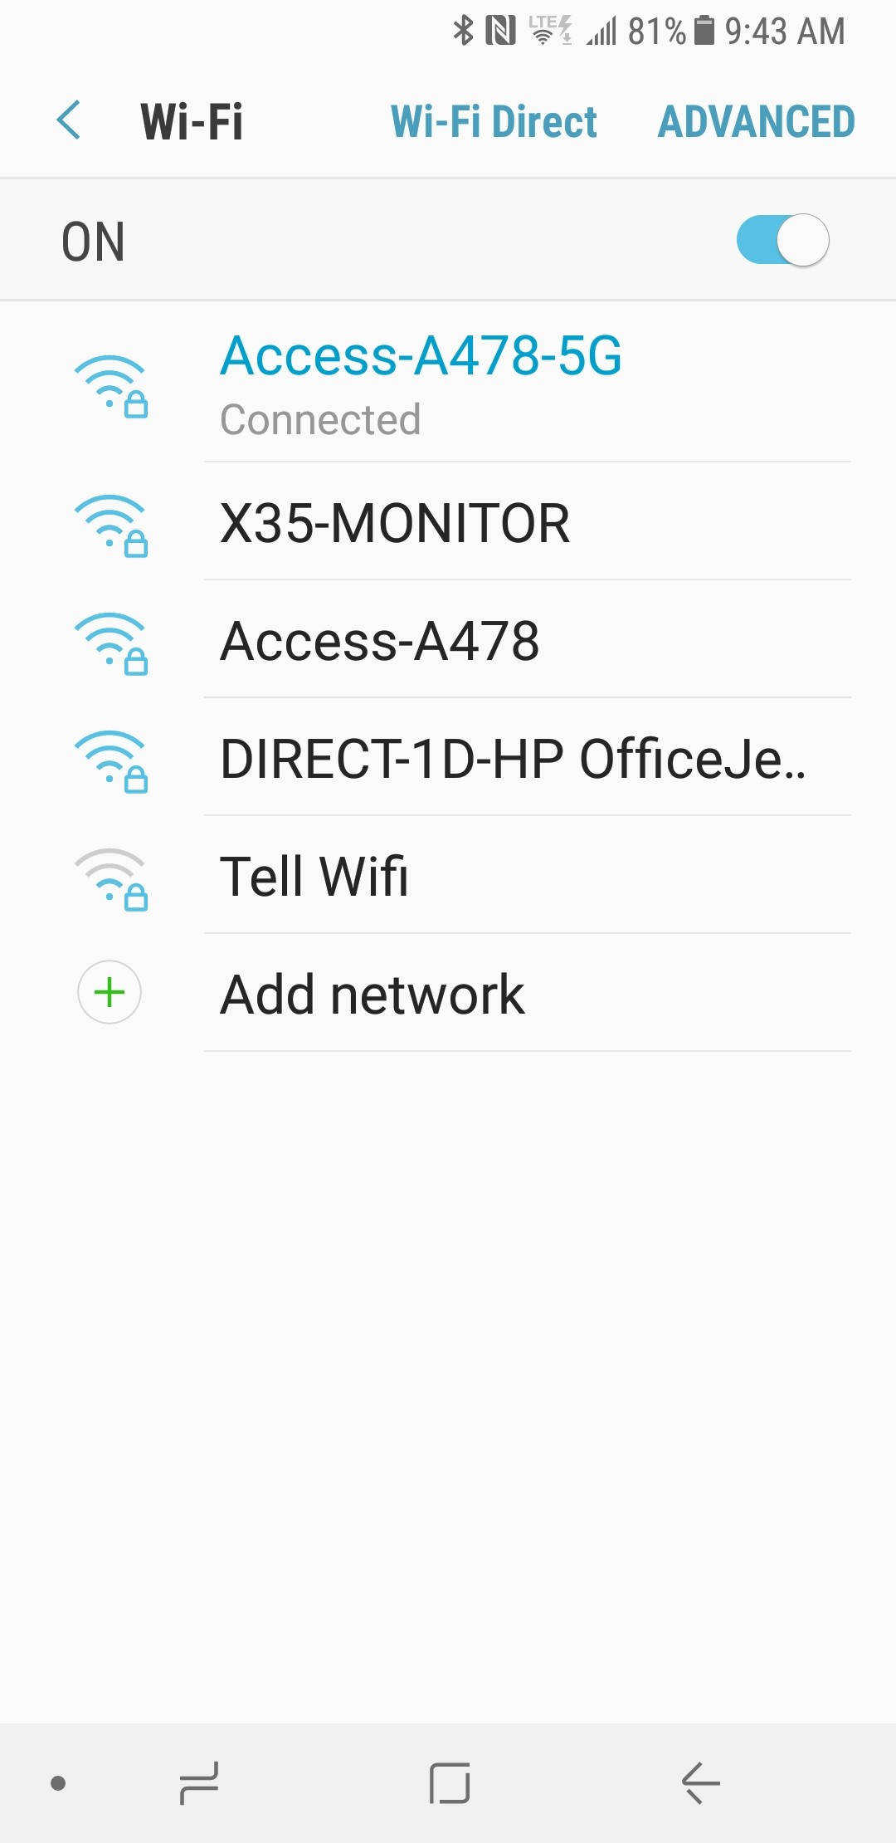
PHONE SCREEN
SELECT X35-MONITOR
NOW REMEMBER THE HOTSPOT IS ACTIVATED ON THE X35-MONITOR
THE X35-MONITOR WILL SHOW UP ON THE PHONE’S Wi-Fi list

Slide 19
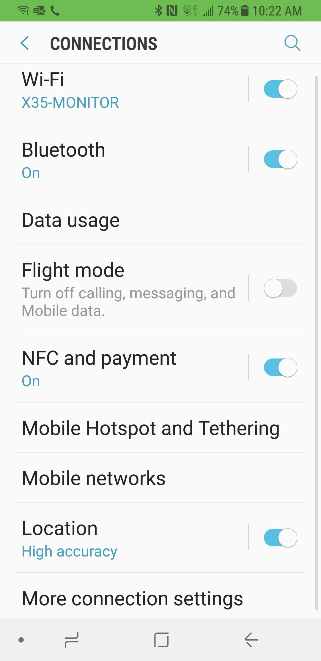
PHONE SCREEN
ONCE YOUR X35-MONITOR IS LOADED ON WI-FI CLOSE YOUR SETTINGS WINDOW AND GO TO YOUR HOME SCREEN WHERE YOU SAVED THE XTEND ICON

Slide 20
HOME SCREEN ON PHONE
SELECT XTEND ICON

Slide 21

PHONE SCREEN
THIS XTEND SCREEN WILL APPEAR

Slide 22
PHONE SCREEN
PRESS HERE ON THE NUMBERS

Slide 23
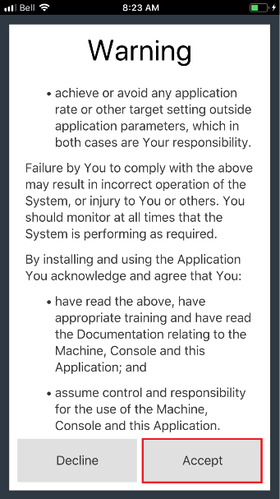
PHONE SCREEN
READ THE WARNING
ONCE YOU HAVE READ THE WARNING AND IF YOU AGREE PRESS ACCEPT
PRESS HERE

Slide 24
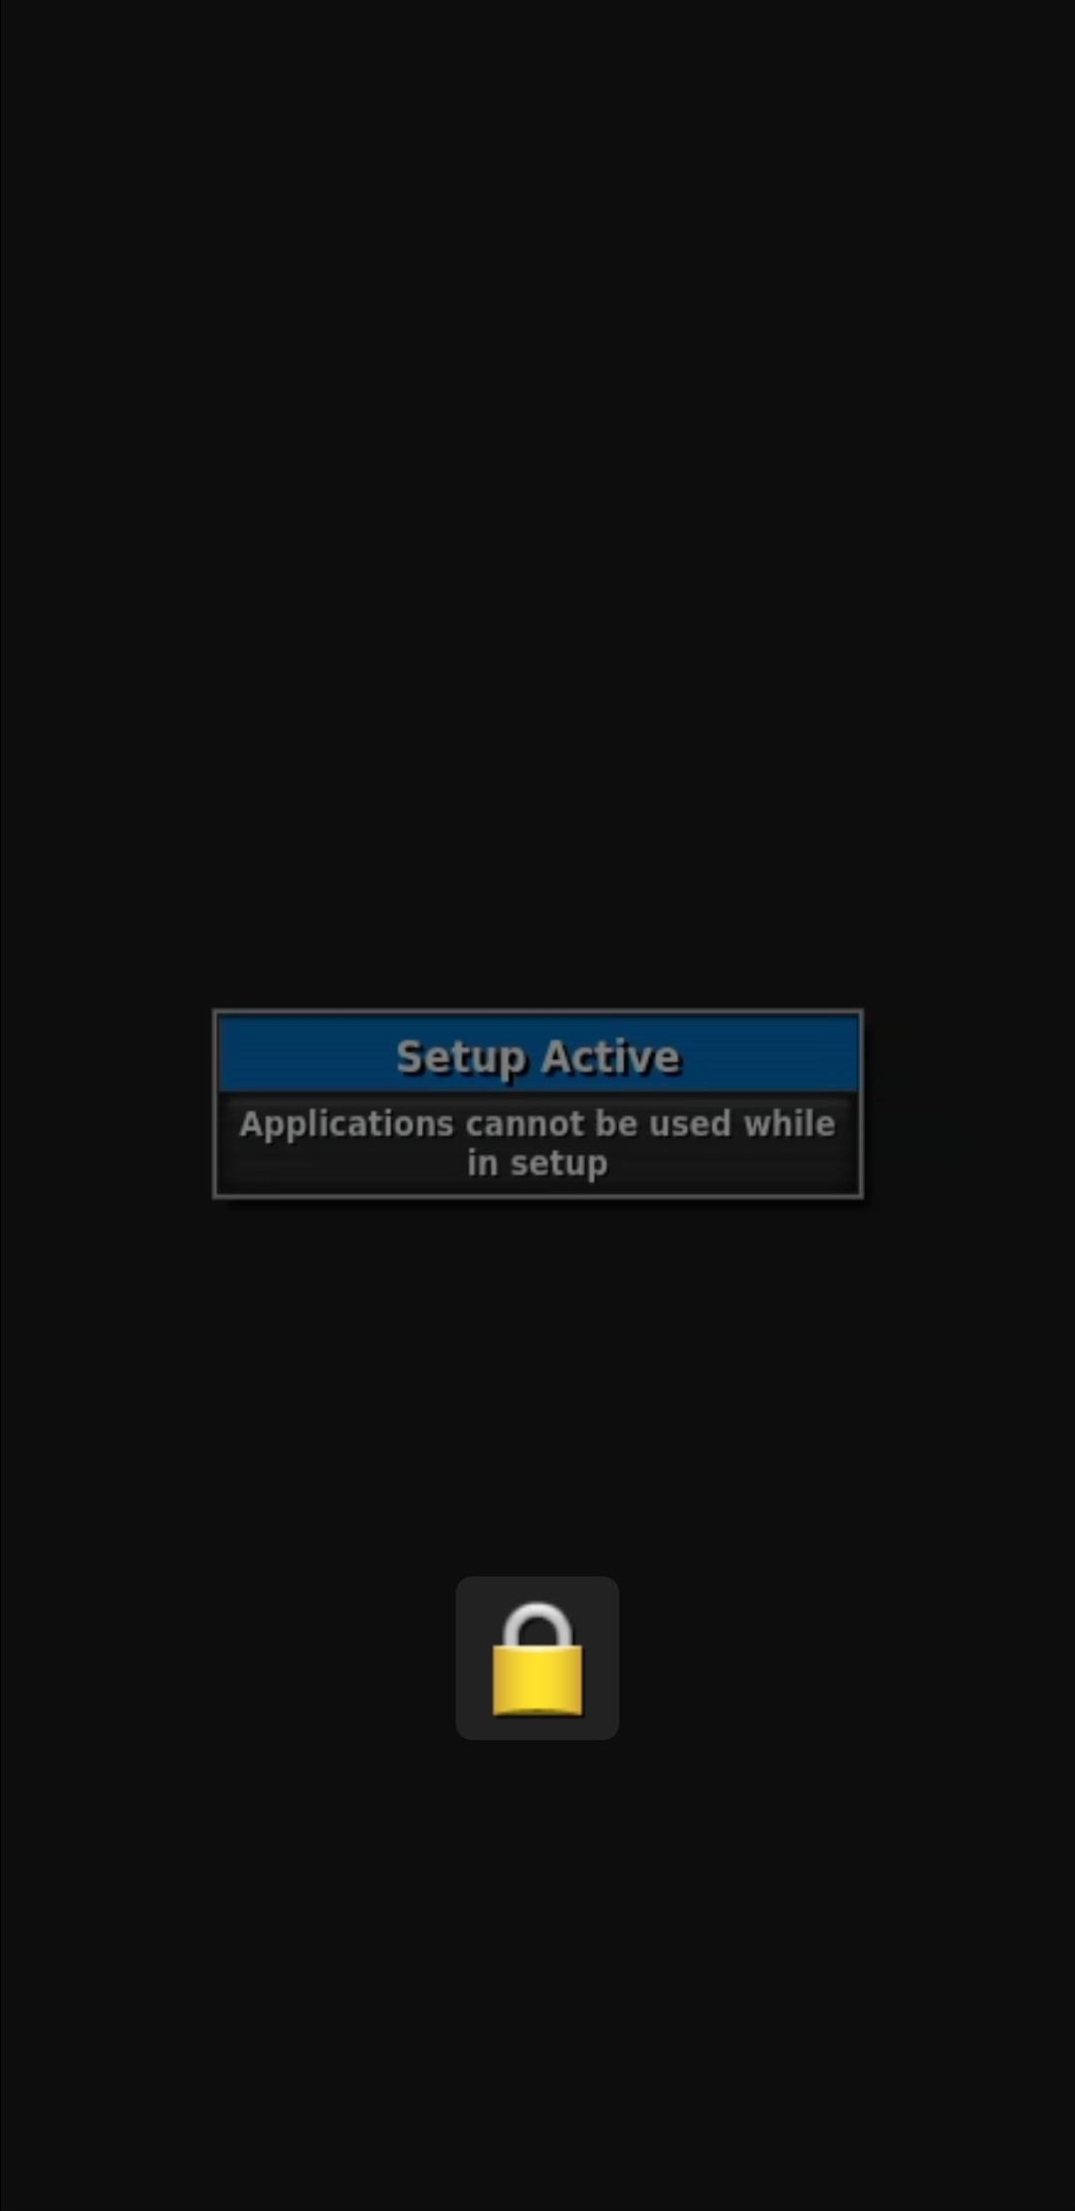
PHONE SCREEN
THIS IS TELLING YOU THAT YOUR X35 MONITOR IS STILL IN THE SETUP TREE, PRESS THE RUNNING MAN ON THE SETUP SCREEN ON YOUR X35 TO GO BACK TO THE RUN SCREENS

Slide 25
CONNECTION TYPE
Hotspot
X35-MONITOR
PRESS RUNNING MAN TO ENTER RUNNING SCREENS

Slide 26
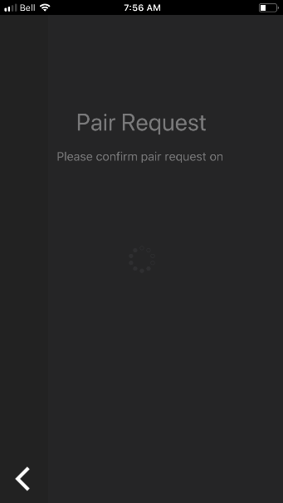
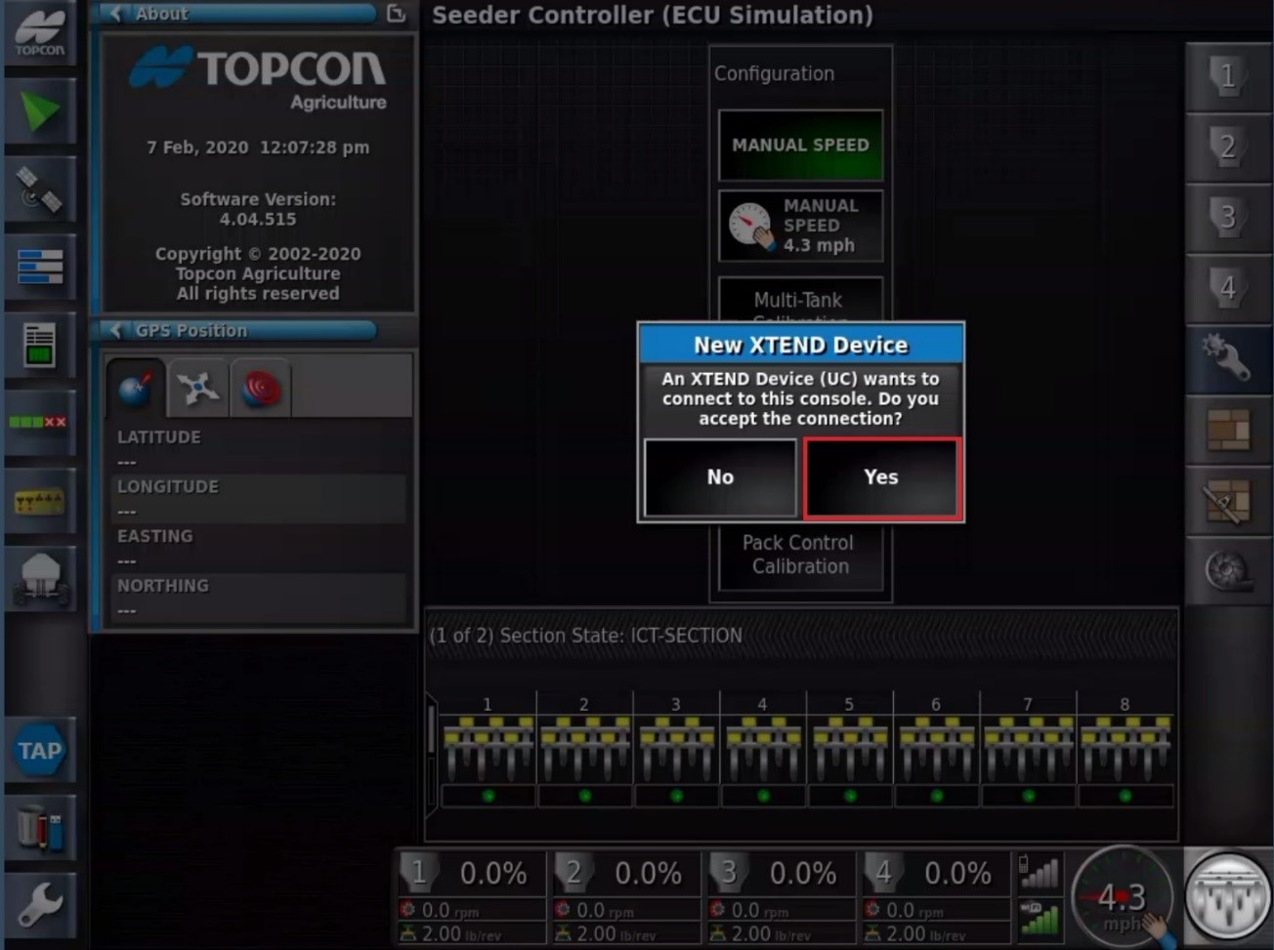
PHONE SCREEN
Pair Request means you need to acknowledge this on the X35 Monitor
X35 MONITOR SCREEN

Slide 27
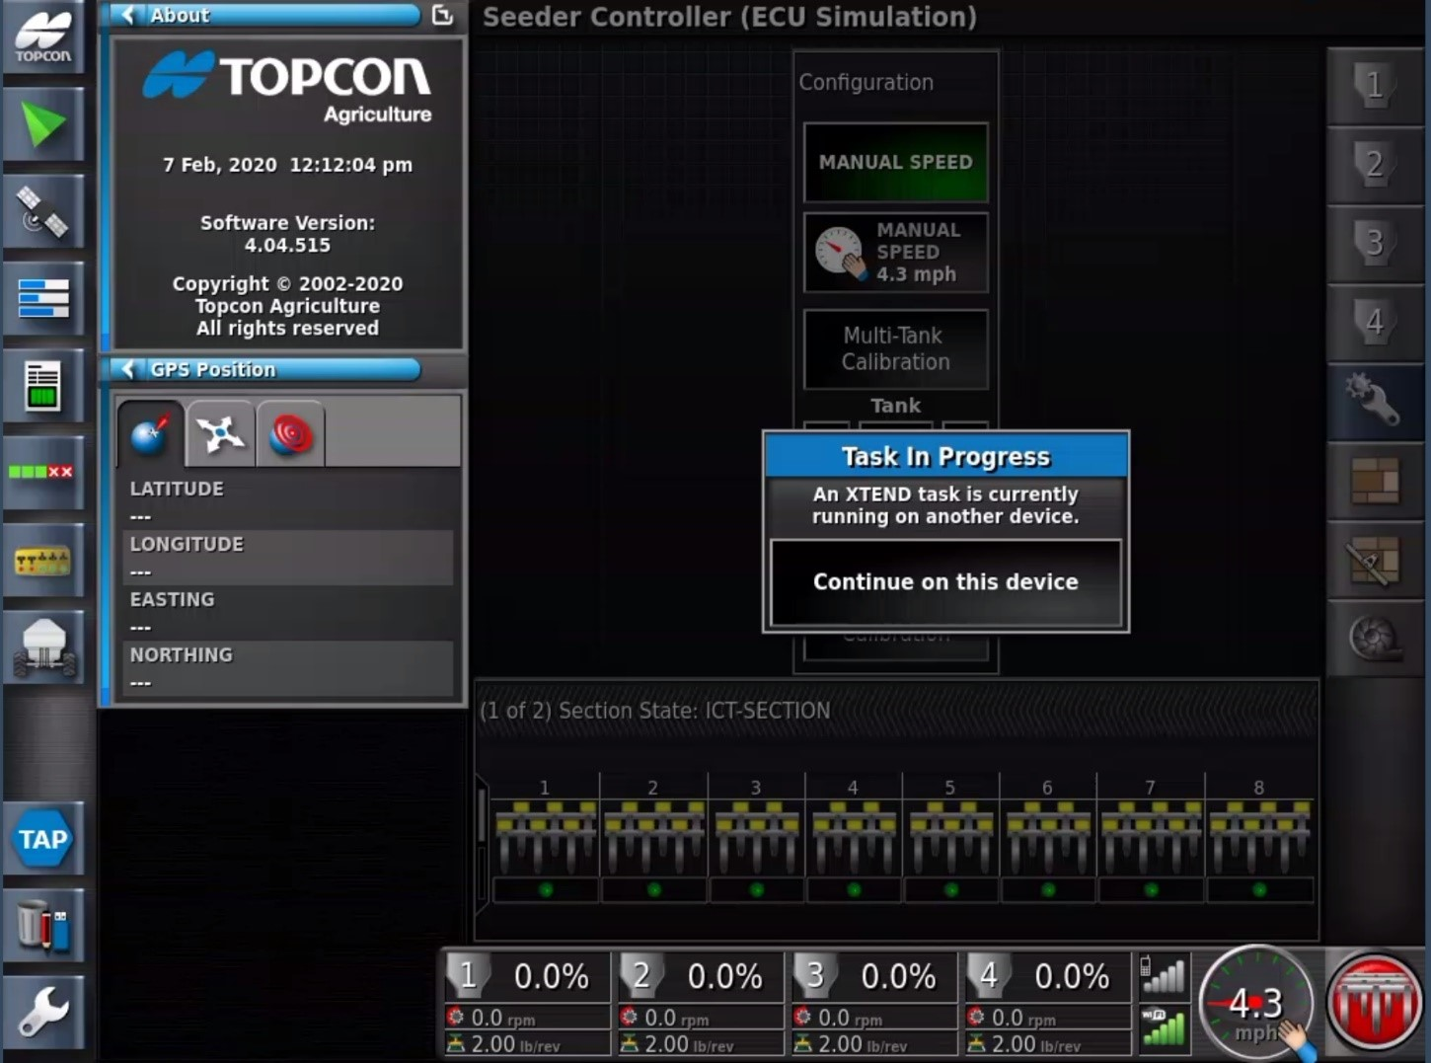
X35 SCREEN
This is telling you that the monitor is being controlled with XTEND on your smart phone

Slide 28
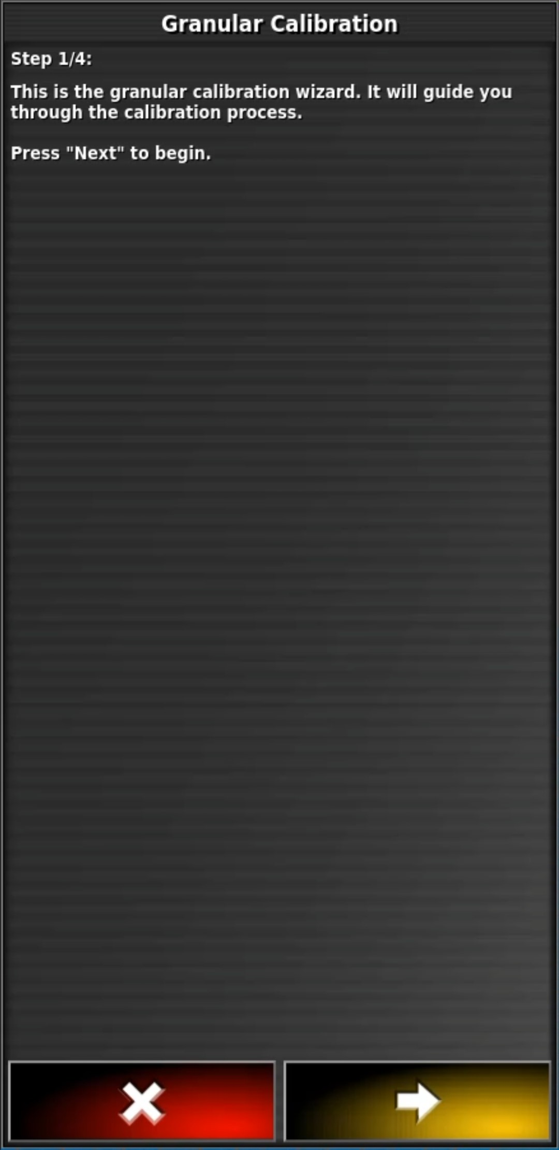
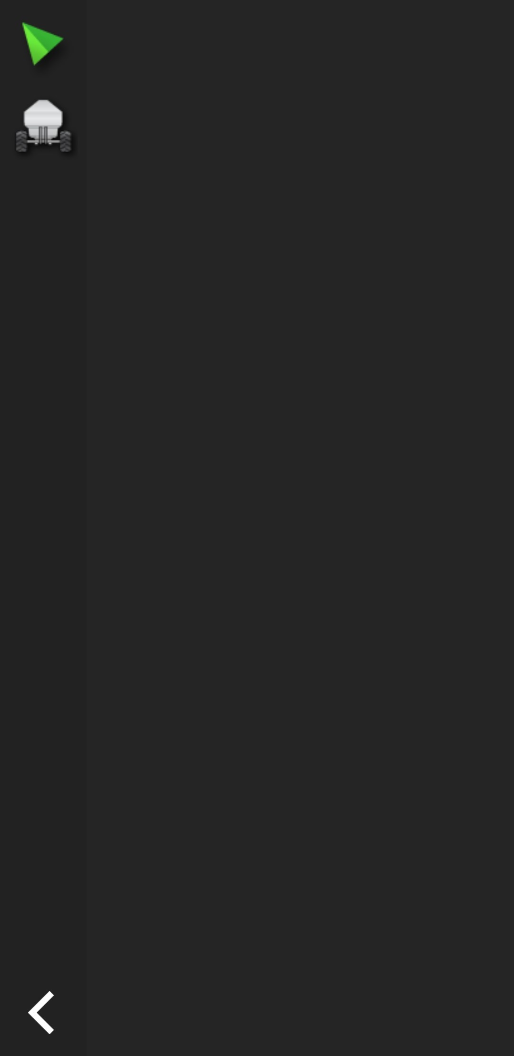
SEGMENT:3 USING EXTEND APP ON PHONE TO CALIBRATE

Slide 29
CHECK LIST BEFORE YOU FILL TANKS OR START CALIBRATING
1) Check seed plate setting before product is in the metering system you would have empty the metering system to change seed plate setting
2) Check the Collector body diverters these in to be in CLEAN OUT position for calibrating or you may damage the diverters
3) Make sure you have the hair pins in the correct position for the drive you require on each tank (DIRECT DRIVE OR SLOW SPEED)
4) Make sure you set your GEAR RATIO in your CALIBRATION SCREEN TO 2 for DIRECT DRIVE and SLOW SPEED TO 16

Slide 30
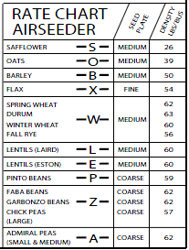
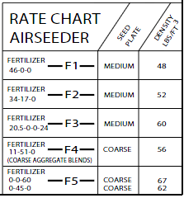
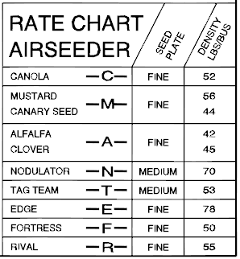
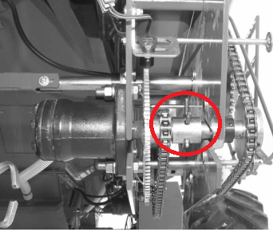
Before you can Calibrate you need to check a few setting
Seed plate setting what seed plate setting is needed FINE, MEDIUM, COURSE
Direct Drive
Slow Speed
CANOLA IS A SLOW SPEED SETTING
SHOWS DIRECT DRIVE HAIR PIN IS OFF THE HYDRUALIC MOTOR
Which Transmission setting do you need DRIECT DRIVE gear ratio 2 or SLOW SPEED gear ratio 16

Slide 31
PHONE SCREEN
OPEN THE XTEND APP

Slide 32
PHONE SCREEN
THEN THIS SCREEN WILL COME UP
PRESS ON THE TANK ICON

Slide 33
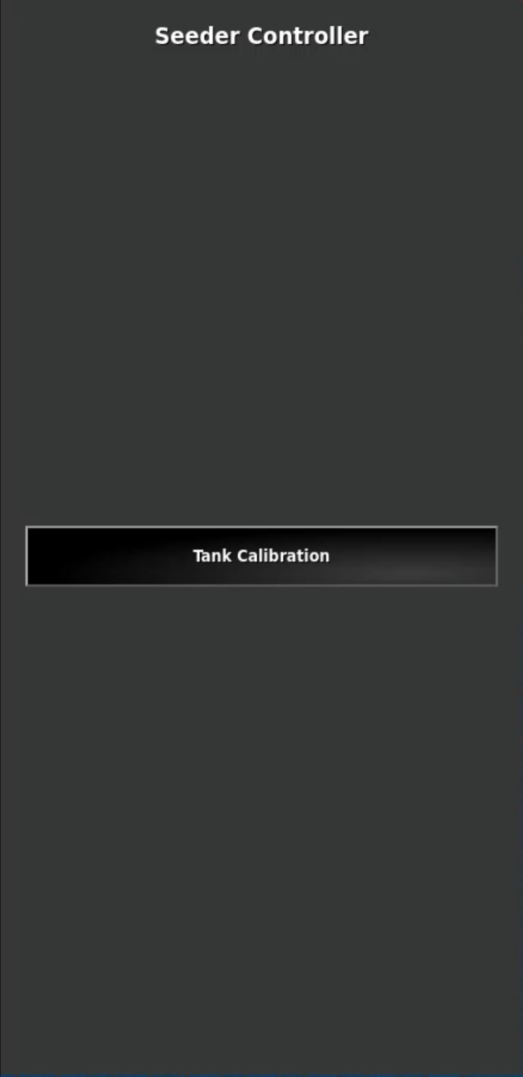
PHONE SCREEN
PRESS ON TANK CALIBRATION

Slide 34
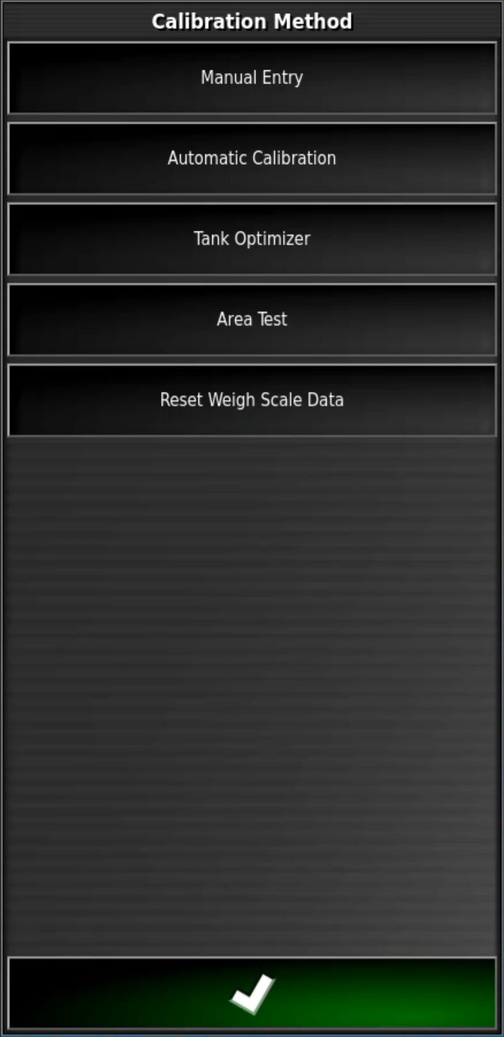
PRESS ON:
AUTOMATIC CALIBRATION
PHONE SCREEN

Slide 35
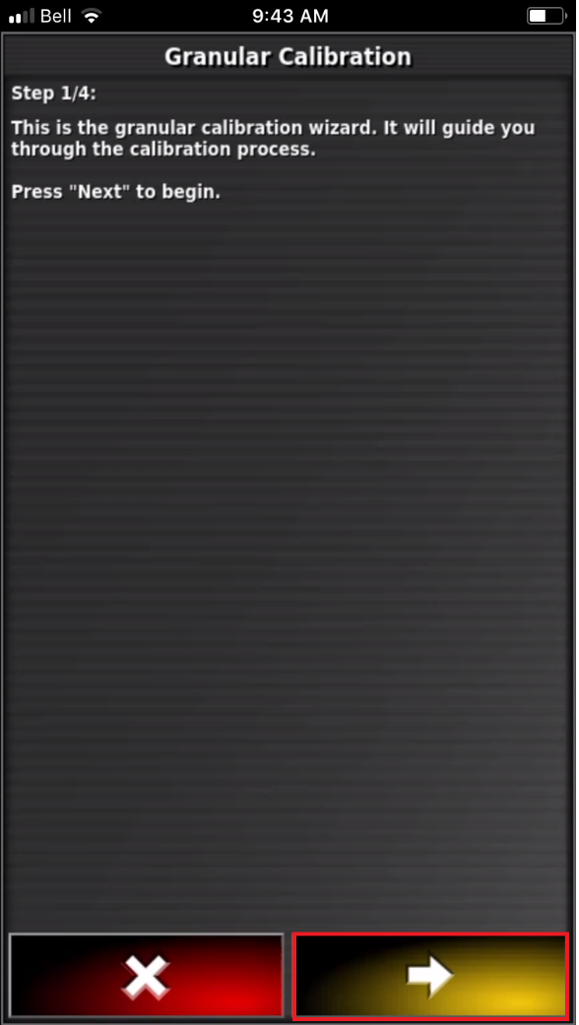
PHONE SCREEN
PRESS THE YELLOW ARROW TO PRCEED

Slide 36
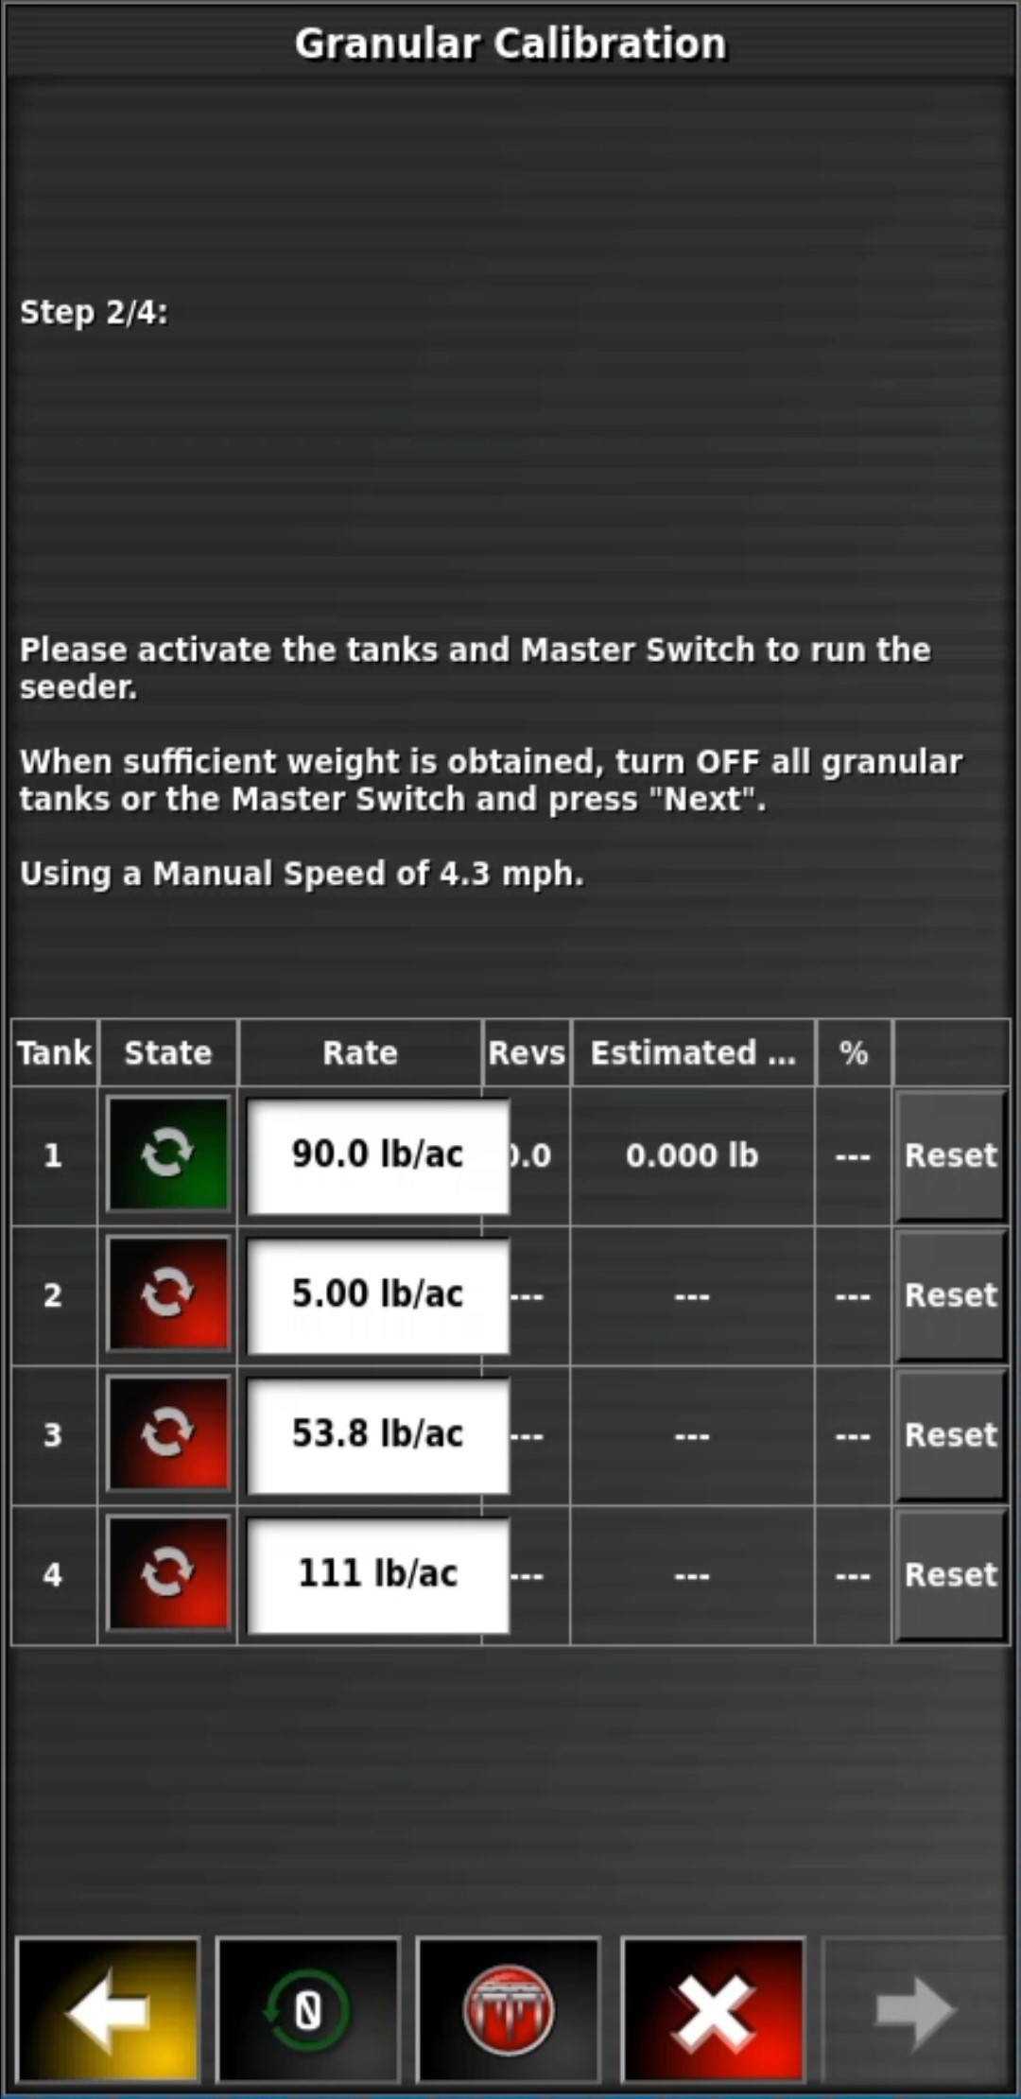
PHONE SCREEN ICONS
PHONE SCREEN
SET SEEDING RATE
Revs: number of revolutions the metering wheel made
Motor load %
ON/OFF STATE (ON\OFF ICON)
0
Estimated weight metered out
RESET ICON
MASTER SWITCH

Slide 37
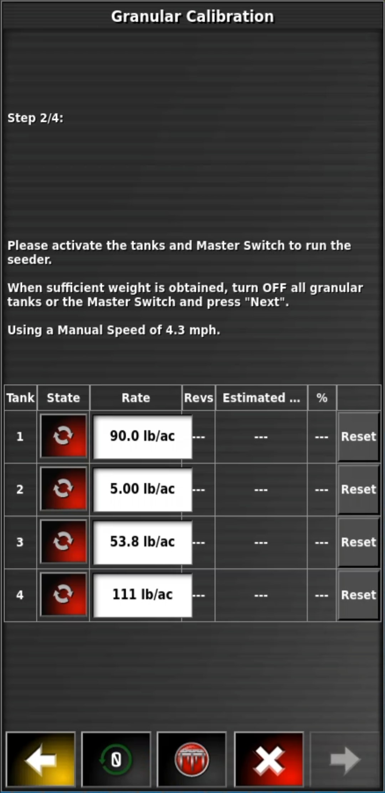


PHONE SCREEN
Enable the State of the Tank you would like to
Prime the Metering wheels EXAMPLE: TANK 1
GREEN IS ON
RED IS OFF

Slide 38
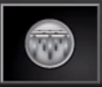
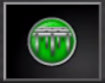
PHONE SCREEN
Metering is Active and is ready to discharge product. The Tank Preset 1 Rate will automatically be displayed
virtual Start / Stop
PRESS THE MASTER SWITCH ON
.
MASTER SWITCH WILL TURN GREEN WHEN ON

Slide 39
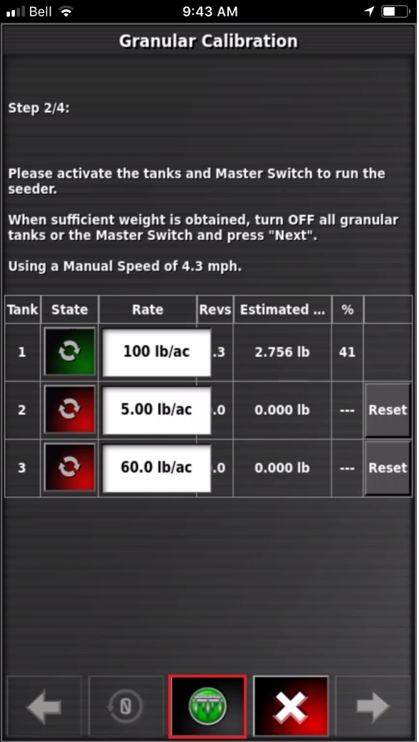

PHONE SCREEN
7.7
7.7
Start / Stop Key
Allow the metering to run for several rotations, stop the metering by pressing the MASTER SWITCH ICON
ONCE THE METERING IS OFF EMPTY THE CALIBRATION COLECTOR BOX

Slide 40

PHONE SCREEN
Reset Icon.
Clear the priming data by pressing the REST ICON
This resets your Revs, Estimated weight so your ready to start a calibration

Slide 41
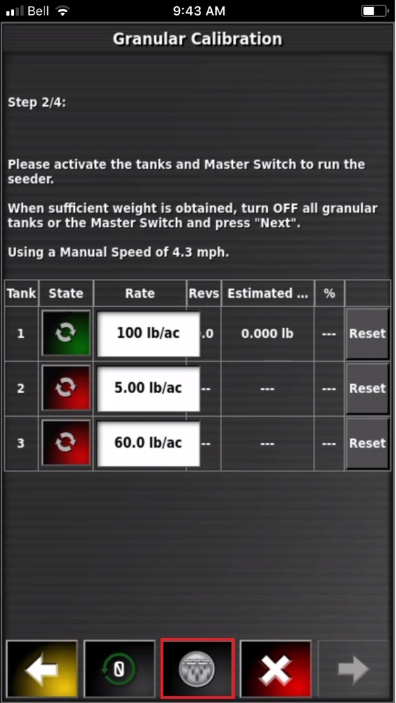
PHONE SCREEN
Now we will do a calibration, metering wheels are primed
90.00
00
0
0
Turn the metering system ON by pressing the MASTER SWITCH

Slide 42
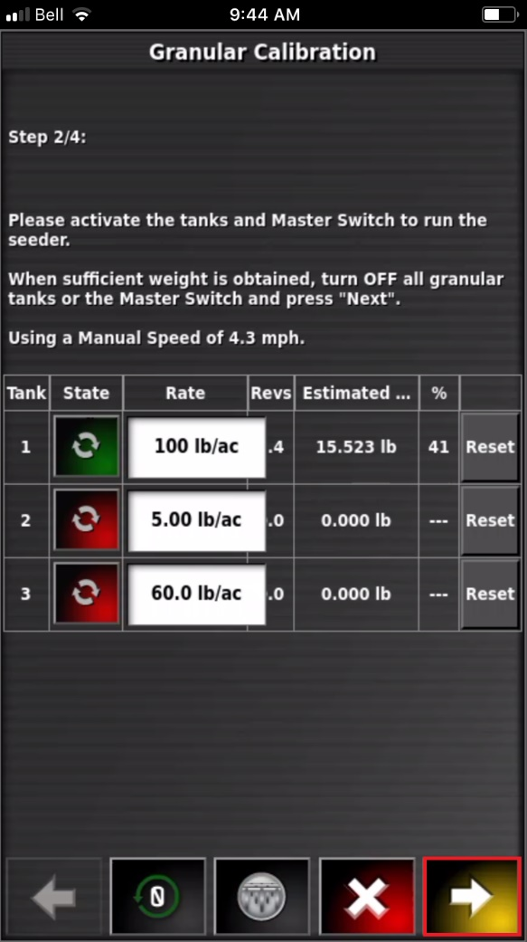
PHONE SCREEN
ESTIMATED WEIGHT
15.523LBS.
SET RATE 90.00 LBS/AC
NOW WE REMOVE THE CALIBRATION COLECTOR BOX AND WEIGH THE PRODUCT
90.00
10
15.523
REVOLUTIONS OF METERING WHEELS 10

Slide 43
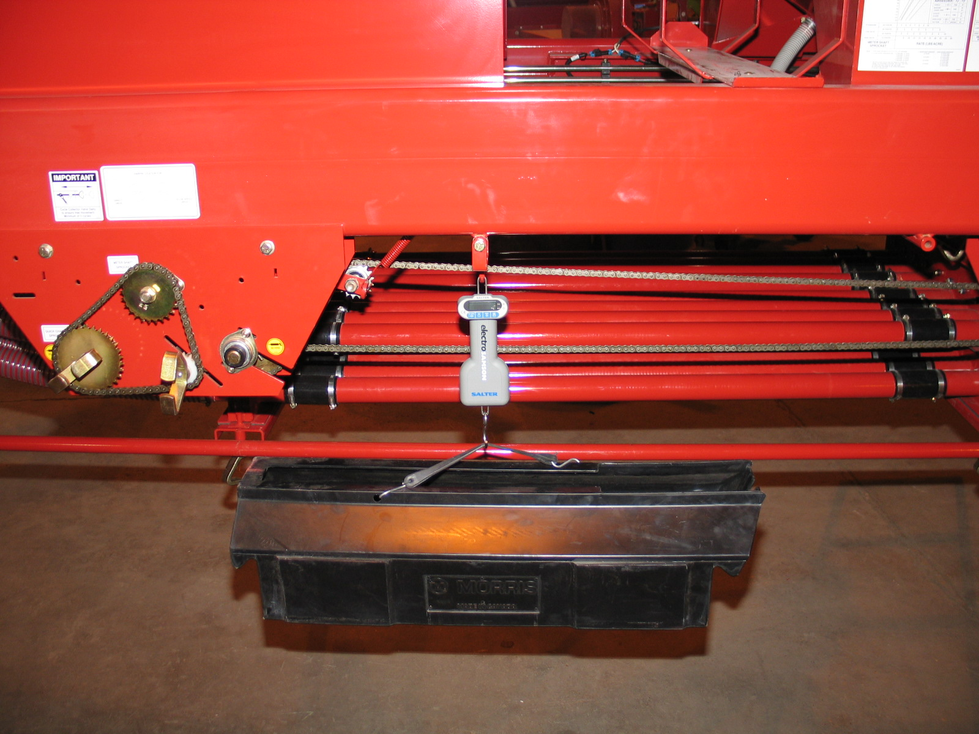
PRODUCT WEIGHT 15.523 LBS
15.523

Slide 44
90.00 lb/ac
10
PRESS ON THE FORWARD ARROW

Slide 45
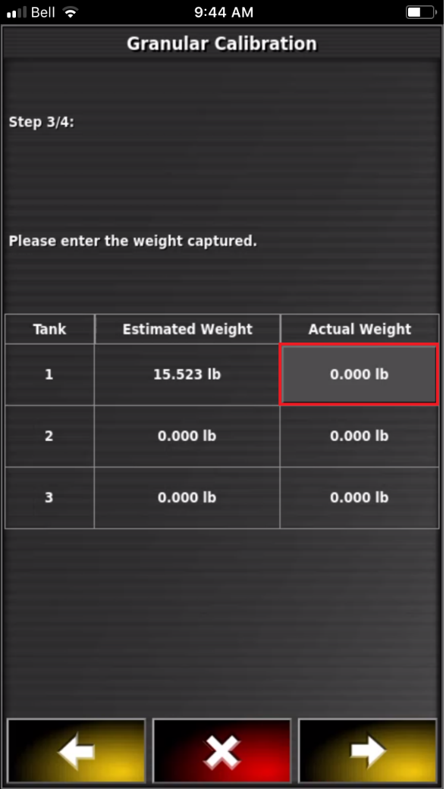
PRESS ON 0.000 LB UNDER ACTUAL WEIGHT

Slide 46
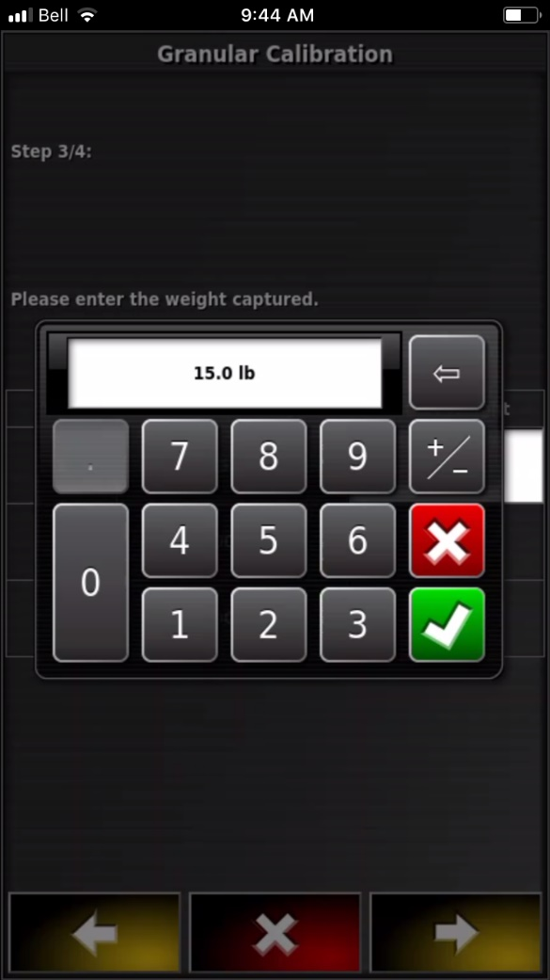
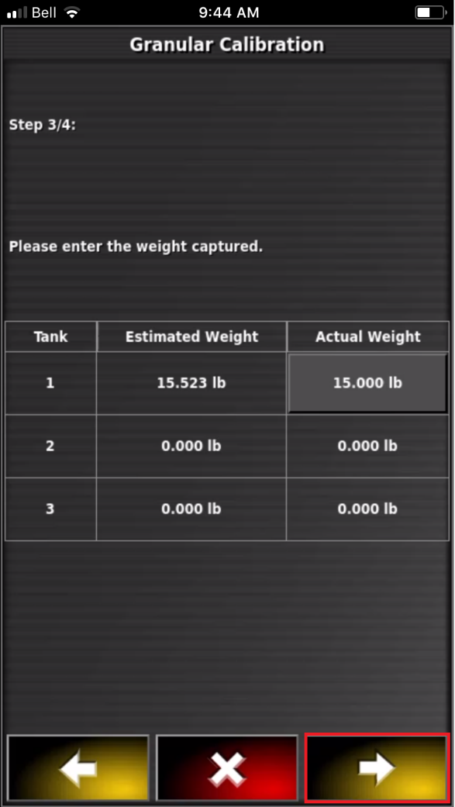
Enter the actual weight from the scale display 15.523 lbs., Followed by the Green Checkmark
15.523
Review the information entered is correct, proceed to the next screen by pressing the Yellow Forward arrow

Slide 47
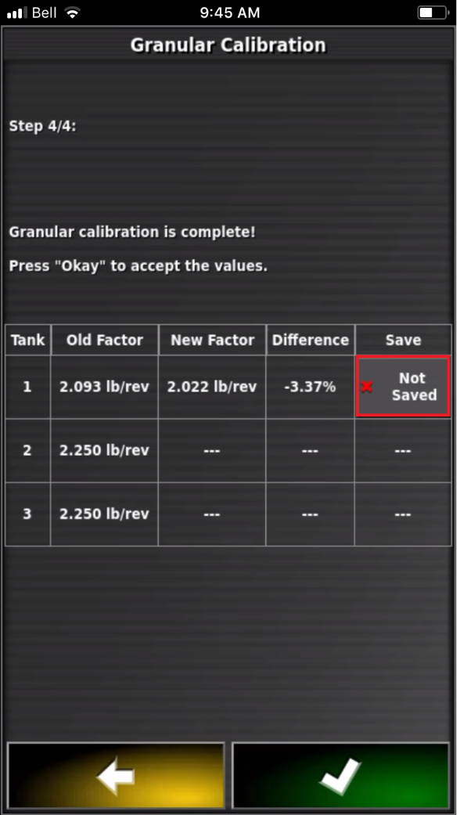
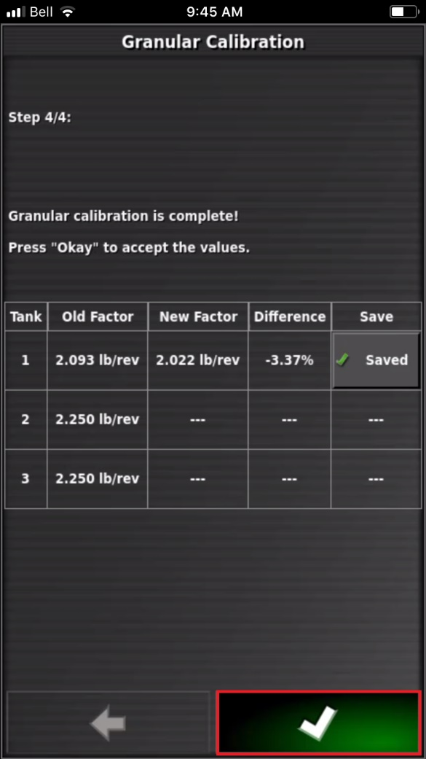
PRESS ON NOT SAVED
WILL CHANGE TO SAVED
THEN PRESS THE
GREEN CHECK MARK

Slide 48
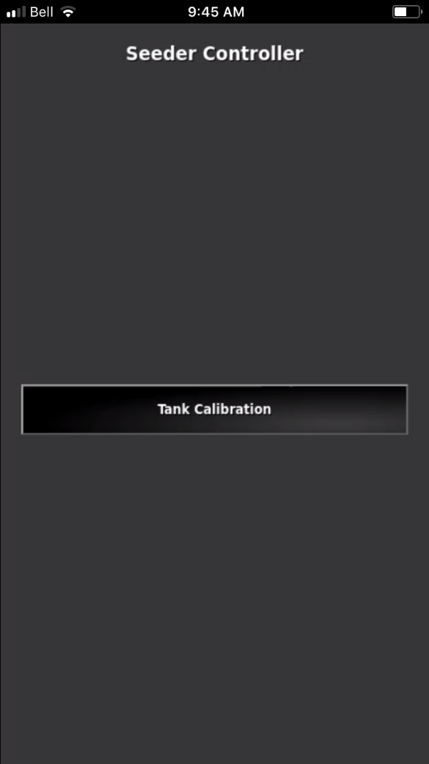
Repeat the Calibration procedure until you are satisfied with the results. It is recommended to repeat the calibration procedure 2 more times or 3 times per tank to fine tune and verify the calibration factors are accurate
Repeat the Calibration procedure on the remaining tanks.

