Slide 1
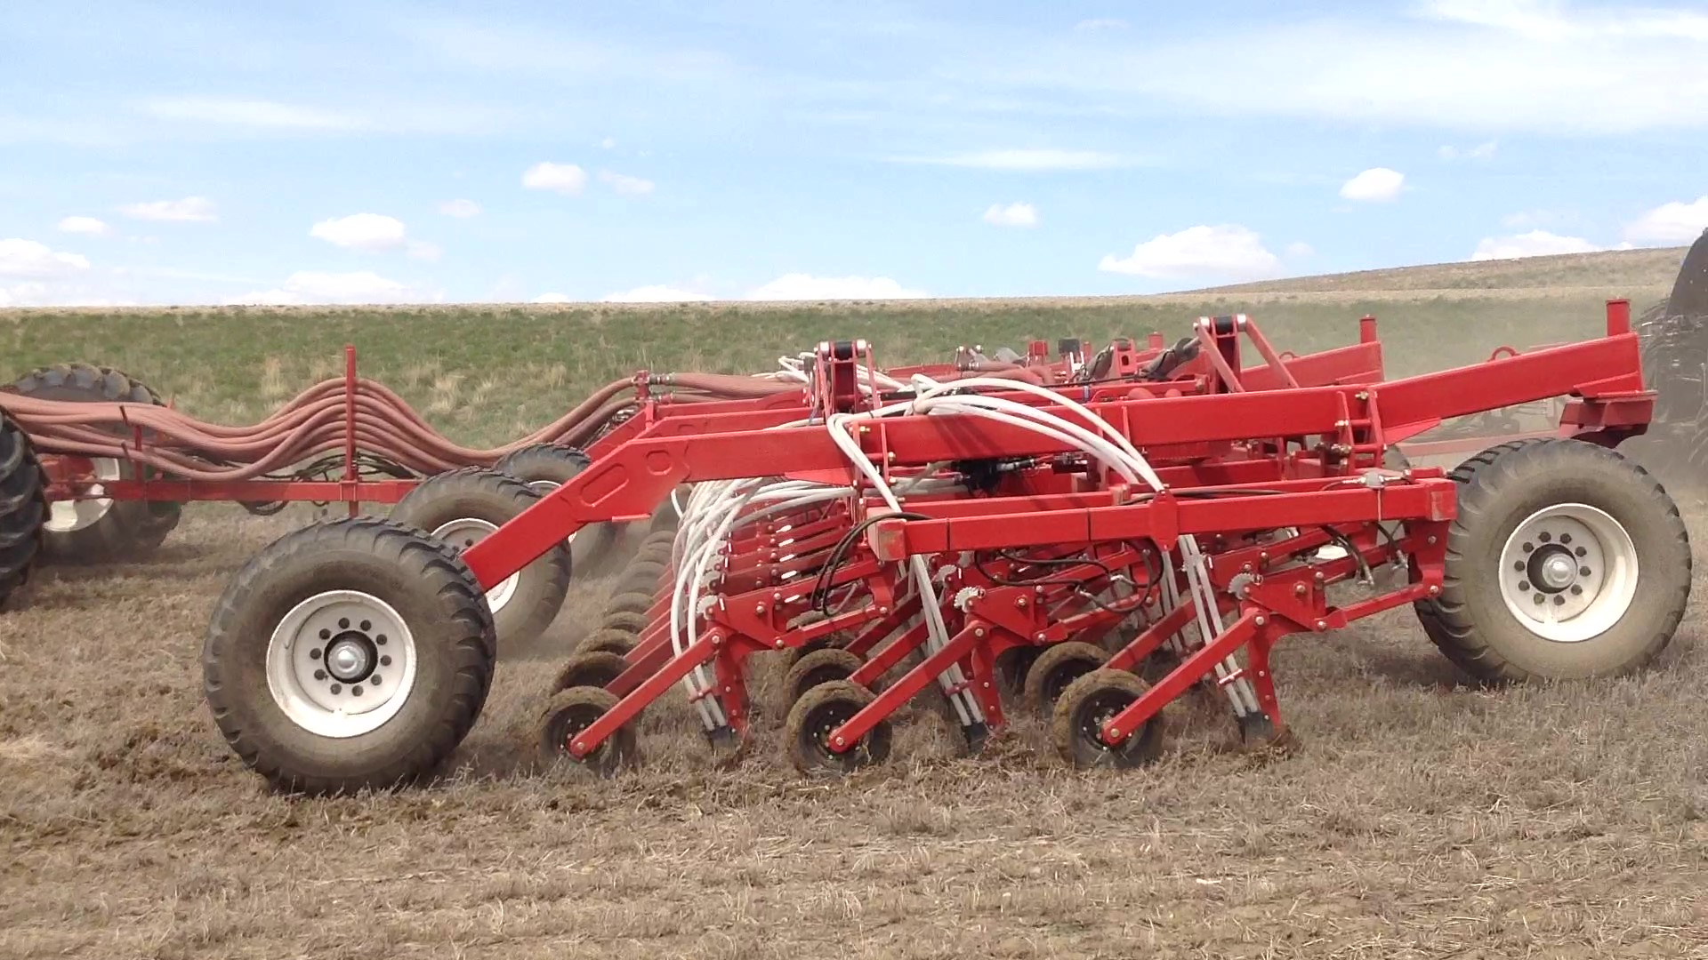

2021 Morris Training
Section 6
1) Seeding

Slide 2
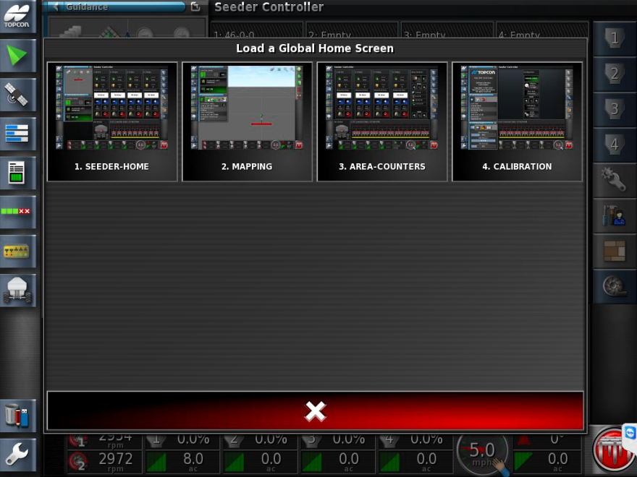
Select MAPPING

Slide 3
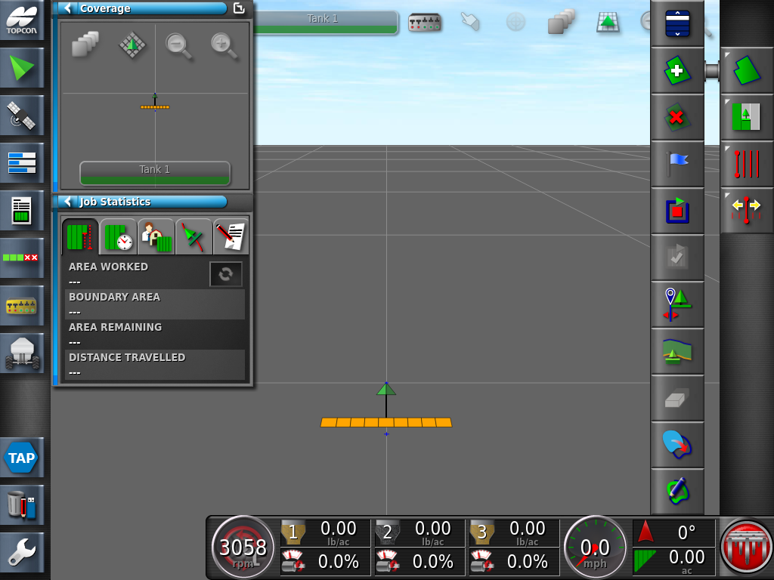


Open the Field Menu icon
Followed by the Select Field

Slide 4
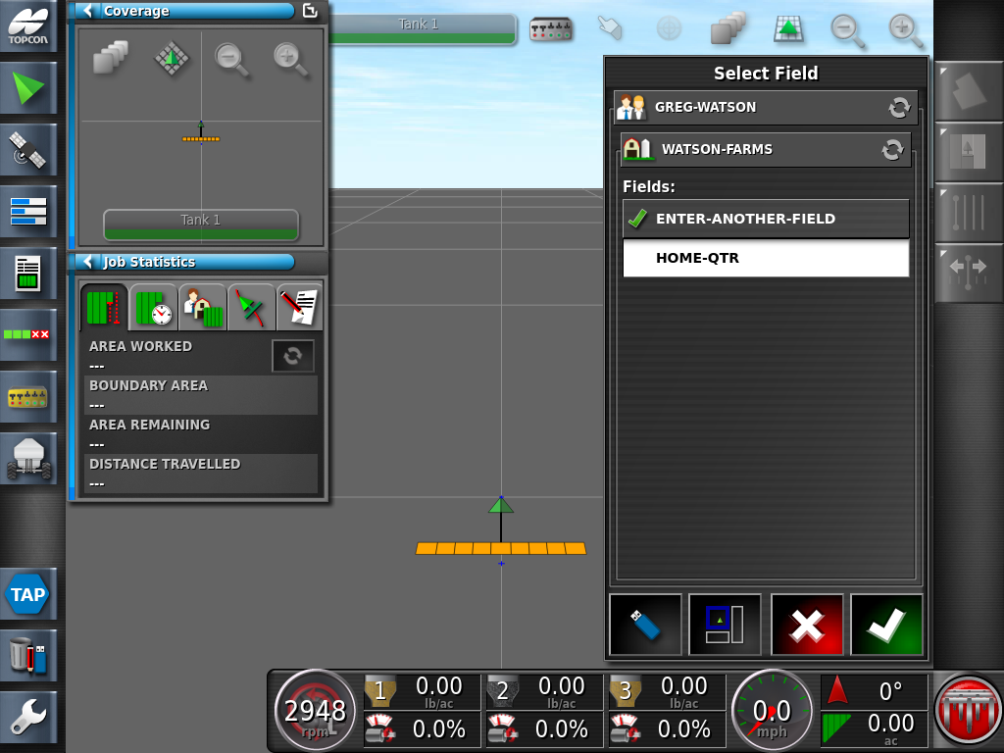
Select the Field you wish to seed. Press the Green Check Mark to apply the settings

Slide 5


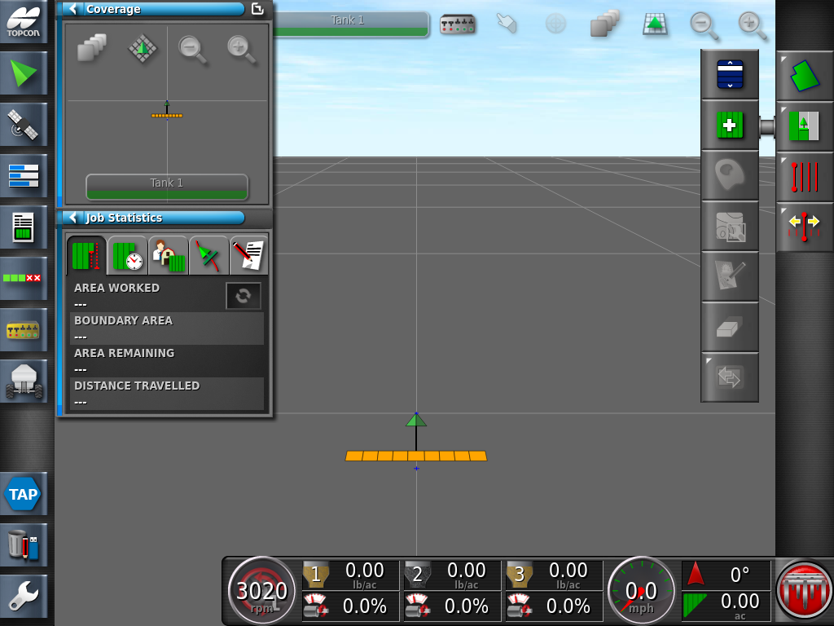
Press the Job menu icon , and followed by the Create New Job icon

Slide 6
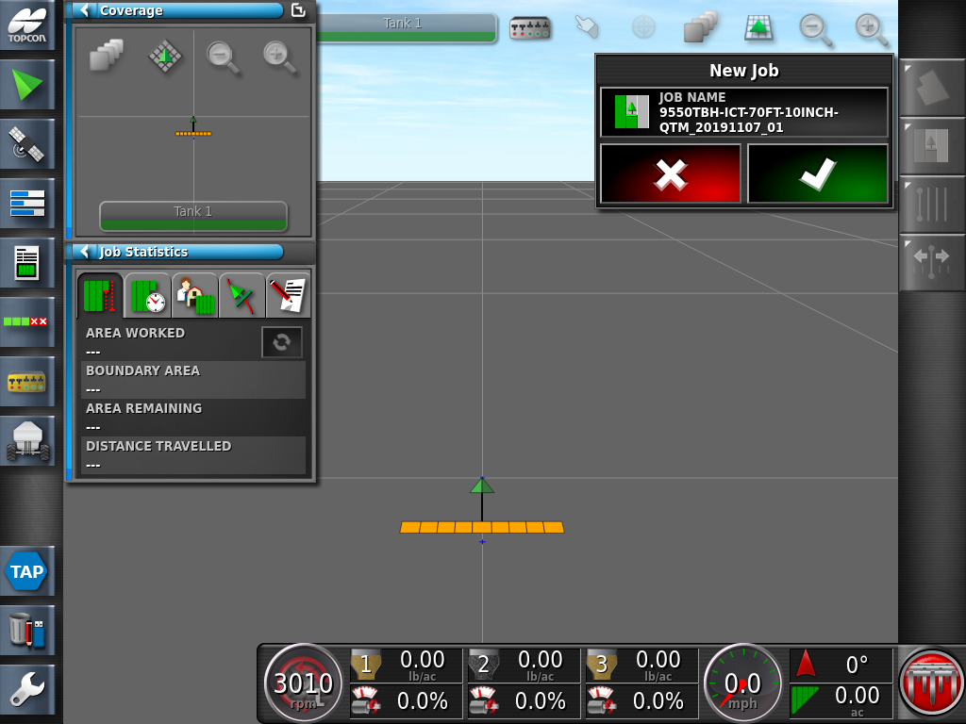
Use the provided or create a new Job Name select the Green Check Mark

Slide 7
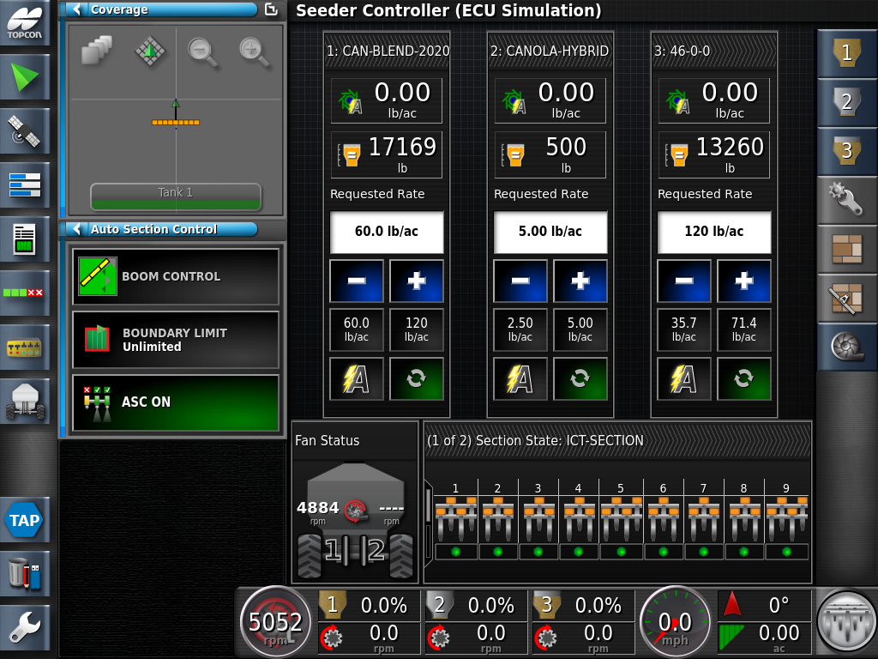
Return to the Seeder Home screen. Ensure the following items are checked before Engaging the Master Switch.
1. TURN ON ALL TANKS
4. RATES ARE SET CORRECTLY
2. ASC ON
5. GROUND SPEED IS PRESENT
3. FAN SPEED IS PRESENT
6. MASTER SWITCH

Slide 8
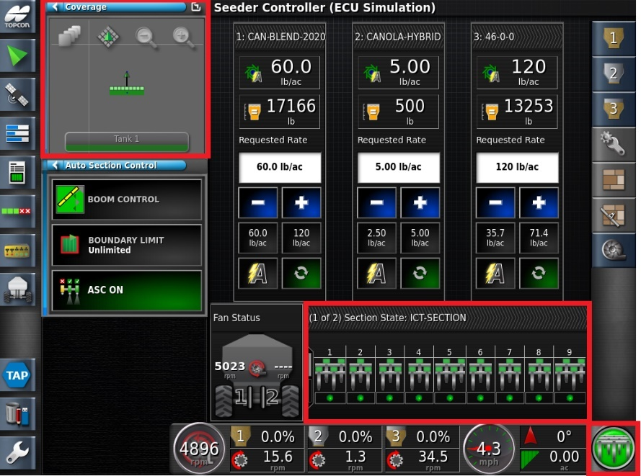
The following icons on the Seeder Home screen will change colors when the Master Switch is active. Green Seeding
Note: There is a several second delay for features on the screen to change to the colour green, this is based on the transition time of the product from the metering wheels to the openers.

Slide 9
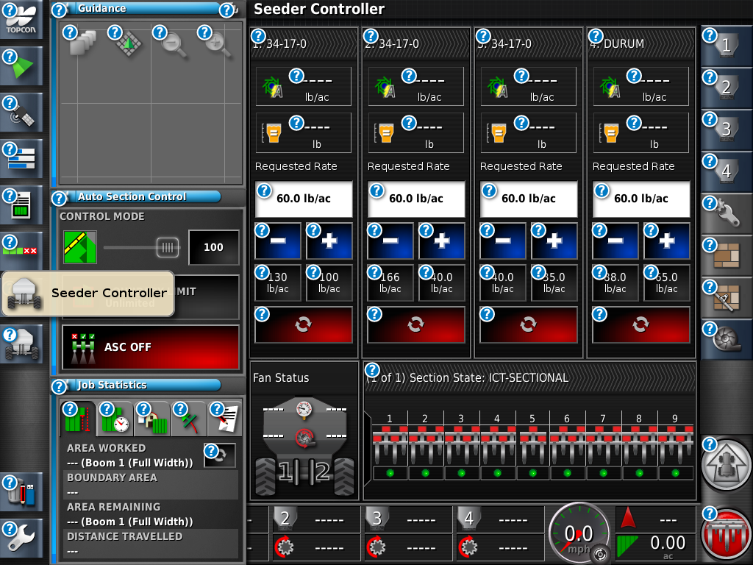
The following icons on the Seeder Home screen will change colors when the Master Switch is active. Yellow Ready to Seeding
Note: There is a several second delay for features on the screen to change to the colour yellow, this is based on the transition time of the product from the metering wheels to the openers.

Slide 10
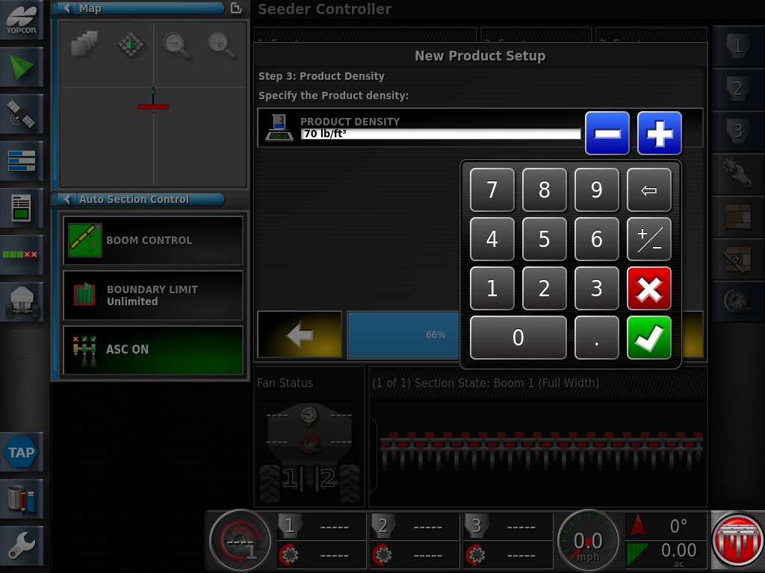
The following icons on the Seeder Home screen will change colors when the Master Switch is active. Red Not Seeding
Note: There is a several second delay for features on the screen to change to the colour red, this is based on the transition time of the product from the metering wheels to the openers.

