Slide 1
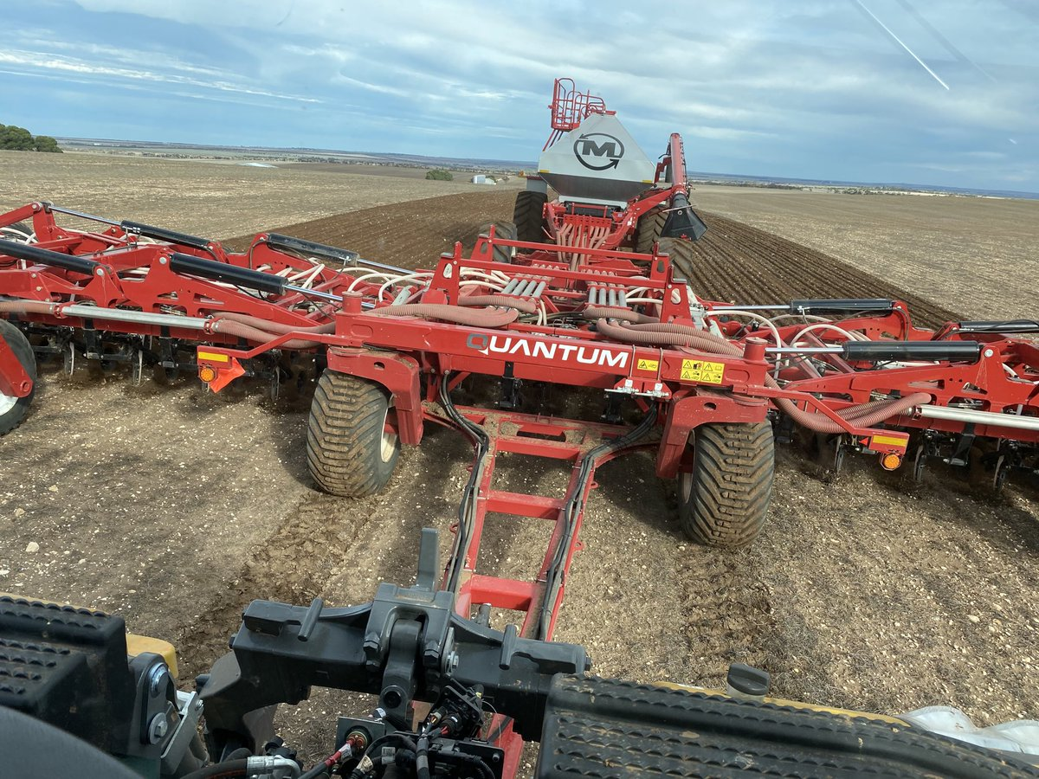

Boundary / Headland
Section 7
1) Setting Boundary/ Headland

Slide 2
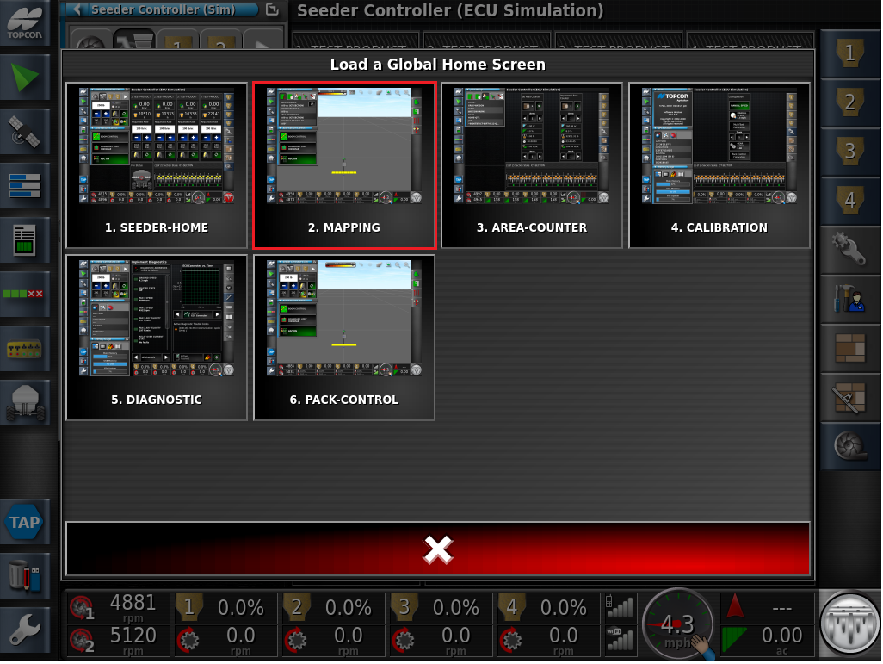
From Global Home Screen-Select MAPPING

Slide 3
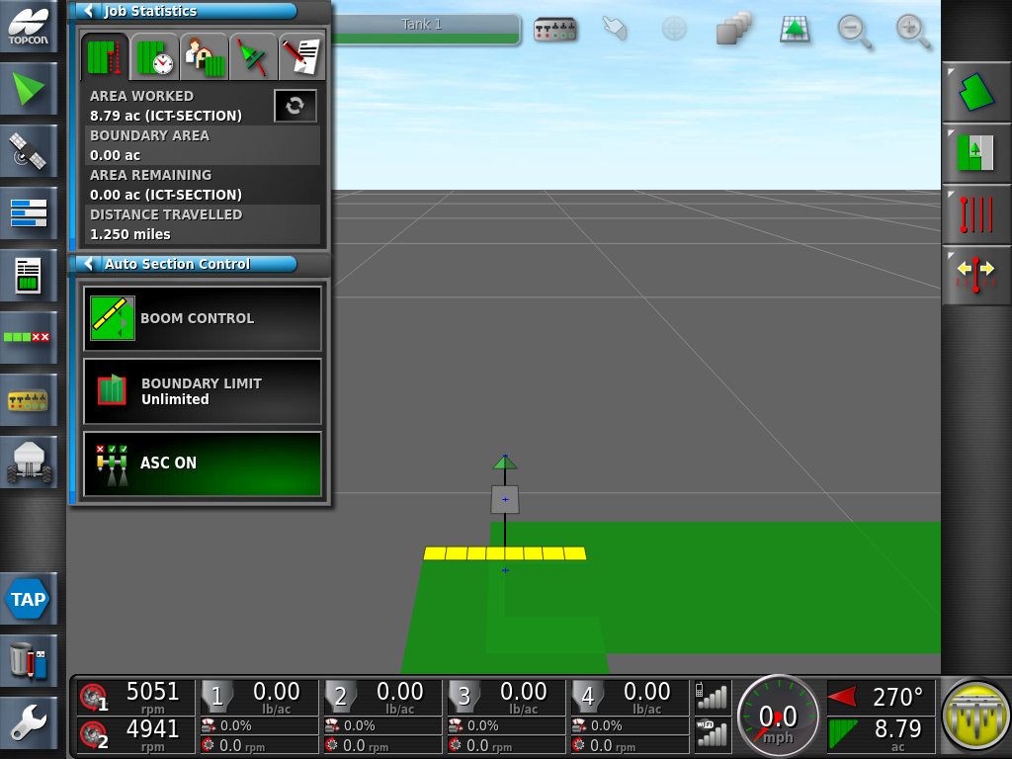
Proceed to create your first headland pass. Once the outside pass is competed, drive straight into the treated area, we want a closed perimeter of coverage.

Slide 4

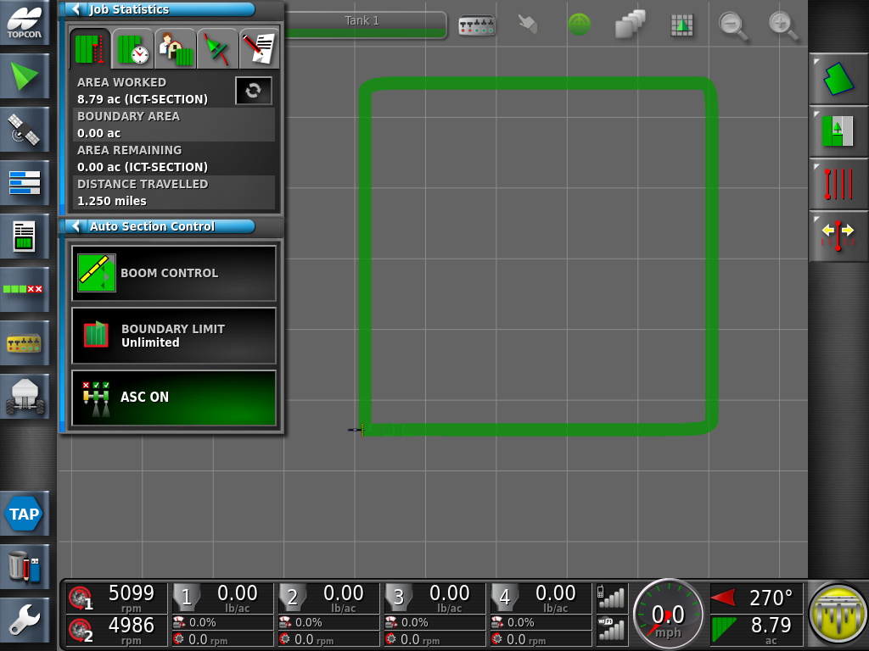
Toggle the Map to the overhead view
Note: how the head pass is a closed loop of coverage, we cannot have any open gaps

Slide 5


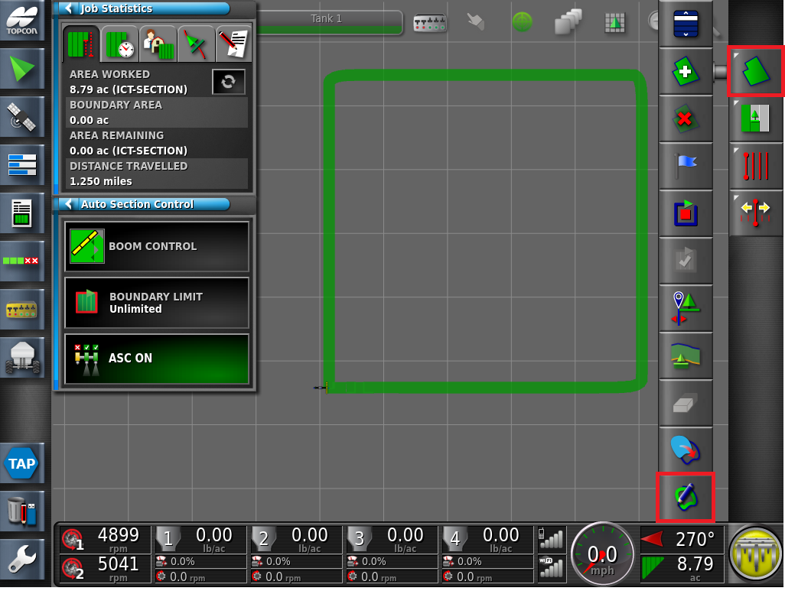
Press the Field icon followed by the Create Boundary from Coverage Icon

Slide 6
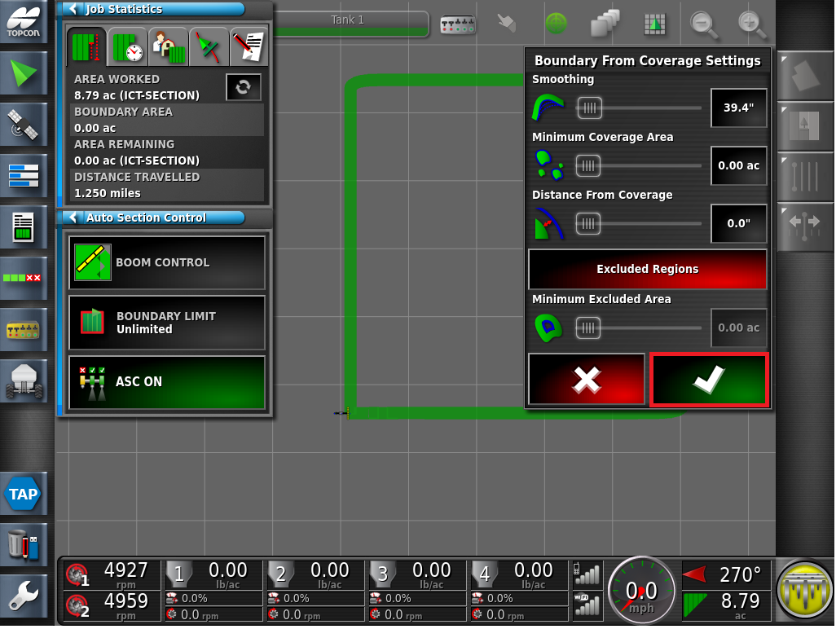
Use the default settings, proceed by pressing the Green Check mark

Slide 7
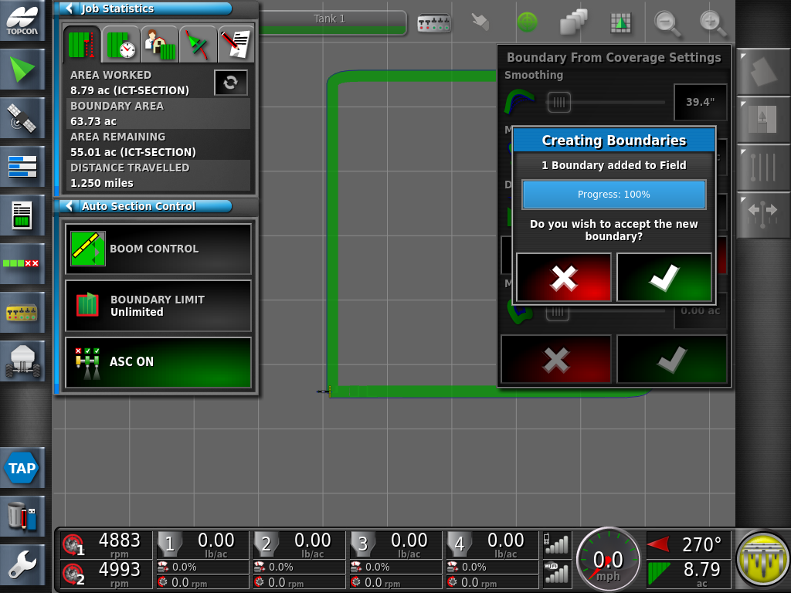
Creating Boundaries, message will be displayed. A Blue boundary will appear around the perimeter of the headland. Accept the Boundary by proceeding with the Green Check Mark

Slide 8
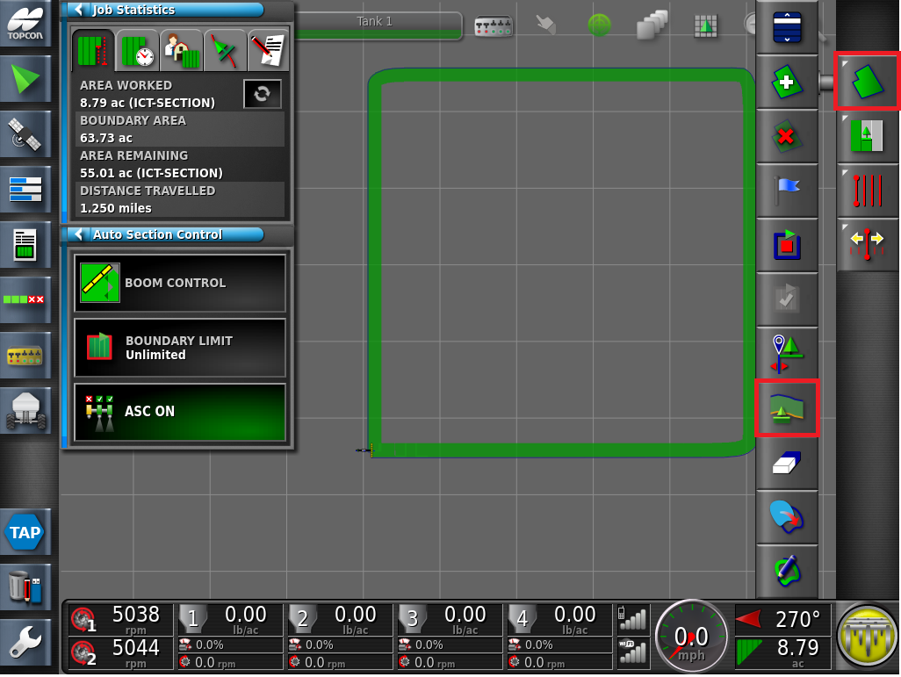

Now that a boundary has been created, there a several new Headland and ASC options which have now become available
Press the Field
Followed by the Configure Headland for this Implement

Slide 9
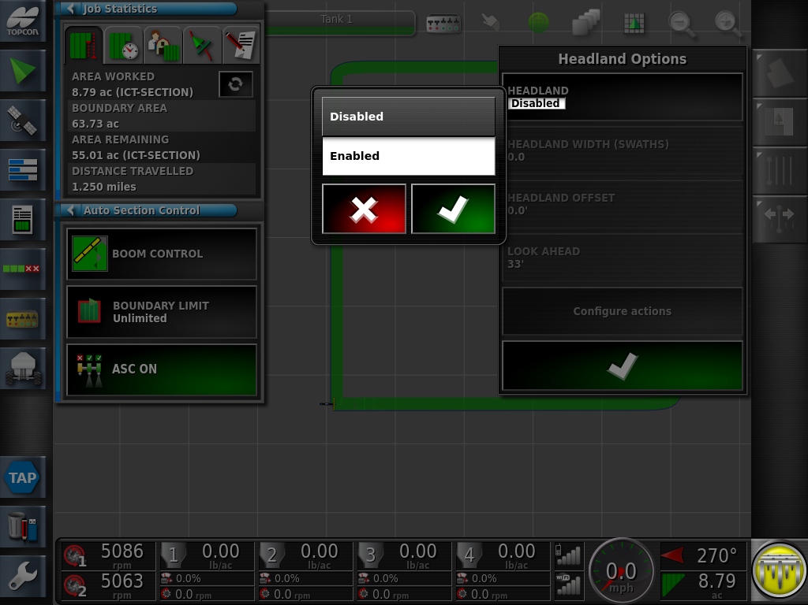
Press on the Headland icon, select Enable followed by the Green Check Mark

Slide 10
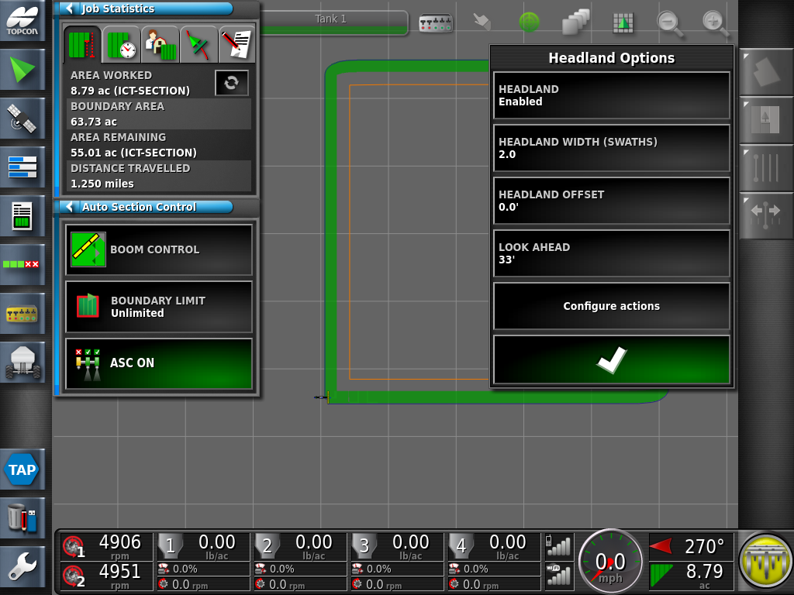
Press on the Headland Width (Swaths) icon, Enter the number of headland swaths desired.
Example: 2.0 Swaths (2 swaths = 2 Widths of your implement)
Note: A larger number of swath widths maybe used, this will depend on your implement width and vehicle travel speed. Apply the settings with the Green Check Mark
A virtual headland peremiter will now be displayed in an Orange boarder. Review and Apply the settngs with the Green check mark.

Slide 11
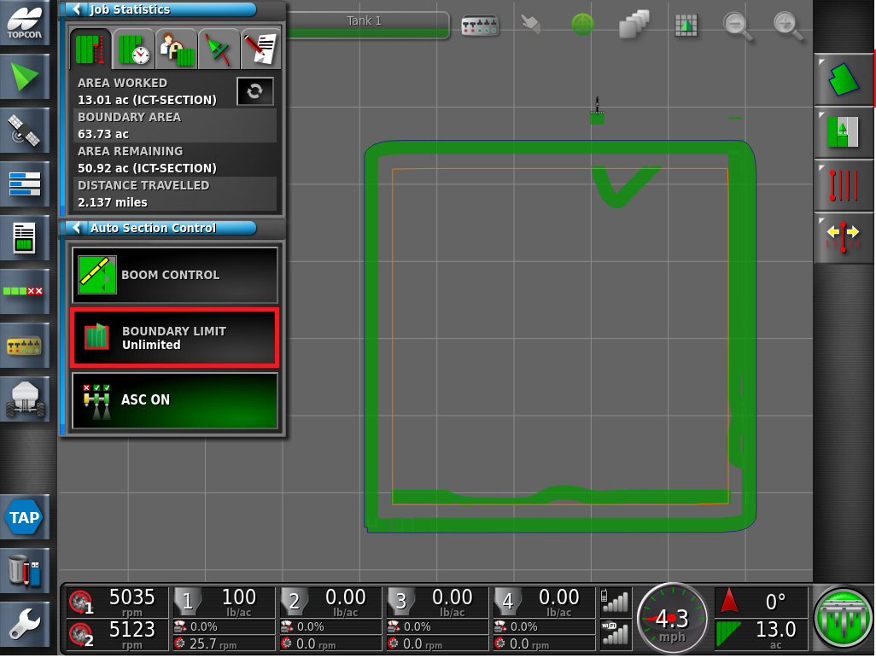


Under the Auto Section Control mini view, Press the Boundary Limit Icon.
You may also toggle back to Perspective View by Pressing on the Map Layer Icon

Slide 12
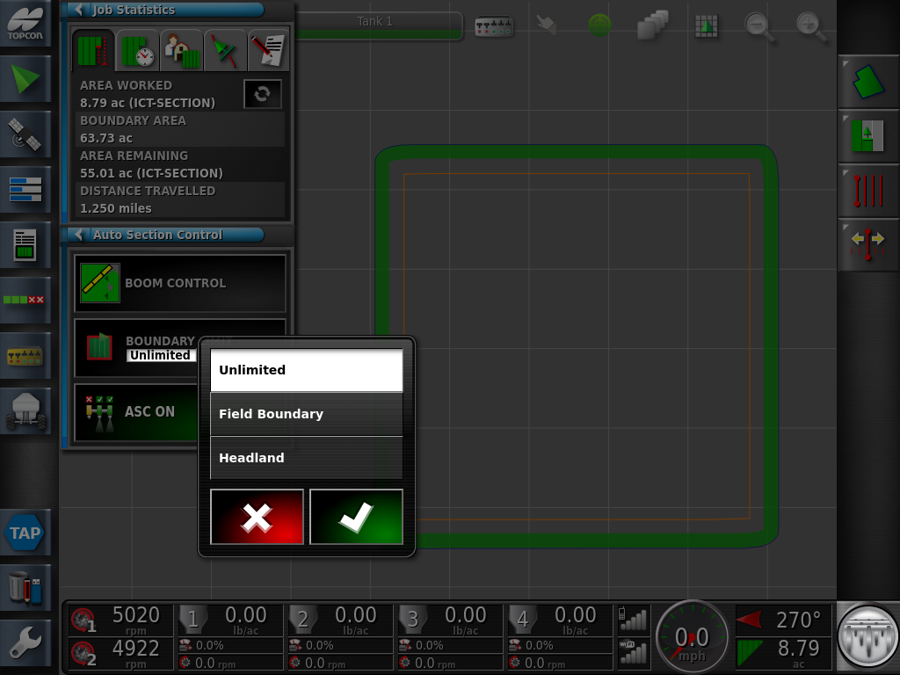
The following settings are available:
Unlimited
Field Boundary
Headland

Slide 13
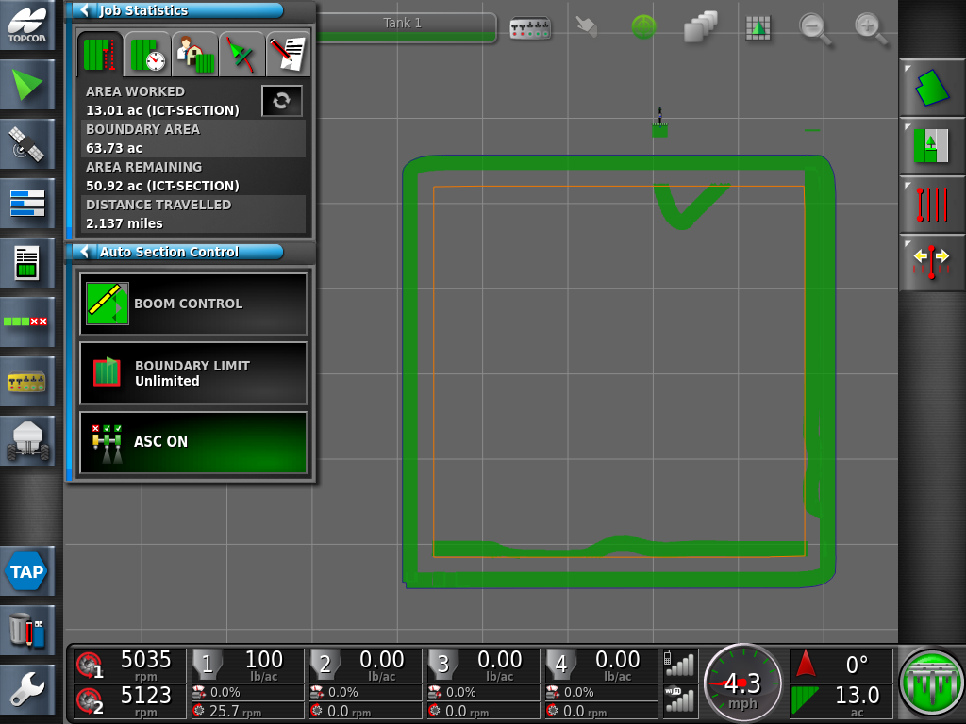
Unlimited, Provides unrestricted application of product in all areas. This will allow you to seed outside of your set boundary.
It is recommended to use only use Headland Or Field Boundary

Slide 14

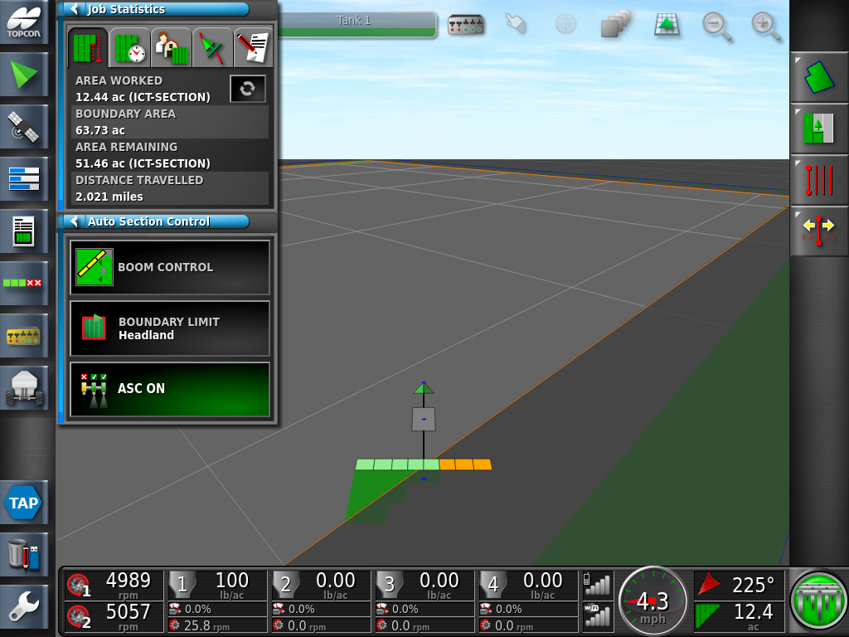
Boundary Limit - Headland - will exclude the headland area from receiving product (this region is seeded last) to cover up any tracks and prevents seed disturbance and over compaction

Slide 15

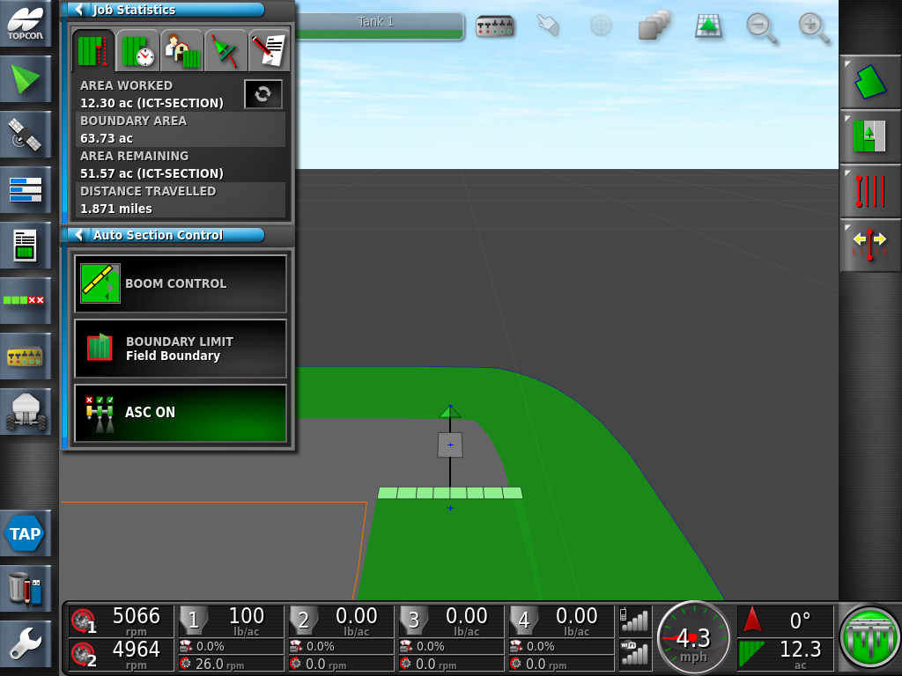
Boundary Limit - Field Boundary –the application of product within the boundary zone of the field. If the implement travels outside of the boundary of the field the metering system will not activate. This is useful to ensure the operator is seeding inside the correct field. Also, during Headland turns it prevents false applications as the ASC is not trying to activate the metering with false look ahead predictions.

