Slide 1
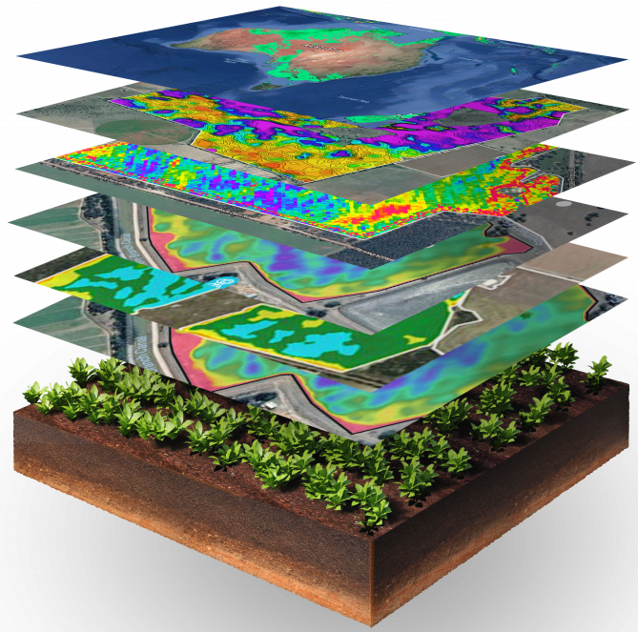

Map Layers
Section 8
1) Map Layers

Slide 2
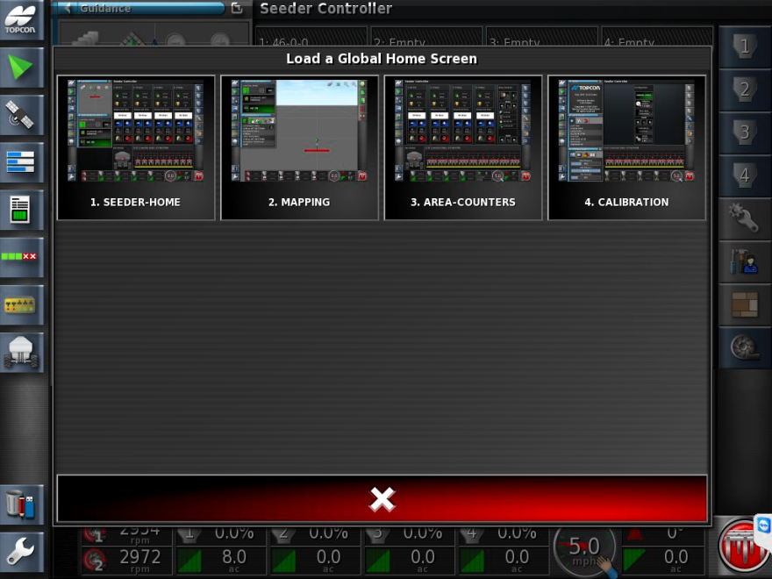
Global Home Screen-Select MAPPING

Slide 3

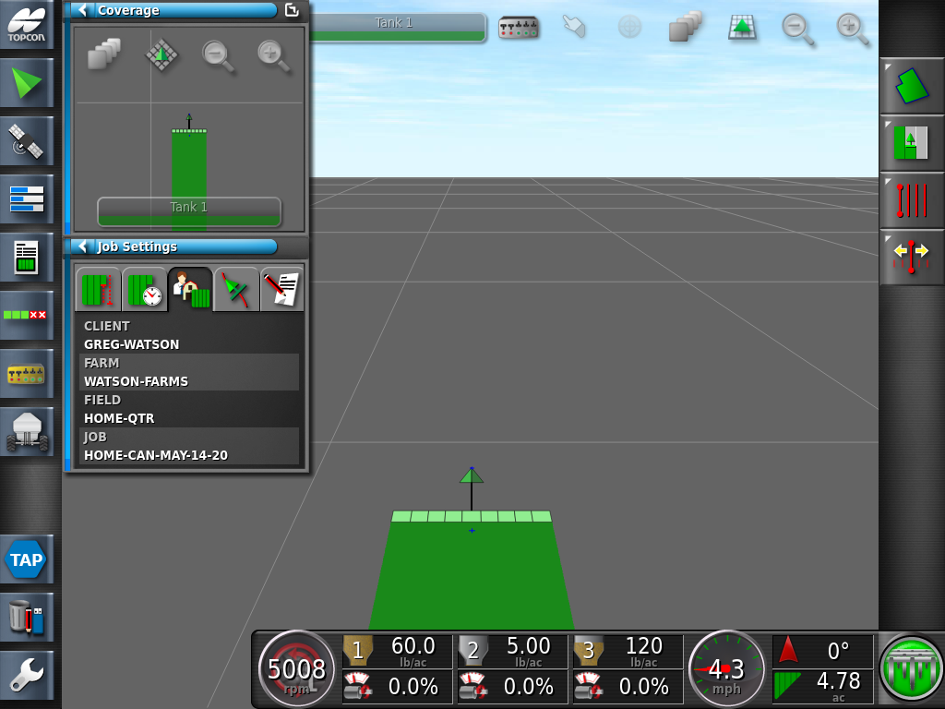
For more detail, you can adjust the Map layers to display a real time applied Rate

Slide 4
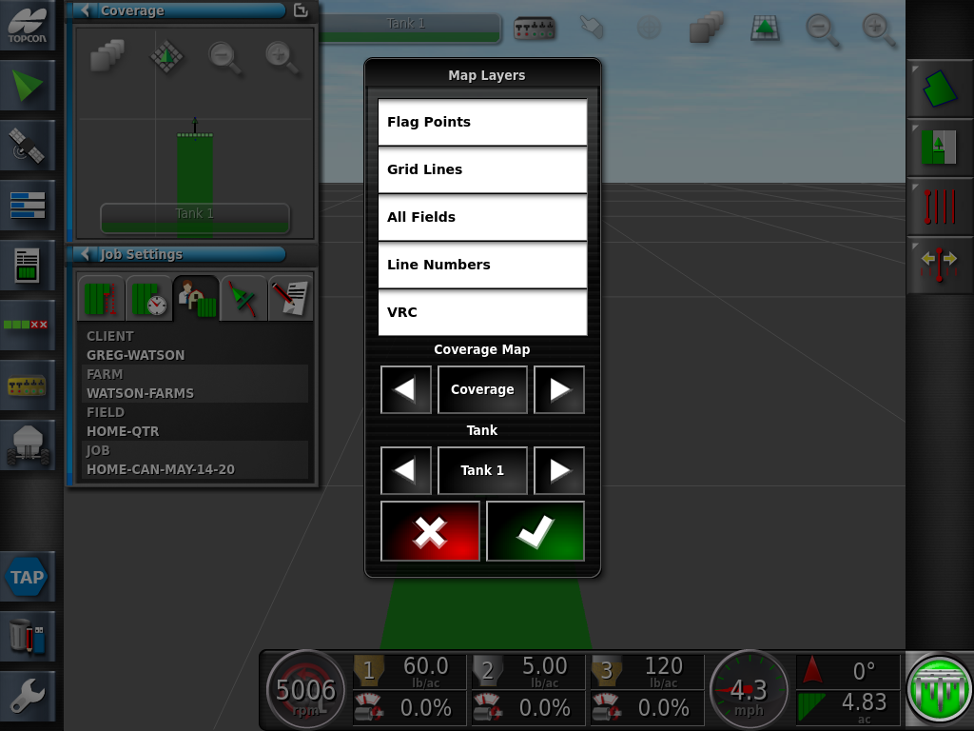
Toggle the Coverage Map from Coverage to Applied Rate Map

Slide 5
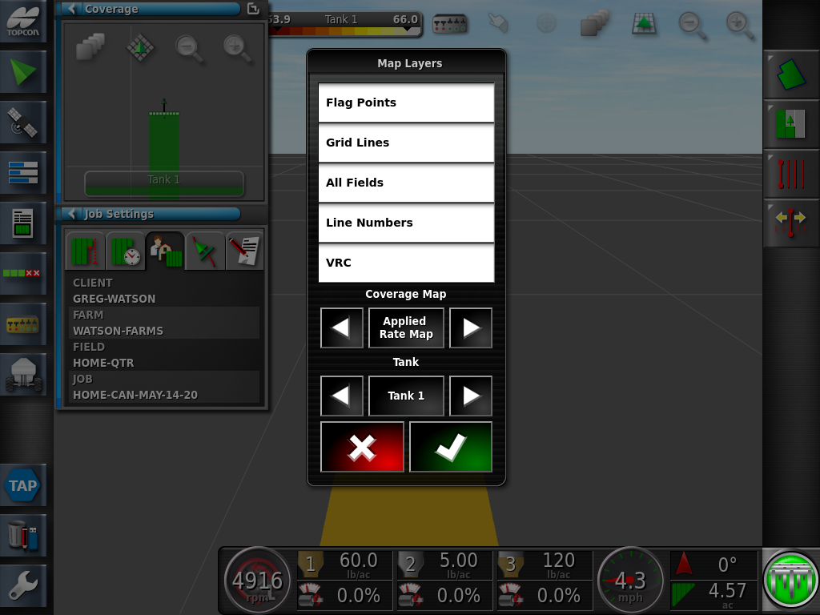
You may also toggle between the different Tanks, Press the Green Check Mark

Slide 6

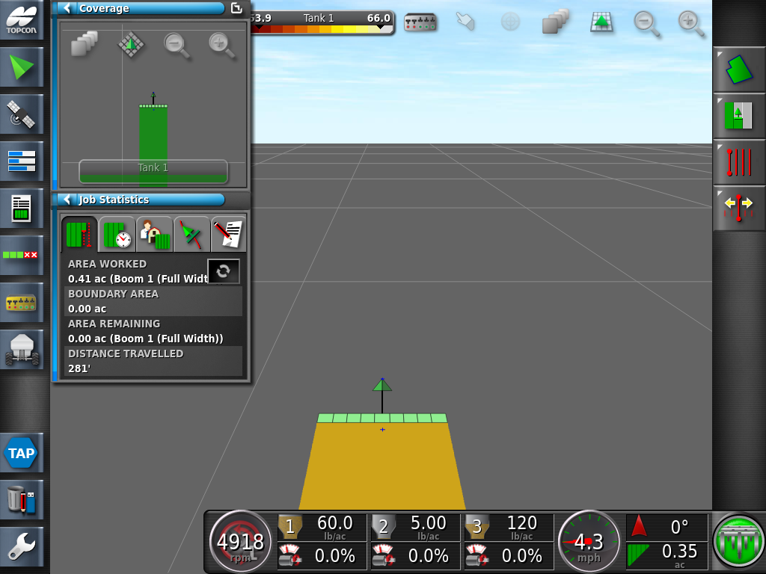
Press on the Color Band icon a the top of the screen

Slide 7
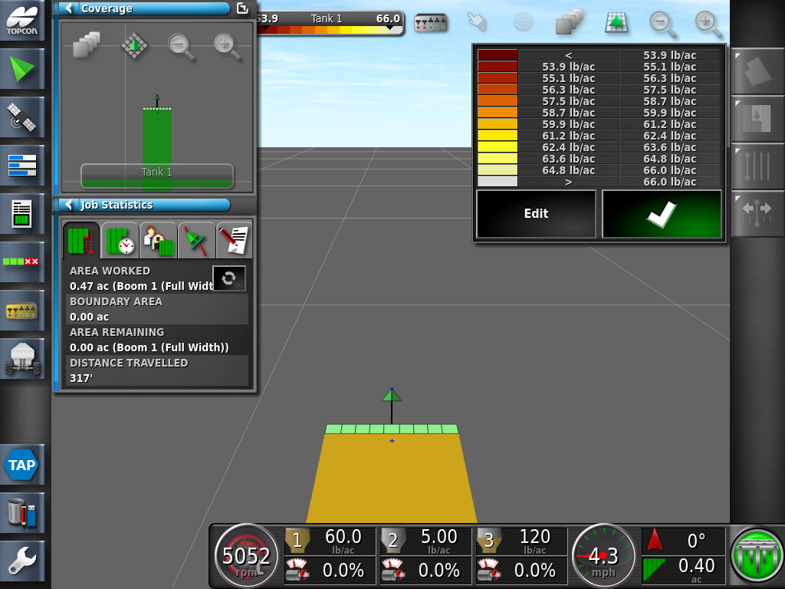
Press on the Edit Icon

Slide 8
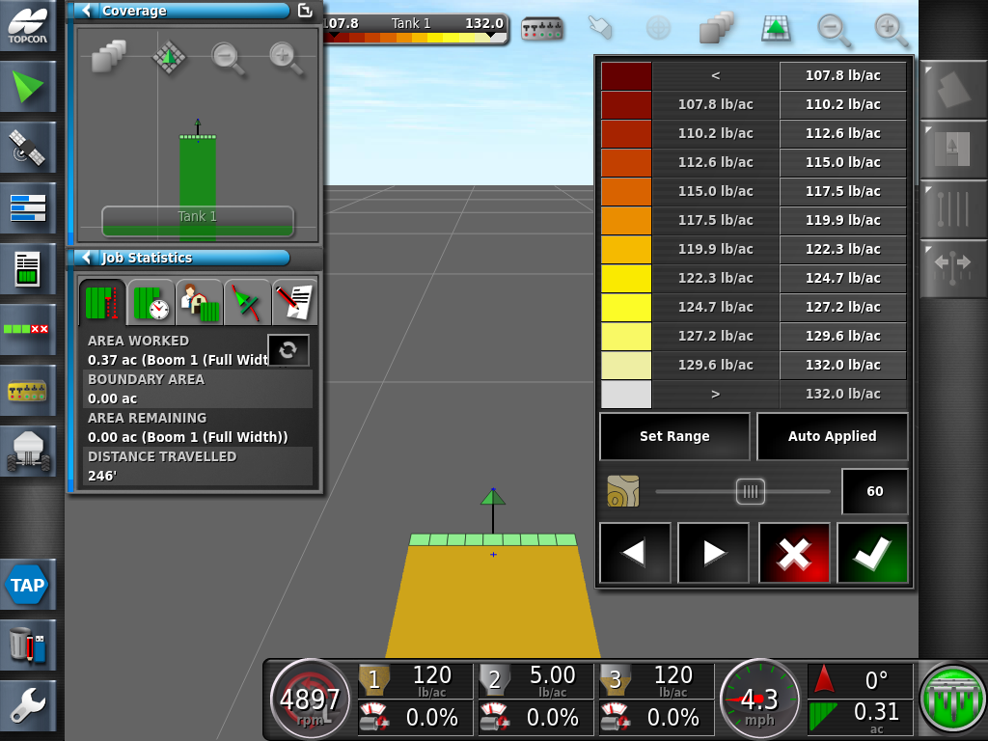
Press the Auto Applied icon followed by the Green Check Mark. Repeat the above procedure on the remaining tanks.

Slide 9

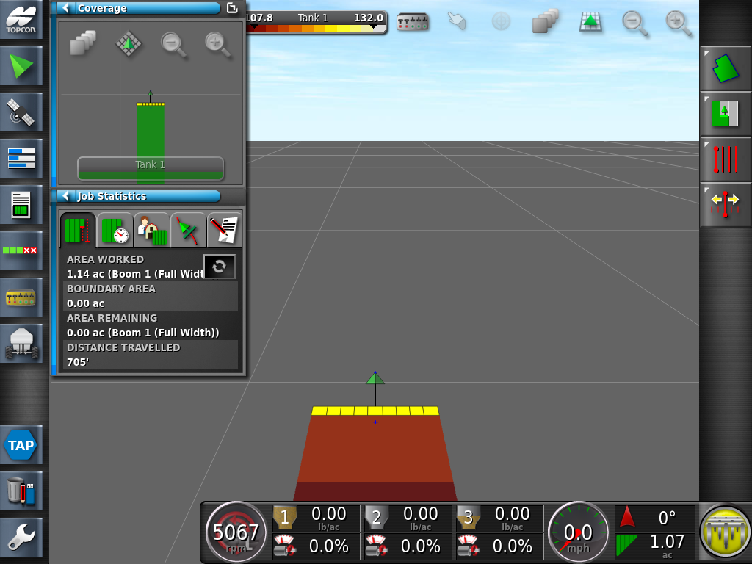

Save the Map layer settings by swiping upwards on the bottom of your screen for the User Control Ribbon and selecting the Change Global Home Sceens Icon

Slide 10
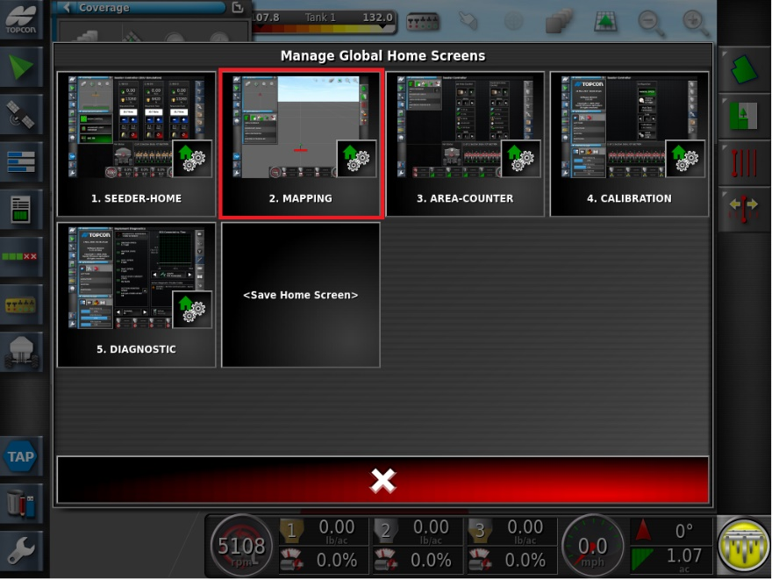
Press on the middle of Mapping Icon (do not press the small Gears Icon).

Slide 11
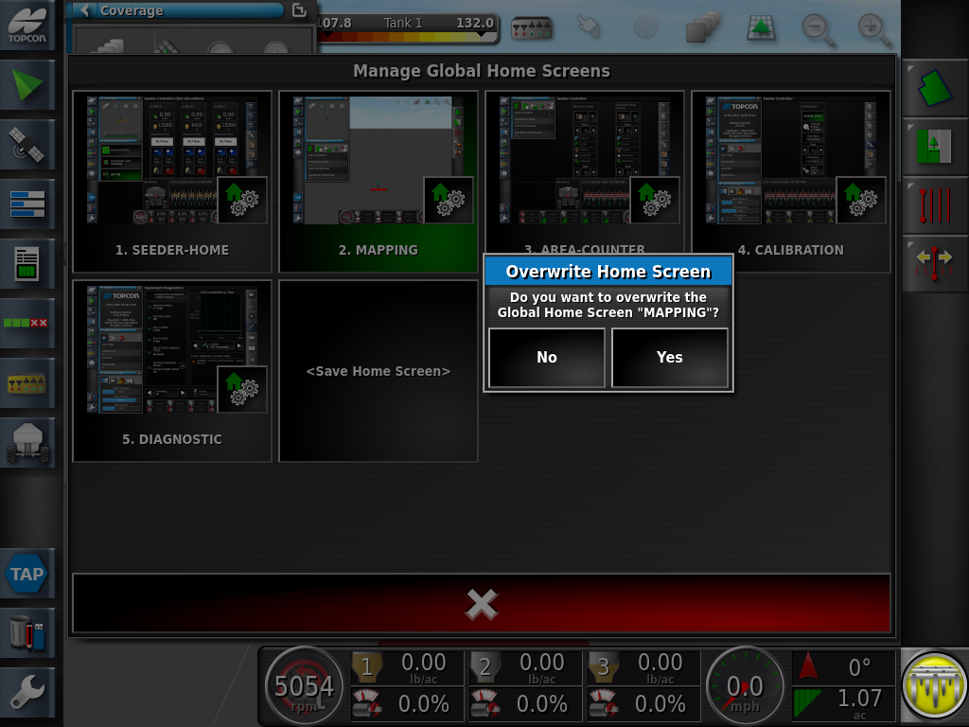
A prompt will be displayed, Do you want to overwrite the Global Home Screen “Mapping”? Yes

Slide 12
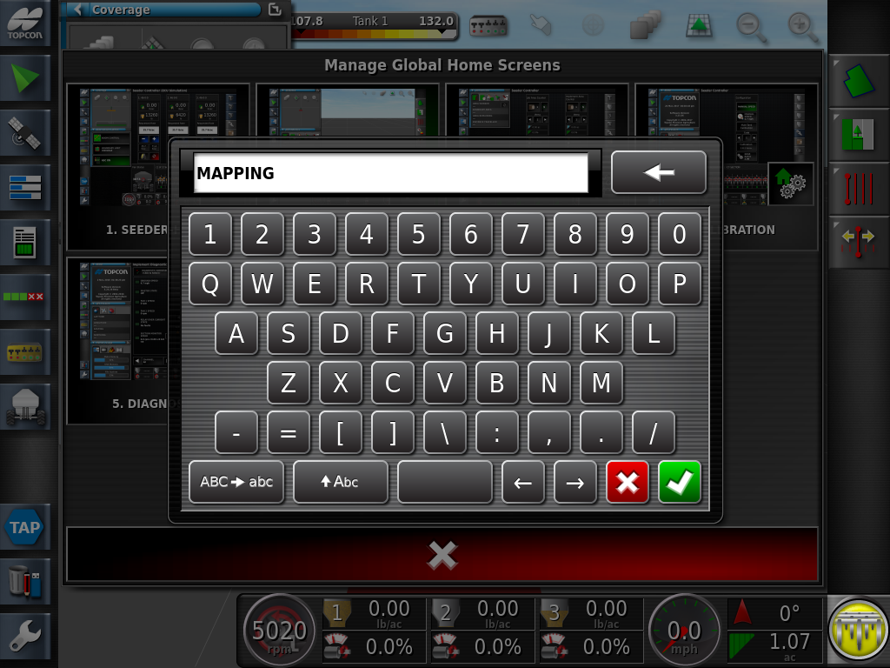
A Keypad will pop up. Name your mapping screen and press the Green Check Mark to confirm the name

Slide 13
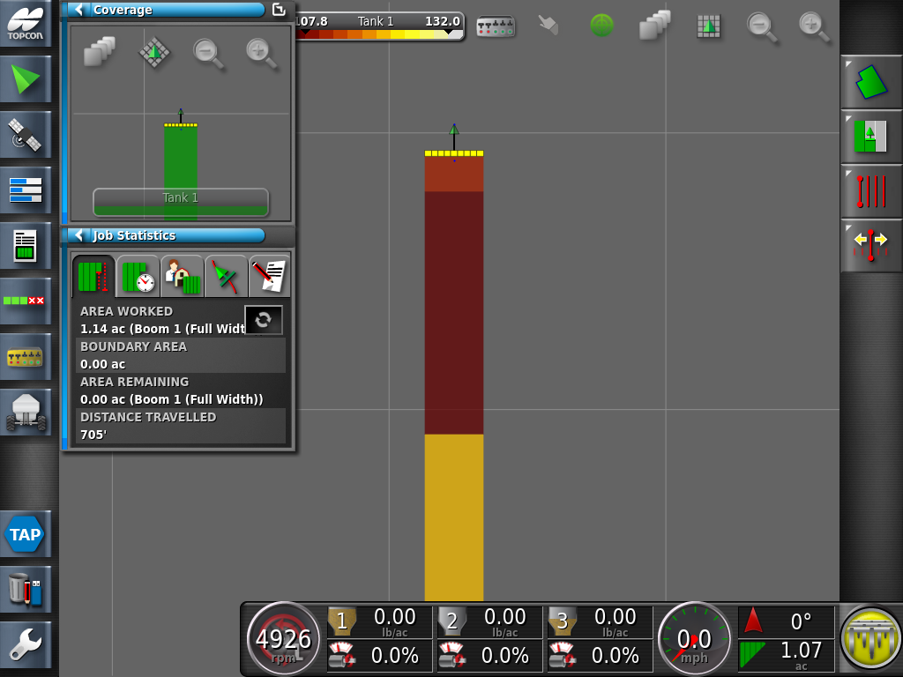

The As applied Data will now be displayed as a multi-colored graph, each color shade represents the lb/ac value. Toggling to the overhead view is a useful method to validate that the application rates have been applied properly. Return to the Map layers icon to select and view the other tanks.

