Slide 1
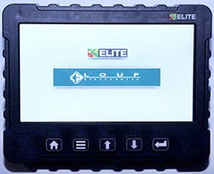

Loup Elite Monitor System
Morris Training 2021
MONITOR - N72101

Slide 2
Elite Monitor
Training Outline
Introduction to Monitor Slide 4-6
Installing Monitor Slide 7
Identifying Switches Slide 8
Home Screen Operation Overview Slide 9-10
Startup Slide 11
Power On
Power Off
6. Sensor Installation Slide 12-17
  Installation Precautions
  Installation Procedure
  7. Monitor Setting Slide 18-32
  Navigating Settings Screens
  Speed Setting
  Wheel Pulse per 400 Feet (PP400) Ground Drive
PP400 Math Calculation
Speed Calibration
f) Shaft and Fan Settings
g) Tank Not in Use
h) Rate Setting

Slide 3
Elite Monitor
Training Outline - Continued
8. Settings Menu Chart – Ground Drive Slide 33-35
Alarm Slide 36-40
Introduction
Nuisance Shaft Alarm
“In Motion” Notification
Low Fan Alarms
Area Display Slide 41
Resetting Area
11. Rate Calibration Slide 42-47
Actual Sample
12. Displayed Rates Slide 48-49
13. Sensor Replacement Slide 50-51
14. Sensor Gap Settings Slide 52
15. Troubleshooting Slide 53-54
16. Software Update Installation Slide 55-56
Calibration Chart - Imperial Slide 5

Slide 4
Elite Monitor
Introduction
>The monitor uses the same multiplexed system as before with all sensors communicating over the same 3 wire
:It uses the same sensors and harnesses as earlier Vansco systems
:No need to have to relearn troubleshooting or repair of sensors or harnesses
The system can monitor and display status of the following functions:
>Fan speed (up to 3)
>Ground speed
>Shaft speeds (up to 4)
>Bin levels (up to 4)
>Flow Blockage (up to 192 runs) (Not Currently Available)

Slide 5
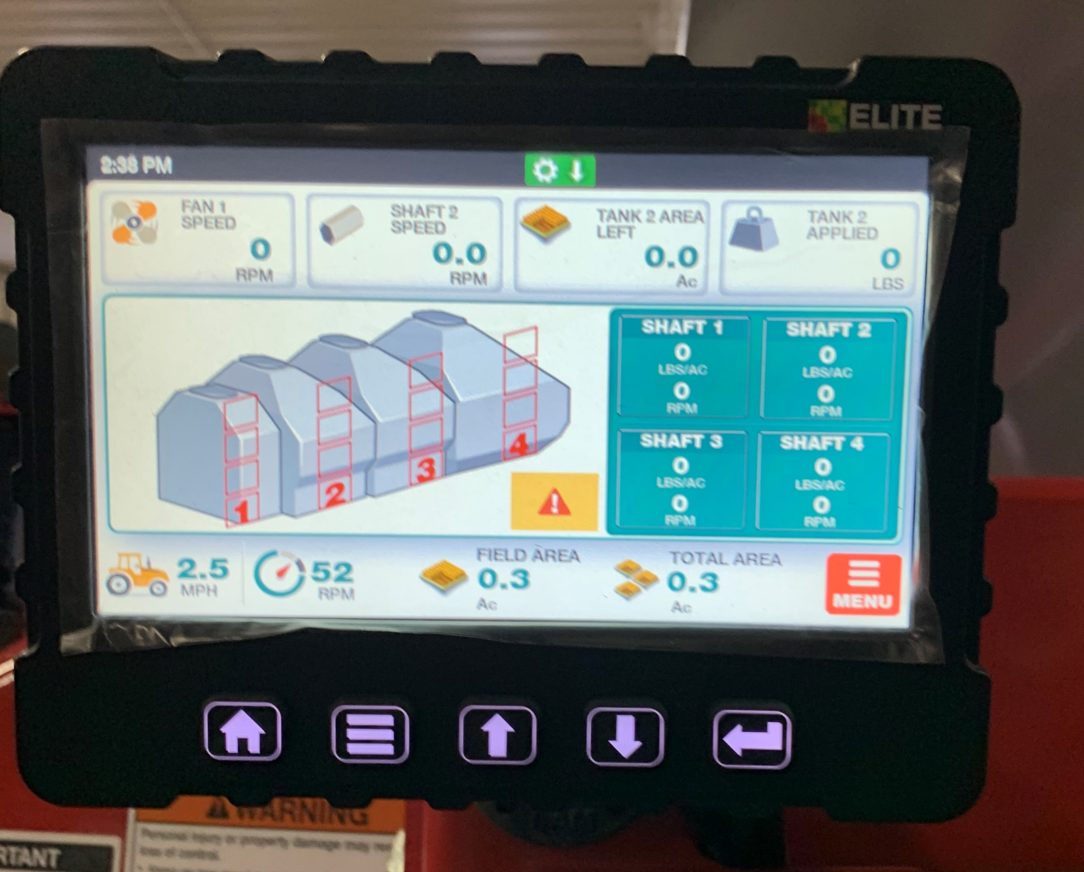
Elite Monitor
Introduction - Continued
In addition, the monitor can determine and display:
>Field Area
>Total Area
>Application Rate (weight per unit area)

Slide 6
Elite Monitor
Introduction - Continued
The monitor allows the following settings to be changed:
> High and Low fan speed alarm point
> High and Low shaft speed alarm point for 4 shafts
> Ground speed pulses per 400 ft and pulses per revolution
> Pulses per revolution of fans and 4 meter shafts
> Low bin alarm for 4 bins
> The number of Blockage Modules that are connected to the monitor
> The width of the implement
> Imperial or metric units

Slide 7
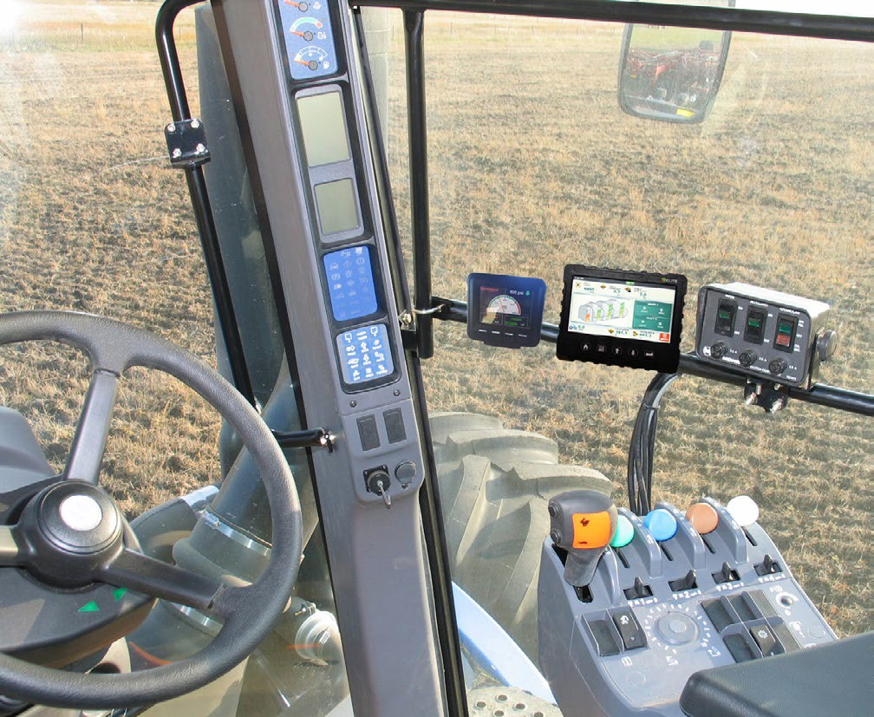
Elite Monitor
Installing the Monitor
Locate monitor and clutch switch in a convenient location in the cab
Plug Monitor power cable directly to a 12V power source. Such as power bar or Power plug
Connect Clutch power cables directly to a 12V battery White or red wires are Positive
Black Wires are Negative.
  Route cable harness to seeding tool and Air Cart.
  Ensure cables clear any pinch points (i.e. tractor
  articulation point, hitch point, etc.)
Program monitor as described in System Installation and monitor programming section
Clutch Switch located in close proximity to Operator for easy access.
Monitor located in easily viewed area.
NOTE: Locate monitor, power and ground wires away from radio and antenna if tractor is so equipped.
NOTE: Do not connect monitor directly to starter switch.

Slide 8
Elite Monitor
Identify Monitor Switches
The five keys on the monitor face are used for controlling
Home Key - Used to return to Main screen.
Menu Key - Used to access Main Settings Menu. Used for moving function selection icon.
Up Key – No Function attached to this key
Down Key - No Function attached to this key
Back Key - No Function attached to this key
HOME Key
UP Key
BACK Key
MENU Key
DOWN Key
NOTE: Monitor will show “communication errors” if the system installation (Sensor Learn Mode) was not completed. See Sensor Installation.

Slide 9
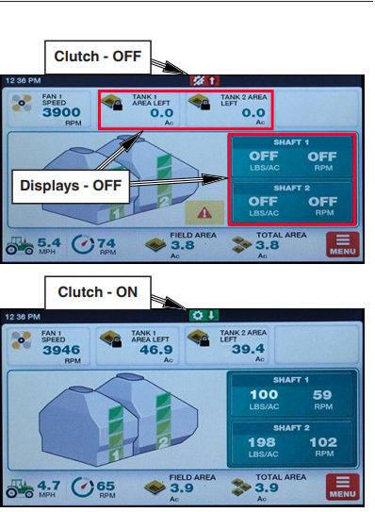
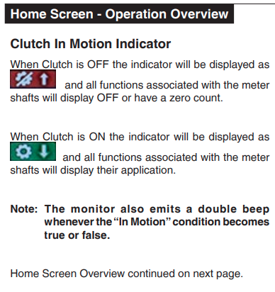
Elite Monitor

Slide 10
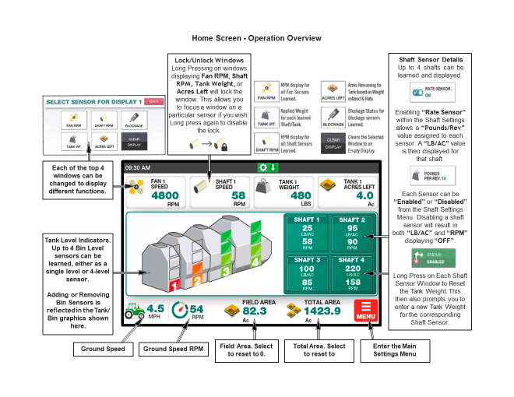
Elite Monitor

Slide 11
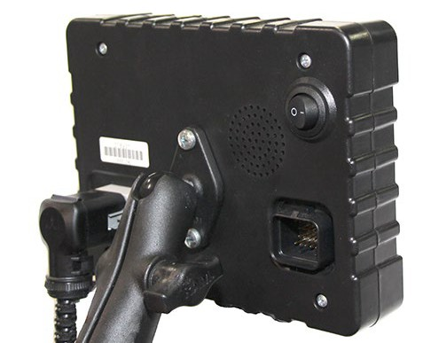
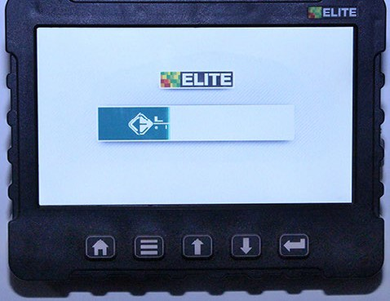
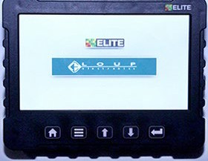
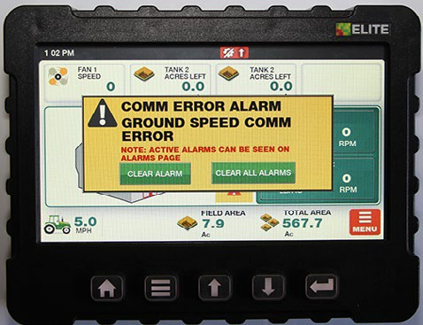
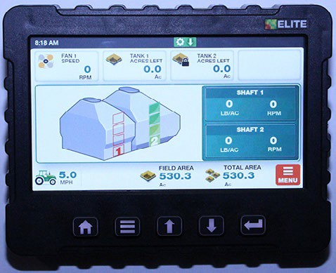
Elite Monitor
Startup
On/Off Rocker Switch
Start Up
Power On
Toggle the Power switch to turn the monitor on.
When the unit is turned on, the following display sequence takes place:
ELITE is displayed while the LOUP bar loads.
This Splash Screen is displayed for a short time – long enough to go through the system startup and wakeup all of the sensors (approximately 3 seconds).
If any sensors are found, the monitor proceeds
to the “Operating” screen
If no sensors are found, the monitor will display a
“COMM ERROR ALARM”.
Power Off
Toggle the Power switch to turn the monitor off.
Operating Screen

Slide 12
Elite Monitor
Sensor Installation
The installation Procedure is required to configure the monitor to the sensors attached to it.
The operator may have to redo the installation if:
1) An extra tank is added to the Air Cart.
2) Replacing or adding sensors.
3) Replacing monitor with a new monitor.
NOTE: Each monitor is unique to the sensors installed. If monitor is moved to another Air Cart it must be reprogrammed to match the sensors.
NOTE: On the following sensor installation the order the sensors are learned (plugged in) is different then the previous Vansco Monitor Systems

Slide 13
Elite Monitor
Installation Precautions
2) There may be occasions when the operator will not have use of all the sensors.
During sensor installation when the monitor prompts for an unused sensor to be plugged in, the operator can press the SKIP THIS SENSOR key to skip over the sensor. The sensor will be assigned a disabled status. A sensor disabled by this method can only be enabled by repeating the installation procedure.
  Note: Skip “Lift Switch”. The shaft ground speed sensor is connected to the clutch eliminating the need for a lift switch sensor
ii) During operation, the operator can disable shaft sensors by setting the pulses per revolution to zero. When pulses are set to zero alarms for that sensor and corresponding Bin Level sensor are ignored and no monitoring occurs.
During installation, the monitor has a predetermined order in which it wants the sensors attached. The installer must be sure that the proper sensor is plugged in the proper sequence
  i.e. If during installation the installer plugs in the Front Shaft and Ground Speed sensors in the wrong order, the monitor would not know this. The monitor would interpret Front Shaft rpm from the Ground Speed shaft and vice versa.

Slide 14
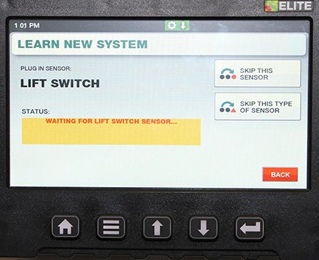
Elite Monitor
Sensor Installation Order
Speed (Ground)
Installation Precautions Continued
Lift Switch
Rate Calibration
3) Blockage modules attached to the harness are handled differently than the sensors attached to the harness. See Assembly Section “Blockage Module”.
Optical Sensors - the blockage modules have to be unplugged from the harness before sensor installation can be performed and are connected like the other sensors requested by the monitor during sensor installation.
Bin 1
Bin 2
Bin 3
Bin 4
Shaft 1
Shaft 2
Shaft 3
Shaft 4
Fan 1
Press the SKIP THIS SENSOR key to skip sensor.
Fan 2
Fan 3
Blockage Modules

Slide 15
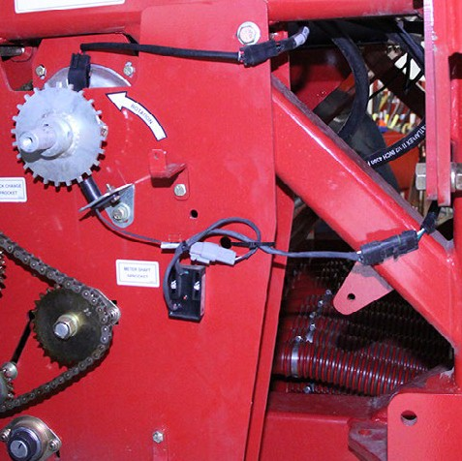
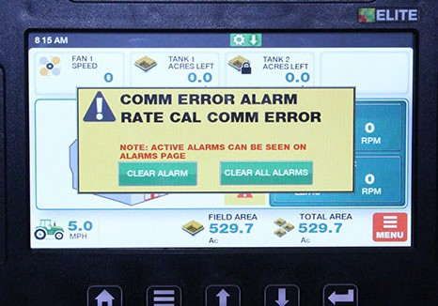
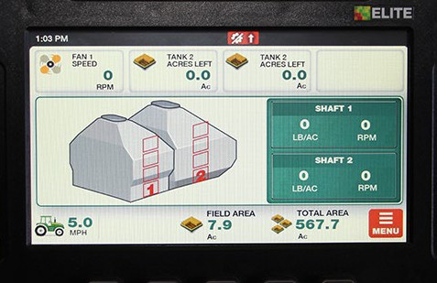
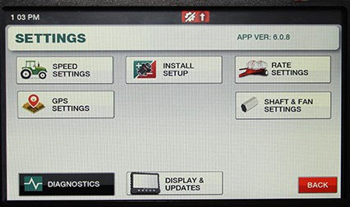
Elite Monitor
1: Turn monitor on. With no sensors found, the monitor display “COMM ERROR ALARM” screen. Press “CLEAR ALL ALARMS”.
2: The monitor will display the HOME screen. Press “MENU” key.
3: The monitor will display the SETTINGS screen.
Press “INSTALL SETUP” key.
Sensor InSensstallation - Continued
Sensor Installation - Continued
stallation - Continued
Installation Procedure
• Disconnect all the sensors (3 pin connector) from the harness before turning monitor on.
Note: Disconnect Hydraulic Rate Calibration at sensor connection indicated below.
Press Menu Key
Press the Clear All Alarms Key
Hydraulic Calibration
Press the Install Setup Key
Sensor Rate Connection

Slide 16
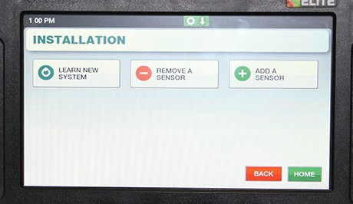
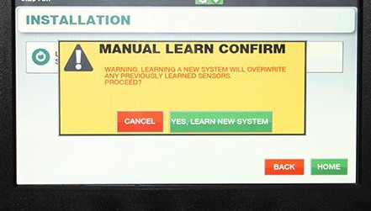
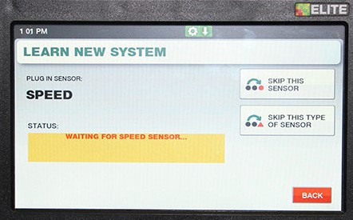
Elite Monitor
6
6
4
Sensor Installation Procedure - Continued - Continued
4: The monitor will display the INSTALLATION screen.
Press “LEARN NEW SYSTEM” key.
5: MANUAL LEARN CONFIRM screen will display. Press “YES, LEARN NEW SYSTEM” key to start sensor learn sequence.
6: The display will indicate to install the SPEED sensor indicating that the speed sensor may now be connected. Connect the speed sensor.
The process is the same for rest of the sensors in the sequence.
Press the
LEARN NEW SYSTEM key.
.
5
Press Yes Key
6

Slide 17
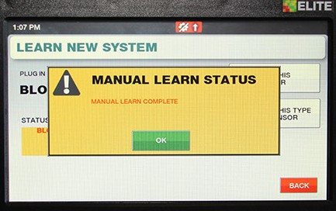
Elite Monitor
Sensor Installation Procedure - Continued
7: When the monitor requests a sensor that will not be used in the configuration, press the “Skip this Sensor” key and the monitor will skip the sensor and advance to the next one in the sequence.
7
Note: There are 12 Blockage Modules. To skip past the blockage modules, press the “Skip this Type of Sensor” the monitor will skip all of the blockage modules and advance to the next type of sensor in the sequence.
8: When all sensors in the list have either been learned or skipped, the monitor will display “Manual Learn Complete”. Press the OK key to complete sensor installation. The monitor will return to the SETTINGS screen.
To verify the installation, turn the monitor off, then turn it on again. The monitor will now proceed to the “Operating” screen with no comm errors.

Slide 18
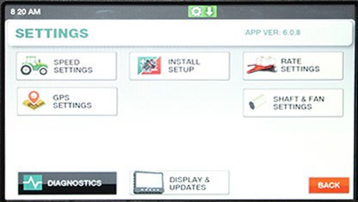
Elite Monitor
Monitor Setting
Navigating Settings Screens
The settings screen contains all the configuration information required to tailor the monitoring capabilities to the installed system and user preferences. Only setting parameters that are relevant are displayed (i.e. if no Shaft 3 is installed, there will not be any Shaft 3 setting parameters made available).
Pressing the MENU key when in the “HOME Screen” enters this mode.
The “SETTINGS screen” will list all of the user adjustable parameters available.

Slide 19
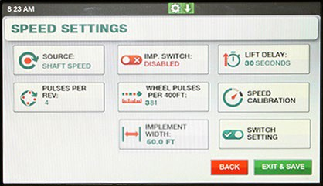
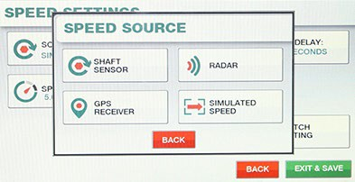
Elite Monitor
Speed Setting
Located by selecting “Menu” and “Speed Settings”, these settings control the type of speed input being used as well as calibrating the speed displayed on the main screen.
Select the “Source” button to change the type of Speed Input to use. There are four options Shaft Speed, Radar, GPS, and Simulated Speed.
1. SHAFT SPEED SENSOR: Uses the shaft rotation sensor located on the Cart to obtain ground speed. Unless otherwise configured this is also used as the lift switch for acres accumulation.
2. RADAR SPEED: Uses the tractor radar for the source of ground speed. Depending on the implement configuration a lift switch may be needed when using radar, this is to ensure accurate accumulation of field acres.
Select the
Shaft Sensor

Slide 20
Elite Monitor
Speed Setting Continued
Important
The Ground Drive Air Cart only supports the
Shaft Speed Sensor.
3. GPS SPEED: Uses a GPS receiver for the source of ground speed. Depending on the configuration a lift switch may be needed when using GPS, this is to ensure accurate accumulation of field acres.
4. SIMULATED SPEED: Allows the user to enter a static speed into the monitor without any other speed source. For use in more unique conditions such as a GPS/Radar failure, or other troubleshooting.
Available when “Simulated Speed” is selected as the source. Use this field to enter the static speed of choice. The monitor will continually display this speed at all times until otherwise specified.

Slide 21
Elite Monitor
Speed Setting Continued
Pulses per Rev (Revolution) are the number of magnets the Air Cart mounted speed sensor sees in one revolution of the shaft being monitored. Use keypad to set this number to 4 and select “Exit & Save”.
Wheel Pulses Per 400FT
Available when “Shaft Speed” is selected This is the ground speed calibration number for the Air Cart mounted speed sensor.
To change, refer to PP400 Chart on next page, select Tire Size on Cart and enter number into the keypad and select “Exit & Save”.
.
Implement Width
Use keypad to set this number to the working width of seeding tool and select “Exit & Save”.
Note: All Menu settings can be set before selecting “Exit & Save”.

Slide 22
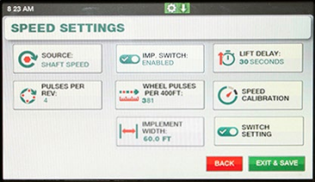
Elite Monitor
Speed Setting Continued
Implement Switch
The implement switch is used to tell the monitor if the Air Cart is seeding and when its not.
The lift sensor is used when shaft rotation cannot be used. (i.e. Radar and GPS)
Each button push toggles this setting between “Disabled” and “Enabled”.
If shaft speed sensor is used set to “Enabled” as well
Morris Air Carts use the shaft ground speed sensor which is connected to the clutch eliminating the need for a lift switch sensor
Lift Delay
When enabled, the Lift Delay specifies the seconds given to make a turn on the headland before an Alarm sounds. This value can range between 1 and 99 seconds.
Use keypad to set this number to 30.
Switch Setting
Select the “Raised Open” setting by pressing the Set
Highest key.

Slide 23
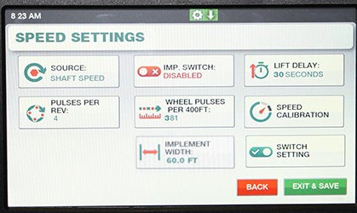
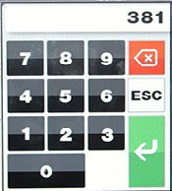
Elite Monitor
PP400 - Ground Drive
Monitor Setting Continued
Tire Size (Good Year)
Tire Style
Rating
Pressure
PP400
Wheel Pulses Per 400 Feet (PP400)
Ground Drive
The chart contains average PP400 values, for the tire options offered by Morris.
Note: Air Carts without brakes use a 63-tooth drive sprocket. Air Carts with brakes use a 64-tooth drive sprocket.
15 psi
382
800/65R32
Lug
172 A8
20 psi
381
No Brakes 800/65R32 Dual Wheels
Lug
172 A8
20 psi
381
Brakes 800/65R32 Dual Wheels
Lug
20 psi
387
172 A8
17 psi
356
900/60R32
Lug
176 A8
26 psi
351
710/70 R38
Lug
36 psi
351
166 A8
800/70R38 Dual Wheels
Lug
173 A8
20 psi
342
850/80R38 Dual Wheels
Lug
180 A8
15 psi
312
520/85R38 Dual Wheels
Lug
155 A8
20 psi
377
PP400 Value

Slide 24
Elite Monitor
Monitor Setting Continued
PP400 Math Calculation
To determine PP400 value, first determine the tire circumference as outlined in “Determining Tire Sprocket” under Operation Section.
Note: The PP400 can also be determined using the speed calibration feature.
Monitor PP400 Formula - Ground Drive with Brakes
For 32” Rim = 81920/Tc
For 38” Rim = 81920/Tc
PP400 =
Tc = Tire Circumference measured in inches
Monitor PP400 Formula - Ground Drive
For 32” Rim = 80640/Tc
For 38” Rim = 80640/Tc
PP400 =
Tc = Tire Circumference measured in inches

Slide 25
Elite Monitor
Determining Tire Circumference
Factors that may affect the tire circumference and in turn metering rates and monitor PP400 values are as follows:
• Manufacturing tire size tolerances can vary +/- 4%.
• Tire pressure.
• Field soil conditions (firm-unworked versus soft worked).
• Tank capacity (empty tanks versus full tanks).
• Tire manufacturer (Good Year versus Firestone).
Note: The values used for monitor PP400 values and tire size sprockets is based upon the tire circumference of Good Year tires at proper pressure with half full tanks in normal working field conditions.
To determine tire sprocket for other tires not listed in the chart or to check the actual tire circumference use the following equation:
• The tire circumference should be checked under normal field conditions with tanks half full.
• Mark tire and starting point.
• Drive air cart 10 revolutions of tire.
• Mark ending point.
• Measure distance from starting point to ending point and divide by 10 to get the rolling circumference of the tire.
Use rolling circumference number in formulas to find PP400 number and Tire Size Sprocket.

Slide 26
Elite Monitor
Important: Tire circumference affects metering accuracy.
Tire Circumference should be determined for your field conditions by following procedure.
Then determine “New Crank Rotations” outlined under Crank Calibration Table.
Also determine new “PP400”
see “PP400 Calculation” in Monitor Section 6.
Tire Size Sprocket
Check that the correct tire sprockets are installed on your machine.
These sprockets are located on the inner side of each transmission input shaft and are driven by the spacing sprocket.
The tire sprocket must be matched to the tire size of the air cart.
Find the correct sprocket for your tire option use the formula below
New Tire Sprocket Size:
For 32” Rim = 5992/Tc
For 38” Rim = 5992/Tc Ts =
Tc = Tire Circumference measured in inches
Note: Incorrect tire size sprocket will cause inaccurate application rates.

Slide 27
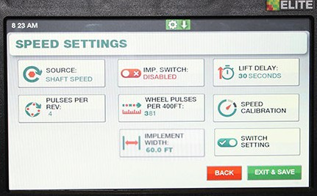
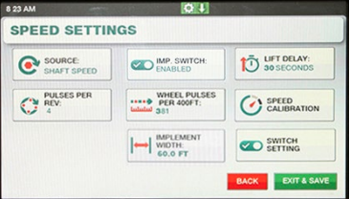
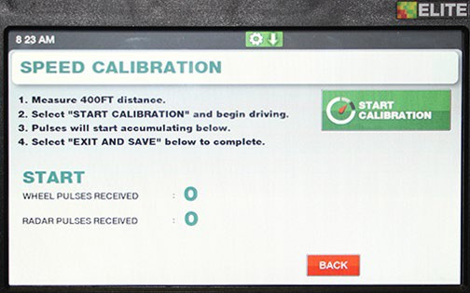
Elite Monitor
2
Monitor Setting Continued
Speed Calibration
If the operator does not know what the pulses per 400 feet should be, or, if more accuracy is desired for present levels of tire inflation or soil conditions, the monitor can be put into “Speed Calibration” mode, pulses will be counted while driving a specified distance.
To start the Pulse Counting Mode:
3
1: Measure and mark out 400 feet (121.92 m).
2: Select SPEED SETTINGS under the “Settings Menu”.
Then select SPEED CALIBRATION.
3: Press START CALIBRATION to start the pulse count sequence.
Drive the marked distance and the monitor will count the number of pulses.

Slide 28
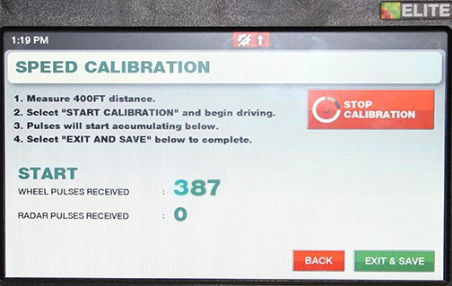
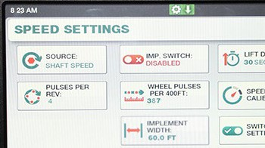
Elite Monitor
4
Monitor Setting Continued
4: When the distance has been travelled, stop forward travel. Press the “Exit and Save” to save the new pulse count under the SPEED SETTINGS screen.
5: The new value will now be displayed under “Wheel Pulses Per 400 Feet” (PP400).
6: To exit SPEED SETTINGS press the “Exit and Save” to save the changes.
NOTE: The monitor can accept PP400 values from 50 to 9999. Therefore, if the new count is less than 50, the existing count is not replaced. The monitor will state “Pulses Too Low” and display options to “Continue Driving” or “Cancel Calibration”.
New PP400 Value

Slide 29
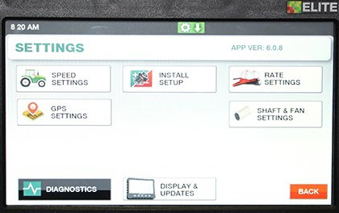
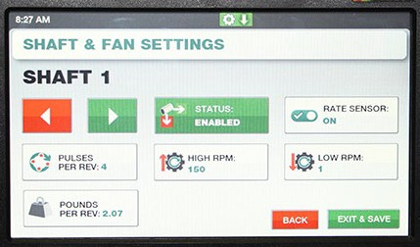
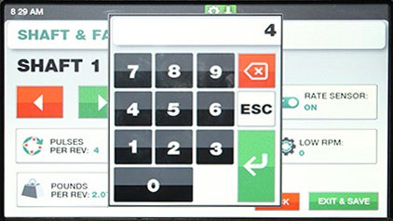
Elite Monitor
1
Monitor Setting Continued
Shaft and Fan Settings
From the HOME screen press “MENU” key.
The monitor will display the SETTINGS screen.
Press “SHAFT & FAN SETTINGS” key.
The monitor will display the “SHAFT & FAN SETTINGS” screen. Starting with SHAFT 1.
Under Shaft 1 set:
• Status - Enabled and Rate Sensor - ON
Pressing the green arrow or red arrow to navigate through the sensors available.
3. Set PULSES PER REV to 4 and HIGH RPM to 150 and LOW RPM to 2
To save changes press EXIT & SAVE.
The monitor will return to the SETTINGS screen.
Repeat steps 2 and 3 for the other shafts.
Note: All Shaft & Fan settings can be set before selecting “Exit & Save”
2
3

Slide 30
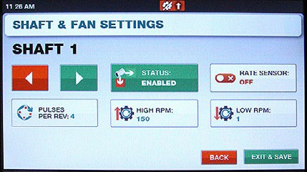
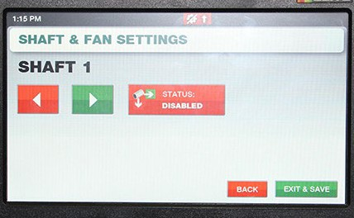
Elite Monitor
Monitor Setting Continued
4
Shaft and Fan Settings – Continued
4. Turning Rate Sensor OFF will close the pounds per rev icon and also the Home screen window for the shaft. The shaft will still be monitored for alarms.
Tank Not In Use
5. If a tank is not being used for an application switch the shaft Status to DISABLED. This will eliminate nuisance alarms.
Remember to Enable shaft when resuming use of tank
5

Slide 31
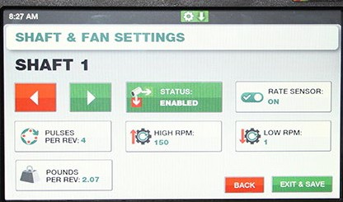

Elite Monitor
Monitor Setting Continued
6
Shaft and Fan Settings – Continued
Rate Setting
6. POUNDS PER REV is automatically set during the Rate Calibration procedure. This value can be manually edit under each shaft setting over-riding the saved setting from Rate Calibration. Once it is overwritten the Rate Calibration value cannot be retrieved. Therefore, it is recommended to keep a record of the Rate Calibration WT/REV value for each tank in a note pad for reference.
This value is used to calculate the Applied Rate and Tank Area Left display on the home page.
Best practice is to perform a Rate Calibration to obtain an accurate WT/REV however, if a quick setting is required the Rate Charts at the end of this section can be used as an estimated value.

Slide 32
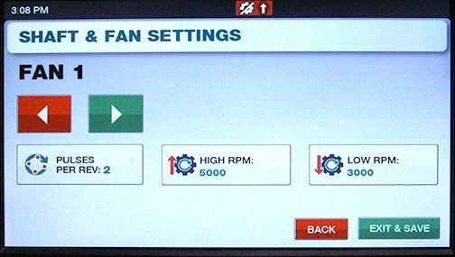
Elite Monitor
Monitor Setting Continued
Shaft and Fan Settings – Continued
7. Set the Fans to:
• PULSES PER REV to 2
• HIGH RPM to 5000 and LOW RPM to 3000
To save changes press EXIT & SAVE.
The monitor will return to the SETTINGS screen.
7

Slide 33
Elite Monitor
Settings Menu Chart - Ground Drive
IMPORTANT
Select “Exit and Save” in each Menu Setting to save changes.
Install Setup
Install New System __________See “Sensor Installation”
Add a Sensor ______________ See “Sensor Replacement”
Remove a Sensor___________ See “Sensor Replacement”
Speed Settings
Source ___________________ Set to “Shaft Speed”
Pulses Per Rev _____________ Set to 4
Implement Switch ___________Enabled
Wheel Pulses Per 400 Feet ___ See PP400 Chart
Implement Width____________ Set to width of seeding tool
Lift Delay__________________ 30 seconds – Can be adjusted to user preference.
Speed Calibration___________ See “Pulse Counting Mode for PP 400”
Switch Setting______________ ON – Raised Open – press Set Highest key

Slide 34
Elite Monitor
Settings Menu Chart - Ground Drive - Continued
IMPORTANT
Select “Exit and Save” in each Menu Setting to save changes.
Fan Settings
Pulses Per Rev _____________ Set to 2
Low Alarm Point ____________ Set to 3000 rpm
High Alarm Point____________ Set to 5000 rpm
Shaft Settings
Shaft 1, Shaft 2, Shaft 3 and Shaft 4
Alarm Setting ______________ Enabled (default) Set to Disabled if tank is not in use. Settings___________________ Pulses Per Rev Set to 4
High Alarm Point 150 rpm - Can be adjusted to 200 for high rates.
Low Alarm Point 2.0 rpm - Can be adjusted to 1 rpm for low rates.
Blockage Module Settings
Runs per Module Setup ______ Set individual Module number of Runs
Individual Runs Setup________ Allows Runs to be Enabled/Disabled
Blockage Module Test________ See “Blockage Module Test”
Blockage Calibration_________ See “Blockage Calibration”

Slide 35
Elite Monitor
Settings Menu Chart - Ground Drive - Continued
IMPORTANT
Select “Exit and Save” in each Menu Setting to save changes.
Display & Updates
Brightness_________________ 50% (default) Set as desired.
Volume ___________________ 50% (default) Set as desired.
Clock_____________________ Set as desired.
Units _____________________ Select Imperial or Metric
System Update_____________ Software Update
Factory Reset - Locked to prevent accidental reset
Unlock Reset - Locked to prevent accidental reset
Note: Only setting parameters that are relevant are displayed (i.e. if no Shaft 3 is installed, there will not be any Shaft 3 setting parameters made available).

Slide 36
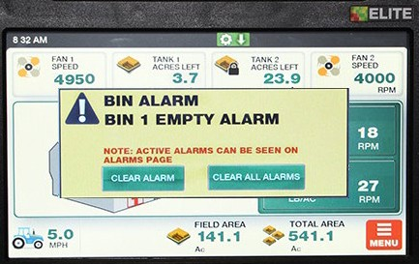
Elite Monitor
Alarms
Introduction
All configured sensors and various other operating conditions are continuously monitored. Alarms fall into one of the following three categories
• Sensor alarms are alarms which are generated when information returned by a sensor exceeds the appropriate threshold
• Communication alarms occur when a sensor repeatedly does not respond to attempts at communication.
• System alarms are for various other conditions that are found to be in fault.

Slide 37
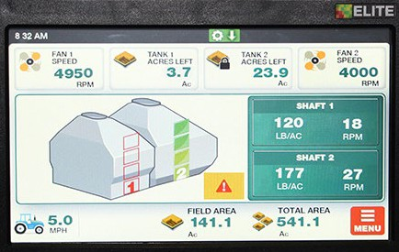
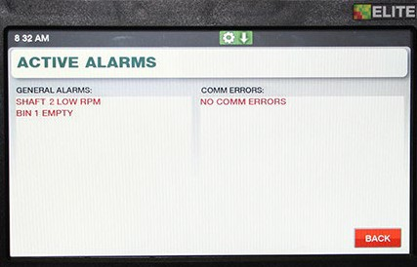
Elite Monitor
Warning Symbol
Alarms - Continued
When an alarm condition occurs, the monitor will beep repeatedly, and an alarm screen will pop up indicating the fault condition.
The audio alarm and alarm screen persist until the alarm condition is fixed or until it is acknowledged by the operator. Follow the steps on the screen to fix or acknowledge the alarm.
After acknowledgement, the “Operating Screen” will be displayed with a flashing “Warning Symbol” indicating unfixed alarms. Press the “Warning Symbol” to show the “Active Alarm” window to view alarms.
When the alarm condition is corrected, the flashing “Warning Symbol” notification is removed from the “Operating Screen

Slide 38
Elite Monitor
Alarms - Continued
Nuisance Shaft Alarm
Low application rates of Canola may cause the seed shaft to rotate less than 2 rpm.
The low shaft rpm will cause the monitor to give a shaft alarm, since the shaft is rotating below the default alarm threshold of 2 rpm.
To avoid this nuisance alarm, change the seed shaft low rpm alarm setting to 1 rpm and change pulses to 1.
Note: Change the setting back to 2 rpm and 4 pulses when returning to higher application rates.

Slide 39
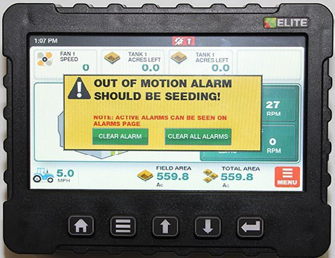
Elite Monitor
Alarms - Continued
“In Motion” Notification
The “In Motion” condition means that the monitor, based on ground speed and clutch state, considers that the system is supposed to be actively seeding.
The monitor emits a double beep whenever the “In Motion” condition becomes true or false. This condition is defined as speed greater than 2 mph (3.2 Kph) and drive clutch engaged.
1. If ground speed is less than 2 mph (3.2 Kph) for more than 30 seconds the monitor will alarm and display “Should be Seeding”.
2. If ground speed is greater than 2 mph (3.2 Kph) for more than 30 seconds and clutch is not engaged the monitor will alarm and display “Clutch Switch is Off”.
3. Certain alarms are inhibited when the “In Motion” condition is false. These are described elsewhere in this manual, but an example is whether to generate an alarm for a stopped shaft
If a speed sensor is unavailable the speed is considered to be greater than 2MPH for the purpose of this variable. This allows metering shaft monitoring to work normally, as if there were motion.

Slide 40
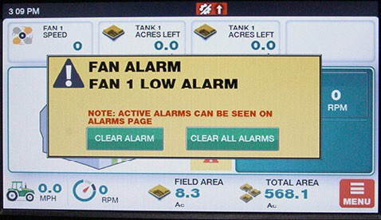
Elite Monitor
Alarms- Continued
Low Fan Alarms
Low fan alarms are handled differently because a stopped fan can result in damage to the metering mechanics as unblown material accumulates.
Low fan alarms can not be acknowledged while the system is “in motion”.
Thus, if a low fan alarm occurs during active seeding, the user will not be able to silence the alarm but will need to stop the vehicle or disengage the clutch.
When this happens, the monitor accepts it as an acknowledgement of the alarm, and an effective “automatic acknowledge” takes place, resulting in the beeper being silenced and the resumption of normal display with “Fan Low RPM” flashing in the alarm window.

Slide 41
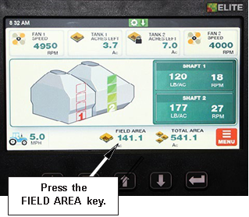
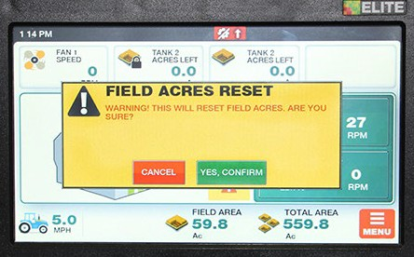
Elite Monitor
Area Display
There are two area counters, field area and total area. They are both accumulated whenever the system “In Motion” condition is true. Area counts are stored in memory when the unit is turned off.
The area counts can be displayed on the “Operating Screen” as outlined in “Navigating the Operating Screen”. The FIELD AREA and the TOTAL AREA are displayed to the nearest tenth of an acre (or hectare)
Resetting Area
To clear FIELD AREA and/or TOTAL AREA follow the steps below.
• From the “Operating Screen” press the desired function of “Field Area” or “Total Area”.
• The monitor will ask “Are you sure?”
• Press the CANCEL key to leave area count and return to the “Operating Screen”.
OR
Press the YES, CONFIRM key to clear area and return to the “Operating Screen”.
Note: Field area will not be reset to zero when total area is reset

Slide 42
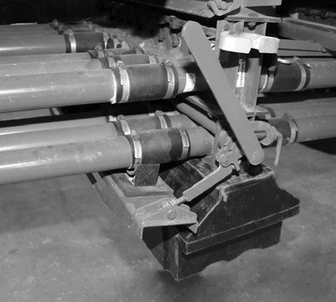
Elite Monitor
Rate Calibration
Flapper Valve Handle
The practice of doing a rate calibration is strongly recommended as it will confirm the actual amounts of product being metered.
The following procedure should be followed for every change of product.
• Ensure correct seed plates are installed.
• Fill tank 1/2 full and drive 600 - 1000 feet to compact product in the tanks.
• Select and install meter rate sprocket per Rate Chart.
• Set Flapper Valves to the “Calibration” position.
• Remove the metering chain from the transmissions that are not being checked.
• Open lower collector door at the bottom of the collector body
• Hook the Rate Calibration Insert on collector bottom and rotate up into position. Secure in place with slide lock.
• Slide rate check box on the collector body.
Collector Bottom
Rate Check Box

Slide 43
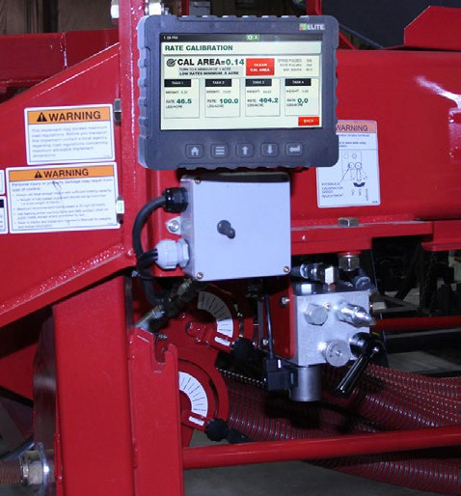

Elite Monitor
Remote Monitor Location
Rate Calibration – Continued
• Engage hydraulic lever to run air cart.
• Turn off fan by switching selector valve (located in the fan supply line) to calibration position.
• Prime metering wheels first by using the primer switch to start and stop the meter drive. Allow the drive to run until material begins to fall through the collector body.
Note: Ensure the fan is not running.
• Empty material from rate check box and reinstall it on the same collector.
• The monitor can be relocated to the remote monitor location for ease of calibration. The 10 pin plug connects to the monitor.
Primer Switch
Selector Valve

Slide 44
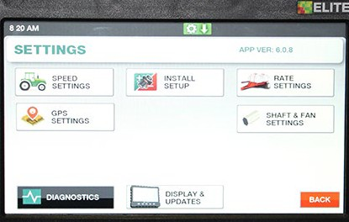
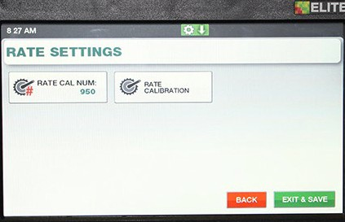
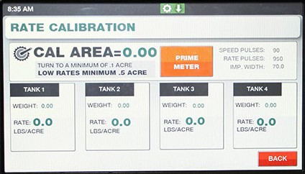

Elite Monitor
1
Rate Calibration - Continued
Actual Sample
Example: Calibrate Shaft 1.
Note: Rate Calibration always displays four tanks even if the Cart only has two or three tanks.
From the HOME screen press the MENU key to enter the SETTINGS screen.
Press RATE SETTINGS.
2 The monitor will display the RATE SETTINGS screen.
Press RATE CALIBRATION key to enter function.
Note: The “Rate Cal Num” is Factory set and can not be adjusted.
PRIME METER will be displayed, You will need to press the prime button it will turn Green, then prime metering wheels as outlined on previous page.
Note: Tapping “Prime Meter” a second time takes you directly to “Start”. Only do this if meter wheels are already primed.
Note: Remember to weigh same box before you start.
START will be displayed, You will need to press the START button, then
engage Hydraulic Calibration Motor by holding switch in “on” position to
begin CAL AREA count.
2
3
4

Slide 45


Elite Monitor
Rate Calibration - Continued
6
5 Release switch when desired Area count is reach on the monitor.
Remove the rate check box from the collector body.
Weigh the sample by using tarp straps to hook rate check box to spring scale.
Some people prefer to use a bucket ( not supplied by Morris) to help with
wind causing issues.
Note: Remember to subtract the weight of the rate check box from the total
sample weight. Accuracy of sample is critical for actual application rate
accuracy.
6. Press WEIGHT under the Tank being calibrated. Use the keypad to enter the
value of the sample weight.
7. The Monitor automatically displays application rate under RATE.
6
7

Slide 46

Elite Monitor
Rate Calibration - Continued
8. To perform a second rate check:
a) Press and hold WT/REV area to bring up warning to
RESET CAL WEIGHT, by selecting “Yes” will zero that
information.
b) Press CLEAR CAL AREA to zero CAL AREA.
c) Repeat steps 4 to 7.
9. Press BACK to return to RATE SETTINGS screen.
Under the RATE SETTINGS screen press EXIT & SAVE to save
calibration rates and exit back to SETTINGS screen.
10. Replace the bottom of the collector. Place rate check box into storage bracket.
Follow the above procedure to check the rate of the other tanks
Rate Calibration - Rate Calibration - Continued
Rate Calibration - Continued
Rate Calibration - Continued

Slide 47

Elite Monitor
Rate Calibration - Continued

Slide 48


Elite Monitor
Displayed Rates

Slide 49



Elite Monitor
Displayed Rate

Slide 50



Elite Monitor
Sensor Replacement
1
The monitor will alarm the operator if there is a faulty sensor in the system by displaying a communication error for the sensor.
To replace a faulty sensor, follow the steps below.
Example: Replace Fan 1 sensor.
From the HOME screen press the MENU key to enter the SETTINGS screen. Press INSTALL SETUP.
The monitor will display the INSTALLATION screen.
Press ADD A SENSOR key to enter function.
The monitor will display the sensor types available. For this illustration we will select FAN SENSOR.
Pressing the green arrow or red arrow will scroll through
the sensors available.
Pressing ADD SENSOR will promote the monitor to search
for new sensor. Plug new sensor into harness at this point.
2
3

Slide 51


Elite Monitor
4
Sensor Replacement
4. Once the monitor acknowledges the new sensor, the
monitor will display NEW SENSOR FOUND Press “Exit and
Save” to accept sensor.
The monitor will display FAN 1 SENSOR ADDED SUCCESSFULLY under Status confirming sensor installation. Press “HOME” to return to operating screen.
Note: Sensors can also be removed from the system in the
same manner by selecting the REMOVE A SENSOR choice
from step 2.
5

Slide 52


Elite Monitor
Sensor Gap Settings
Reed Switch Sensors
These sensors are used on slowly revolving shafts, in this case the meters and ground speed.
Check the gap between the sensor and actuator.
A gap of .030 inch (0.76 mm) is recommended.
Actuator
Reed Switch Pickup
Variable Reluctance Sensors These sensors are used on high speed shafts, in this case the fan. Target to sensor gap is critical with these sensors. A gap of .030 inch (0.76 mm) is recommended.
.030" Gap
Actuator
Reed Switch Pickup
Reed Switch Pickup
^{.030" Gap}
0.76 mm
Reluctance Sensor
Reluctance Sensor
Bolt/Nut on Plate in Fan

Slide 53
Elite Monitor
Troubleshooting Guide
Most electronic problems are usually one of the following:
• Harness connections.
• Damaged harness wires.
• Loose terminal in harness plug.
• Sensor to Actuator clearance.
• Defective sensor.
The monitor will alert the operator of these problems as a communication error.
Checking Harness
First, check for the obvious things like broken connections, loose terminals, insulation rubbed off and so forth.
• Check continuity of wires with ohm meter
Checking Sensors
The best approach to testing a sensor is to substitute a suspected sensor with a known good one. If the problem goes away, the sensor is faulty. If it does not go away, it is faulty wiring.
Bin Level Sensors ensure there is no foreign material covering the optical sensor. Remove material with a cloth as not to damage lens.
Make sure sensor wires are not damaged

Slide 54

Elite Monitor
Troubleshooting Guide - Continued
Diagnostics
The Diagnostics screen can help in identifying issues with sensors, harnessing or other items. Status reports for Battery Voltage, Sensors Learned, MUX Communication speed and GPS Communication speed are displayed. Contact Loup Electronics if you need technical support.
Checking Blockage System
Check modules by performing a blockage module test on the monitor.
Optical sensors make sure the “optical eyes” are not coated with material or worn down. Remove material with a cloth as not to damage lens.
Pin sensors make sure there is no buildup of material on the pins. Remove material buildup with a knife and gently scraping away the material buildup.
Make sure sensor wires are not damaged.

Slide 55


Elite Monitor
USB Drive
Updating Software
Download software from www.morris-industries.com. The file downloaded will be in a .ZIP format and need to be extracted. When extracted you should see a folder titled “Elite Update” and within it the Elite software file. Copy the “Elite Update” folder to the root level of the USB drive.
Update Process
Insert the USB drive on the right had side of the Elite console.
Select “MENU - DISPLAY - SYSTEM UPDATE – UPDATE SOFTWARE”
Monitor should now show a popup window displaying
the update file on the USB drive.
Press Software Update Key
Press File Key

Slide 56





Elite Monitor
Updating Software
Select the new version to begin loading the software.
When done loading the console will ask you to cycle
power. Upon doing so the monitor will start with a blank
screen and the keypad will pulse for a short period as it
finished the update. The console will then boot into the
newest version.
Confirm the monitor has been updated
by checking the version number inside the main
settings screen.
Software Version
Key Pad will Pulse

Slide 57

Elite Monitor

Slide 58


Elite Monitor

Slide 59

Elite Monitor

Slide 60


Elite Monitor

Slide 61
Loup Elite Monitor System
Morris Training 2021
Thank You for taking the time to learn about the new monitor system

Slide 62
Elite Monitor
Video

